Slide 1
Direct work handbook
Things we should do when children are received into the care system
Notes:
Introductions
Timing short coffee break half way through

Slide 2
The transition between home and foster care is a very stressful and traumatic experience for children.
We at Western Bay adoption service are striving to minimise the trauma of moves for children and have compiled this handbook to help practitioners facilitate the work that needs to be done to promote the best possible outcomes for children.
Our philosophy is to keep the child central to all of the work undertaken
The handbook pulls together our thinking along with the recommendations from The Good practice Guide for Transitions launched by Adoption UK in 2020 and By Your side Practitioners Guide written by psychologist Viv Norris.

Slide 3
There is a commitment to giving the child a clear account of what is going on in the here and now that makes sense to the child, to find ways to talk about difficult topics and to help the child process their emotional responses.
The direct work with the child should be undertaken by the person who has the most significant relationship with them.
Foster carers/primary carer should be involved in all of the work with the child as their trusted adult and protector and the person who will be supporting them emotionally throughout the process whilst they are getting to know their new family.
Relationships should be seen as the Golden Thread in children’s Lives
Notes:
Whilst we at Western bay focus on minimising the trauma of moves there is a significant amount of work that can be done with child on reception into care.
Often we find this work is not undertaken until a further move is contemplated .
Lets take some time to think about how it may feel to be taken into Care
Going to Japan ex. Read the script send groups to break out rooms to discuss for 15 mins and thencome back to the larger group and feedback for 15/20 mins

Slide 4
Reception into Care
Help the child understand why they need to be in foster care, what the concerns are and who will help.
Incorporates a number of sessions with the child to include:
Introductions, setting the scene and boundaries
What children need / who takes care of them / who makes decisions about what is best for them
Different types of families, birth families foster families adoptive families
Foster carers must be prepared that the child may become more unsettled and agitated during the direct work as they are given time and space to think of next steps.
Notes:
Today we are focusing purely on the direct work we should undertake from the point of reception into care. The activities will help children to identify and express their feelings, promote their identity and empower them in the process of being a looked after child.
They will have a sense of things being done to them that they have no control over and we want to help redress that balance.
The doing of things together and travelling by their side through their process is extremely important and having a trusted adult travelling the journey is crucial . The foster carer should be that person as the child’s primary carer and main attachment figure . The person who needs to understand their process and the help them to live with difficult feelings and survive.

Slide 5
The Foster carer should be part of this work and able to provide reassurance within the sessions and in-between sessions.
The social worker should communicate with the foster carer prior to the sessions to explain what will be covered.
A variety of activities and approaches can be used to communicate with the child that are built on an understanding of child development, attachment theory, developmental trauma and play.
Age appropriate activity based work helps children feel more comfortable expressing feelings and builds up trust; the games , stories, songs, rituals that are used during these early sessions can be used during introductions and transitions with the adopters to give the children the sense of continuity and coherence and help them co-regulate with safe adults.
“in order for the adults involved to create coherent support for the child, it is essential to have a shared language and understanding as well as opportunities to meet, reflect and share information “
Notes:
We can be mistaken in thinking there is nothing we can do to help young children to understand their story and as such we often skip the work. But there are many ways of communicating with children play being their primary mode of communication. It is our task to try and engage with the child in a way that makes sense to them and for very young children that may be through their senses as we hold memories sensorily in our bodies . Thus stories rhymes songs and rhythmical movement can be incorporated into the play.

Slide 6
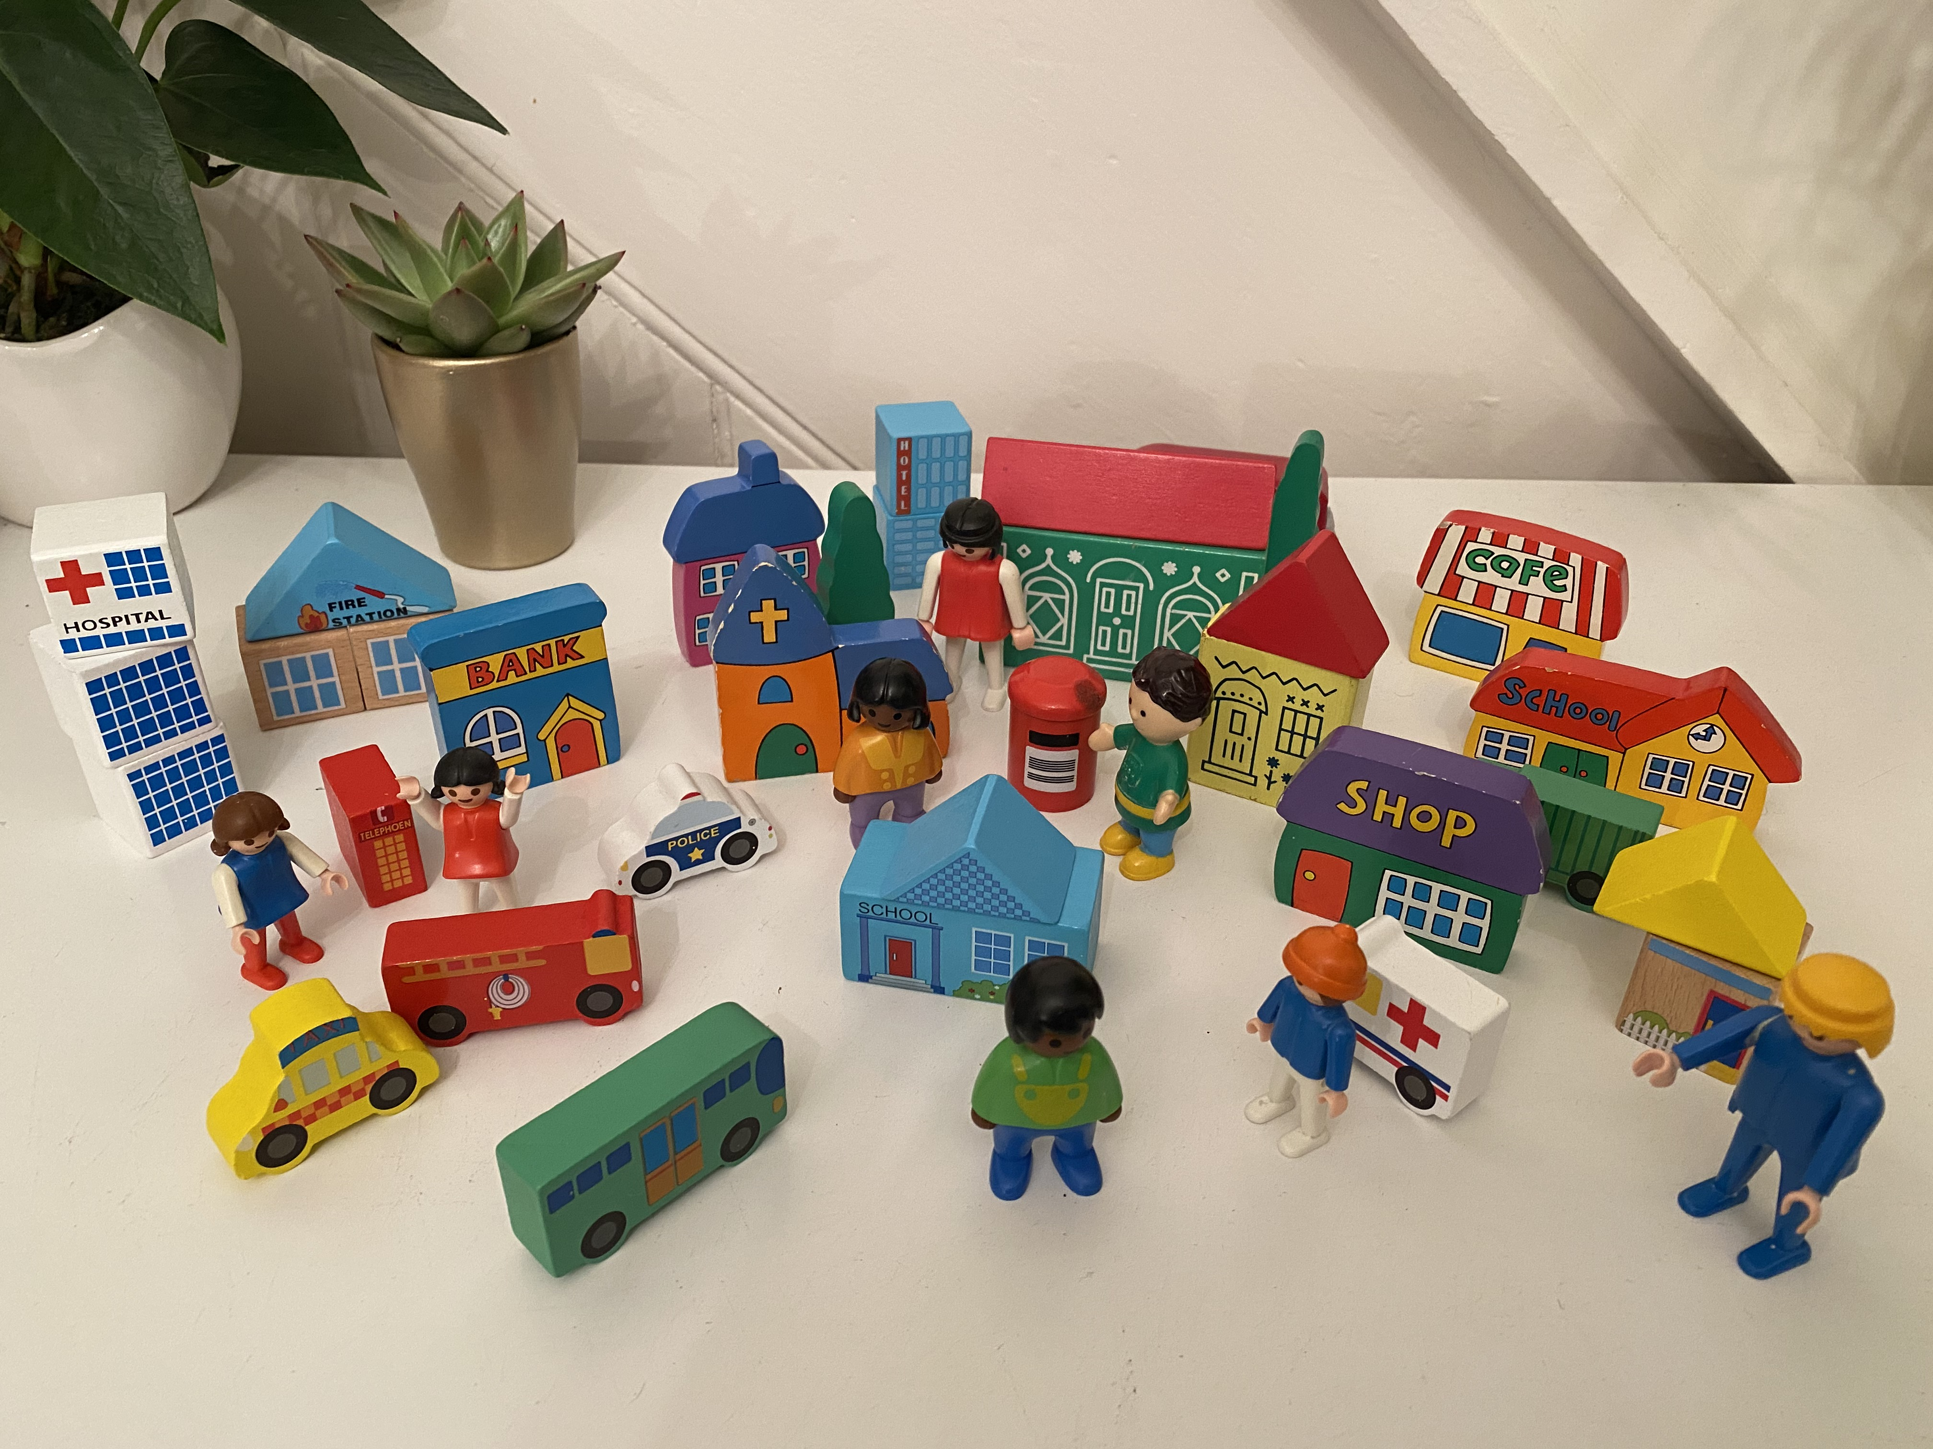
Stage 1: Direct work activities
Narrative story / Parallel Story
Memory Box
All about me memory book
Feelings
The wall of needs
Families
Relationship Based play
Notes:
These are the activities we should be undertaking from reception into care. Some of which you may be familiar with others maybe not .

Slide 7
Parallel stories & Narrative stories
A parallel story is a story written to reflect the story of the child/ren.
The story is written about characters and NOT about the child/ren.
It is written in simple language and illustrated to reflect the story.
A parallel story is used to help children become familiar with their own story in a very safe way…One step removed.
This is a very simple version of the child’s situation.
Who is worried.
Why they are worried.
What is being done about it.
It serves to keep the child informed.

Slide 8
Step by step guide to writing a parallel story
Introduce the characters
Set the scene
Describe where they live i.e. busy town, countryside, near the beach, home environment, things they like to do. Things they enjoy together. Remember to stay in character and stick with metaphors and symbols throughout the story e.g. fish live in rock pools or the sea rather than houses. But they may be small rock pools with lots of fish in which are very busy.
The characters should reflect the make up of the birth family e.g. number of children, gender and parentage. i.e. 1 parent /2 parents/siblings.
The characters should be something that the child likes and eagerly relates to eg dinosaurs /fish /unicorns . Choose something that can easily be illustrated using Clip art or Paint.

Slide 9
INTRODUCE AND DESCRIBE THE PROBLEM
What does this involve? Arguing, not enough food, people getting hurt, not having toys etc.
Highlight that the parents are not doing a good job of caring and how this affects the children. E.g. the fish feel scared and hungry and look skinny and their scales have stopped twinkling.
INTRODUCE CHARACTERS WHO HELP
One character needs to represent the social worker i.e. the character whose job it is to keep children safe and the other representing the judge i.e. the character who has to make decisions about what needs to happen to keep the children safe. (Not to be referred to as the social worker or the judge remember to stay in character) State what they decide to do i.e. find the right family where the children can be safe and well cared for.

Slide 10
DESCRIBE THE CHARACTERS IN THE NEW FAMILY AND THE PROCESS OF READJUSTMENT
Reflect the foster family set up/ home and how they help the children to settle and meet their needs. Food, home, school, friends, kindness, fun etc.
Make the characters and their qualities come alive e.g. if the foster carer is bubbly and loud and has lots of energy that should be reflected , if the home is busy with lots of other children coming and going that should also be reflected. Highlight the things they do to help the child eg feed them healthy food help them to make friends visit the park start school remaining in character throughout.
NORMALISE EMOTIONS AND SET BACKS AND GIVE HOPE FOR THE FUTURE
Highlight how they may have felt adjusting and learning to trust. Show how their enthusiasm for life returns when they are getting their needs met and they feel safe and loved and able to trust.
Offer reassurance that they are brave and strong and have people around them who will be able to help them with any other changes they may need to face in their lives.

Slide 11
SHOW SOME RESISTANCE LACK OF TRUST FEAR ANXIETY
Use the child/ren’s characters you have developed to express the feelings that may be evoked for children who are removed from birth families. Anger, sadness, fear of the unknown, lack of trust in adults, sadness, anxiety.
DESCRIBE THE PROCESS OF MOVING
Who helps support them to be brave enough to make the move, how do they do this …taking them on the journey. Making sure they are safe and their feelings are attended to.
Example of Billy and Bonnie Move home was created by Suzanne Twigg Social worker Neath Port Talbot with support from Julie Howes Western bay adoption service

Slide 12
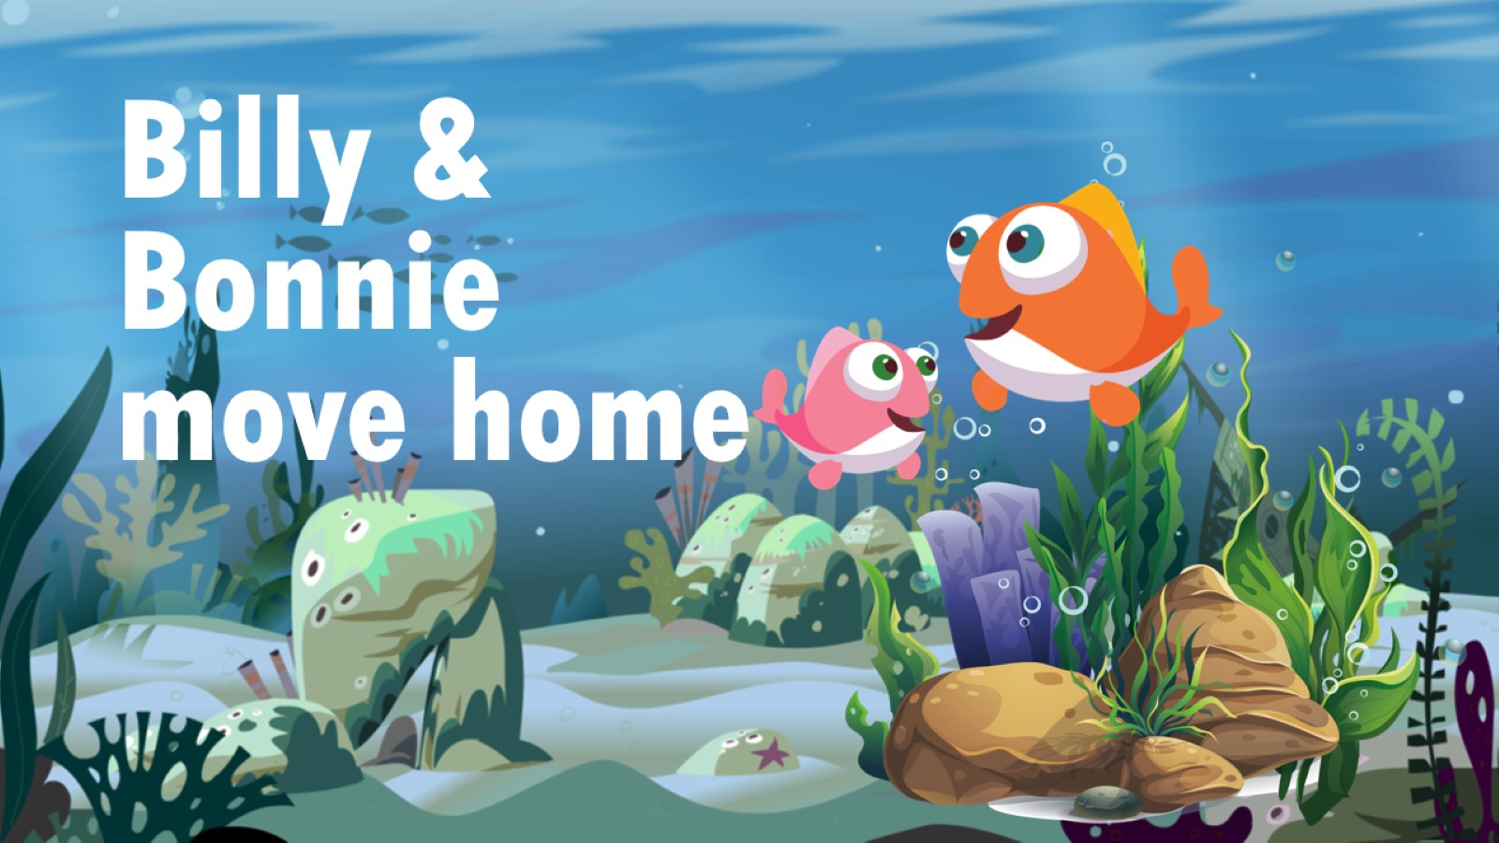

Slide 13
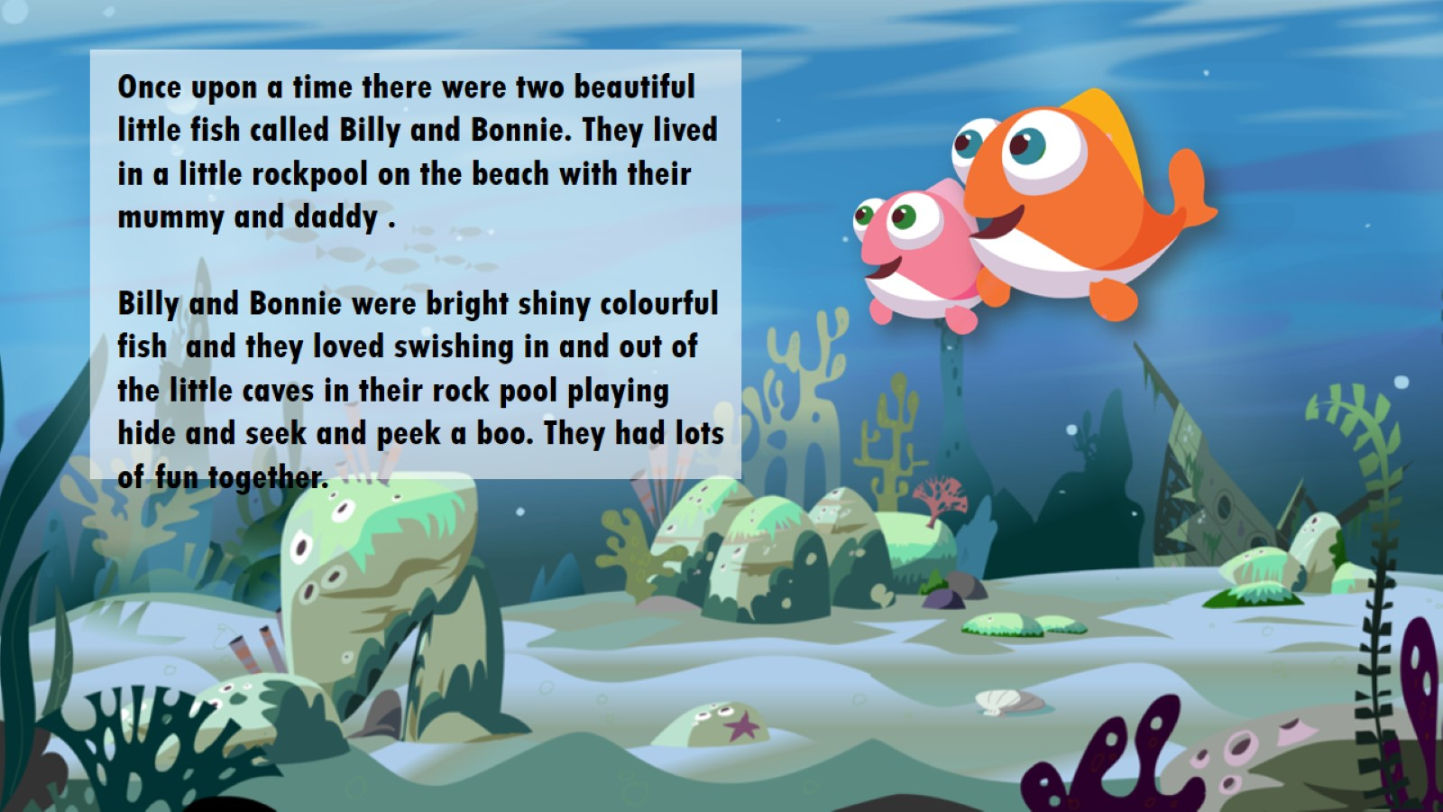

Slide 14
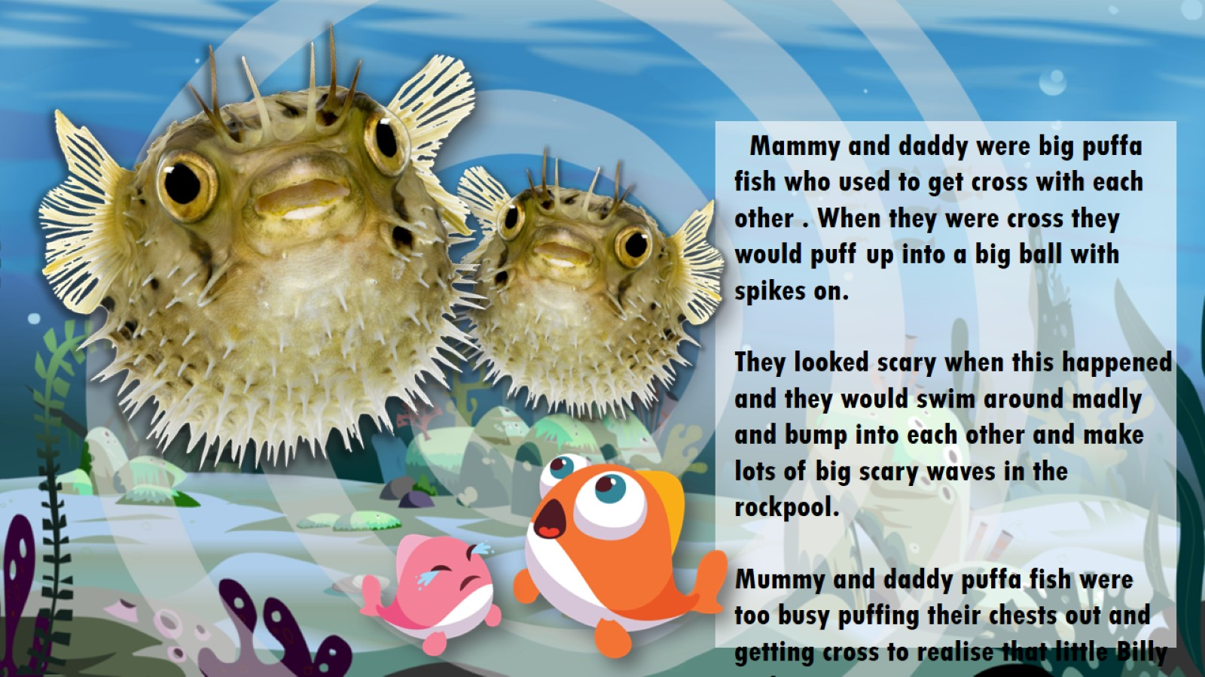

Slide 15
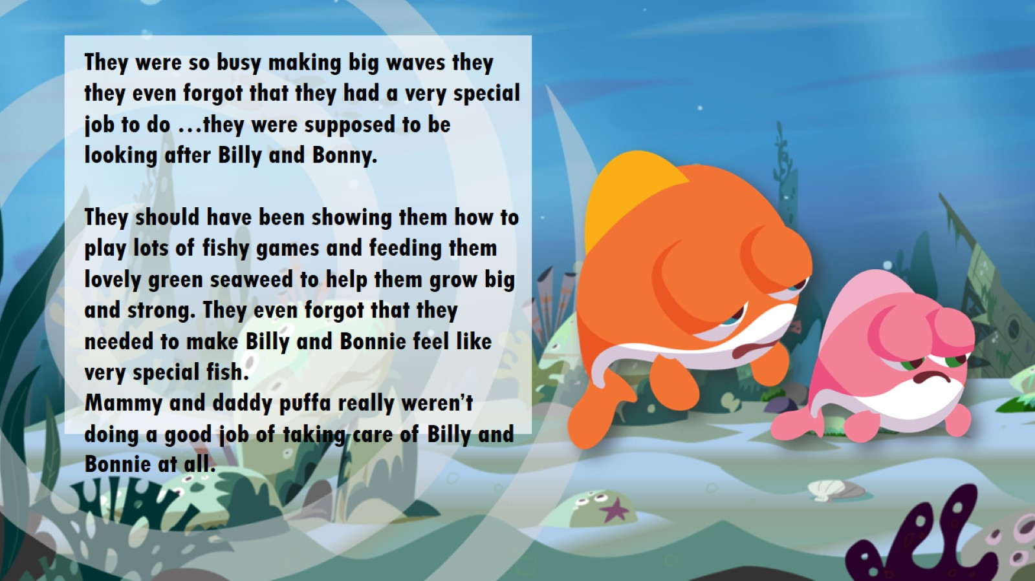

Slide 16
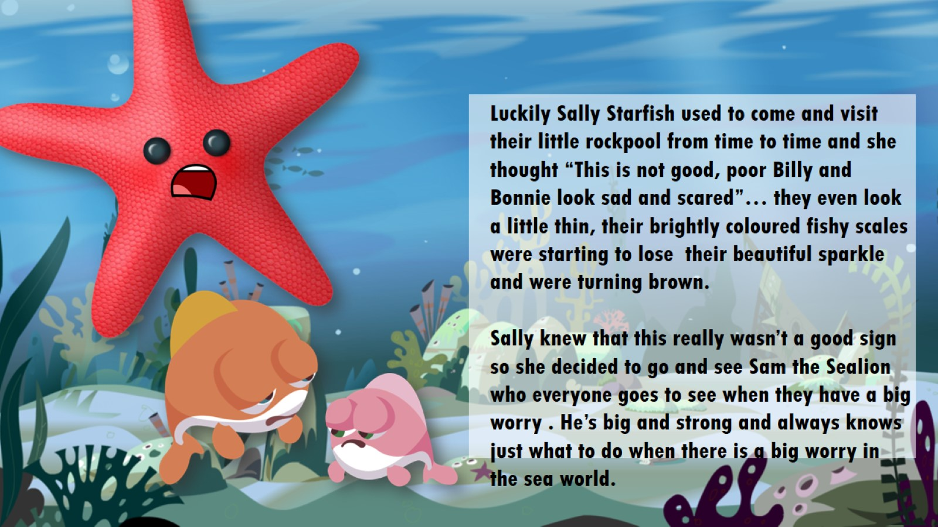

Slide 17
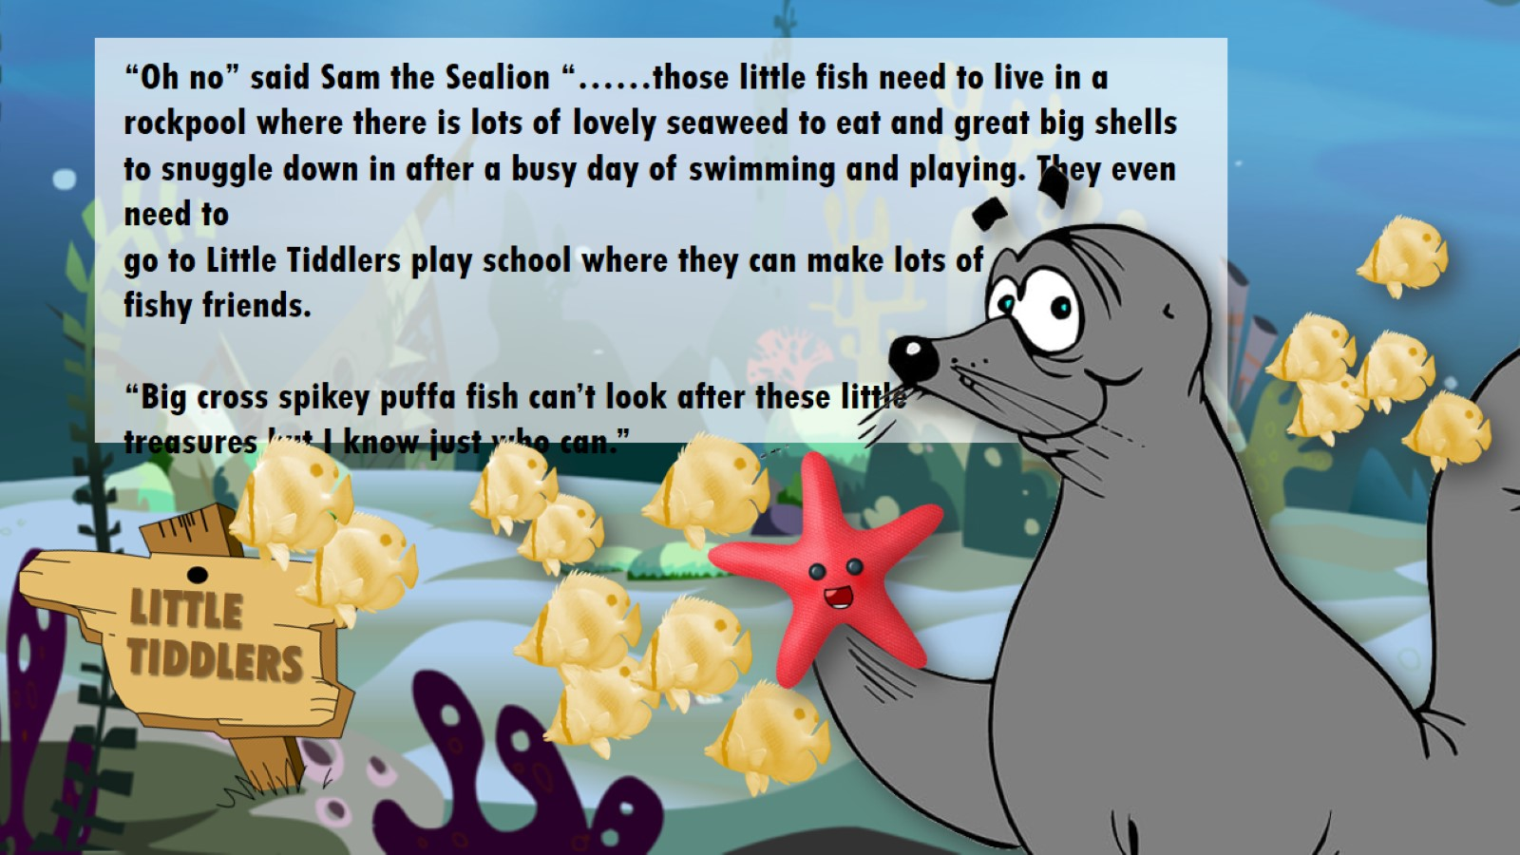

Slide 18
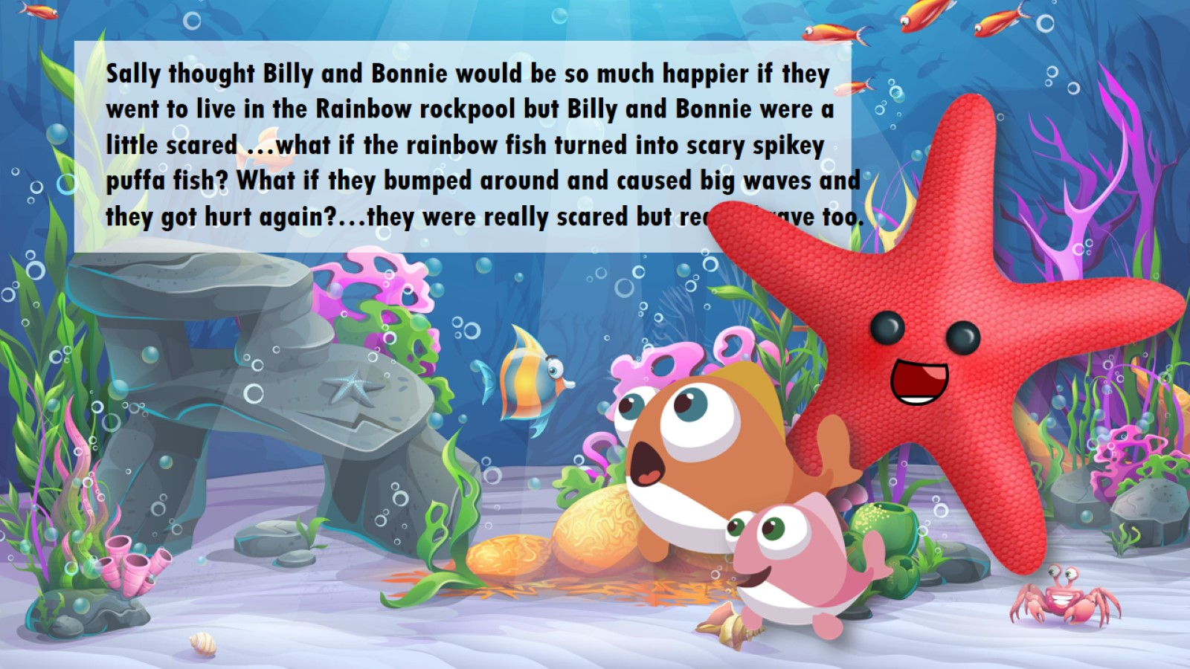

Slide 19
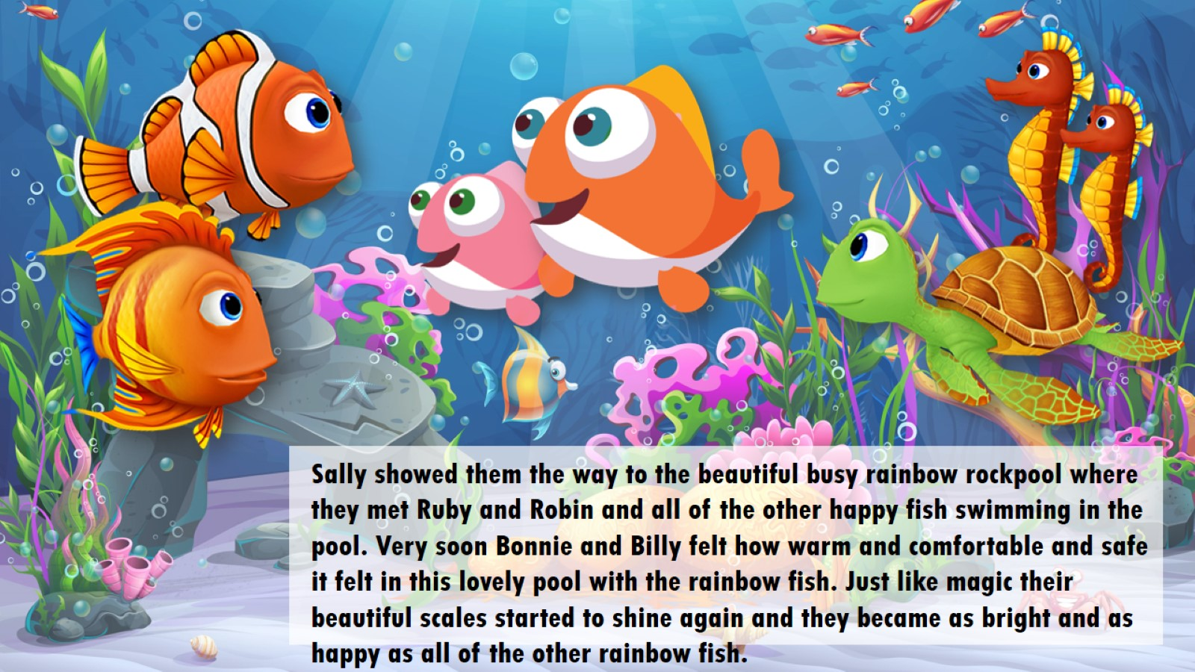

Slide 20
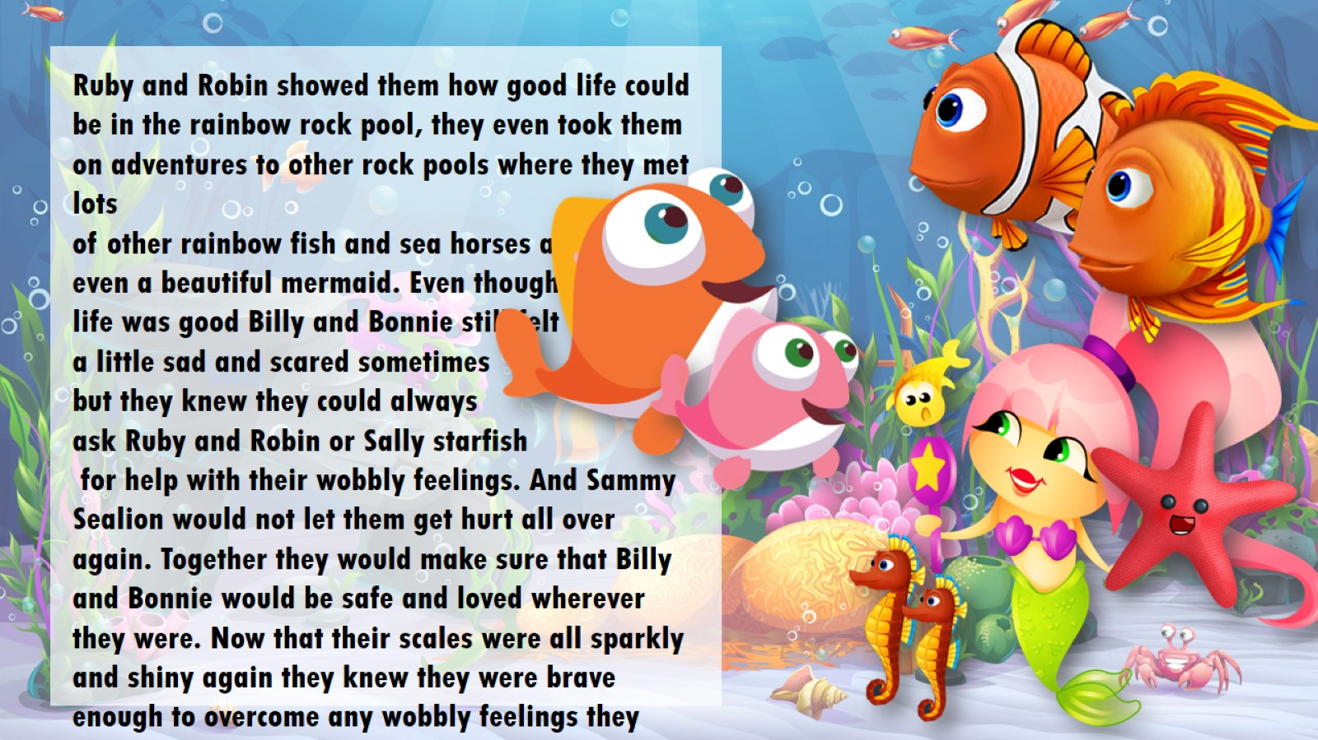

Slide 21
Example of a narrative story
This should also be illustrated for the child
Lucy and Todd’s story
When Lucy was small she lived with her mammy and daddy and baby brother Todd.
They weren’t always safe at home because mammy and daddy argued a lot. They would shout at each other and sometimes hurt one another.
When this happens it can be very scary for little children.
Sometimes when they argued the police were called to come to make sure Lucy and Todd were safe.
The Police were worried they thought that Lucy and Todd were frightened and sad so they asked a Social Worker called Claire to come and visit them.
It’s Claire’s job to help families keep children safe and make sure they have every thing they need.
Children need lots of love, a clean and warm home to live in, clean clothes, nice food, lots of fun and to be kept safe.
Claire was worried that Lucy and Todd were not safe so she took them to live with Gareth and Rosie who are foster carers.

Slide 22
Gareth and Rosie take good care of Lucy and Todd.
Claire tried to help mammy and daddy to stop arguing and fighting and to learn how to look after Lucy and Todd properly.
Mammy and daddy were cross with Claire and they said they didn’t want her to help them.
Lucy and Todd visit mammy and daddy each week. Sometimes they bring a picnic and they play games together but sometimes they tell Lucy and Todd things that made them feel scared or confused.
Claire went to see the judge to get some help to decide what would be best for Lucy and Todd.
The judge said that Lucy and Todd must stay with Gareth and Rosie whilst Claire and all of the other people who know and care about them figure out what to do next.
A Judge is a person who works in a Court and makes very important decisions.
After the Judge had listened to what everyone had to say she decided that they need to be looked after by foster carers who can give them all of the things that children need.

Slide 23
Foster carers look after children whilst the social workers try to help their parents to be able to look after them properly.
Foster carers do all the things that children need. They provide a warm home, a bed to sleep in, clean clothes, toys to.
play with. They take children to school so that they can learn, take them to the doctors when they are poorly and encourage them to make friends.
Claire will visit Lucy and Todd at Gareth and Rosie’s. She will read them stories and help them with their feelings whilst she tries to work out where the best place is for them to be.
Claire and other people carried on trying to help Mammy and daddy but they didn’t stop arguing and fighting.
The social workers and the police and the doctors all went back to talk to the Judge who made the decision that Lucy and Todd couldn’t go back to live with their mammy and daddy because it is not safe for them.
They need a family who will keep them safe, and loved and give them all the things that children need to be happy and healthy.
Lucy and Todd may have lots of questions they want to ask.
All of their questions are very important and they can ask Gareth and Rosie or Claire their Social worker anything at all and they will try their best to help.

Slide 24
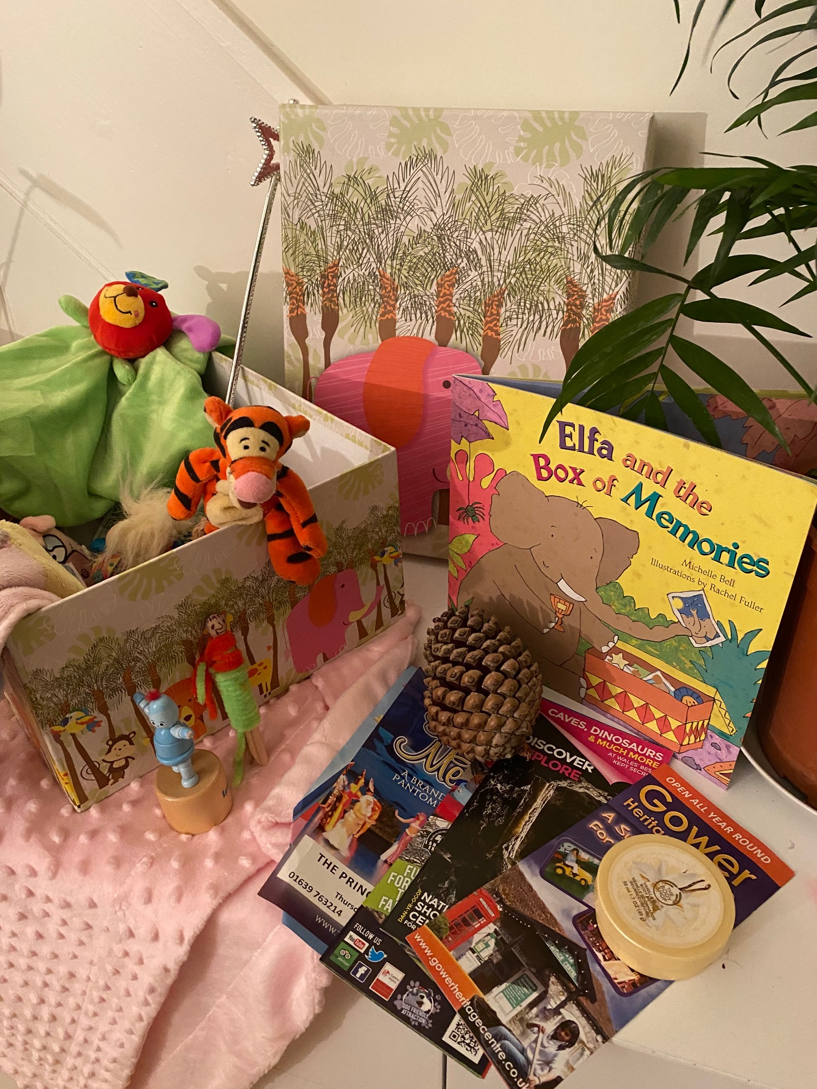
Memory boxes
0-4 years old
Hospital identity tag Health Record Book
Scan photo Milk Teeth
Sample of hair First set of clothing
Baby photo Umbilical peg
Nursery / playgroup art work / cards
Newspaper issued on day of child’s birth
Hand and foot prints of the baby Favourite toy
Favourite bedtime story Christening / birthday cards
Jewellery First holiday photos
Family photos Dummy
Height chart
Notes:
Read Elfa and the box of memories

Slide 25
Remember to label and date items so that the child understands the significance of them
5-10 year olds
Photos of festivities – birthdays / Christmas etc.
Art and crafts made by the child
Favourite books /DVDs
Collected items e.g. pebbles
Football jerseys
Pictures of pets, pet collar etc.
Toys
Leaflets of places visited
Favourite sweet wrappers
School tie / badge
Drawings
Picture of favourite teacher / school attended /class photos
School reports
Photos from holidays / days out
Samples of mum / dad’s favourite perfume
Items of favourite clothing
Certificates / medals / awards
Photos of siblings
Photos of friends
Anything from the 0-4 list

Slide 26
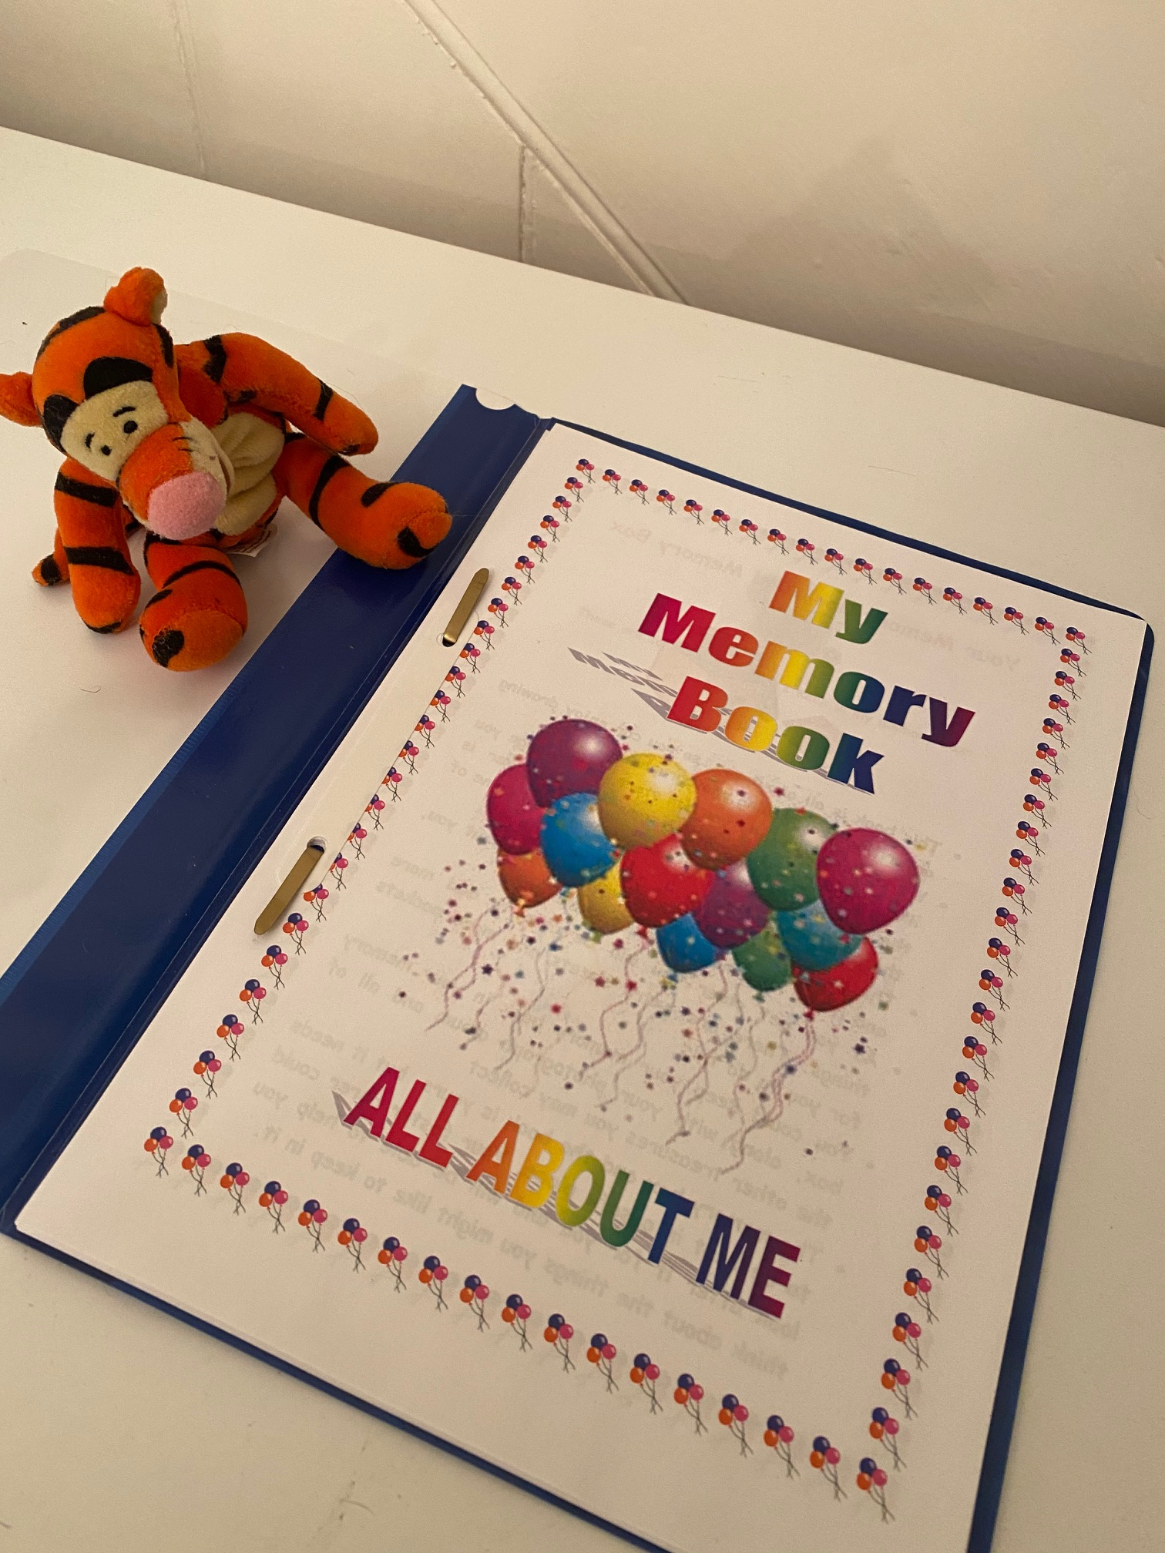
THE ALL ABOUT ME MEMORY BOOK
This can be filled in with the child wherever possible and for the child if they are too young or unable to participate . Together carers and children can record lots of interesting and important facts about themselves. The books are a great record of their early life history which may be lost in transition. It also provides a great starting point for the child to share with their new family when they first meet

Slide 27
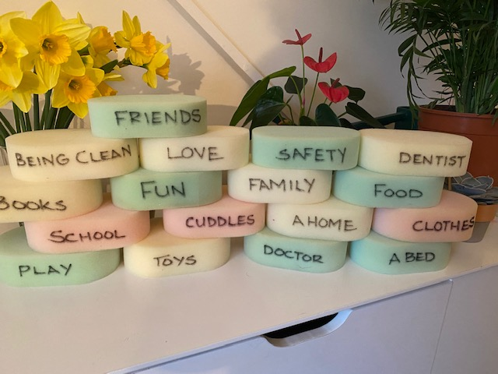
Give the child an understanding of the basic needs of children and how they may be met.
Use blocks or sponges with the needs of children written on the side of them so that they may be used to build a strong wall . It can be used to demonstrate how when certain pieces are missing the wall it can become weak and even collapse.
For younger children making a cut and stick picture to show what they need may be used.
Identifying children’s needs

Slide 28
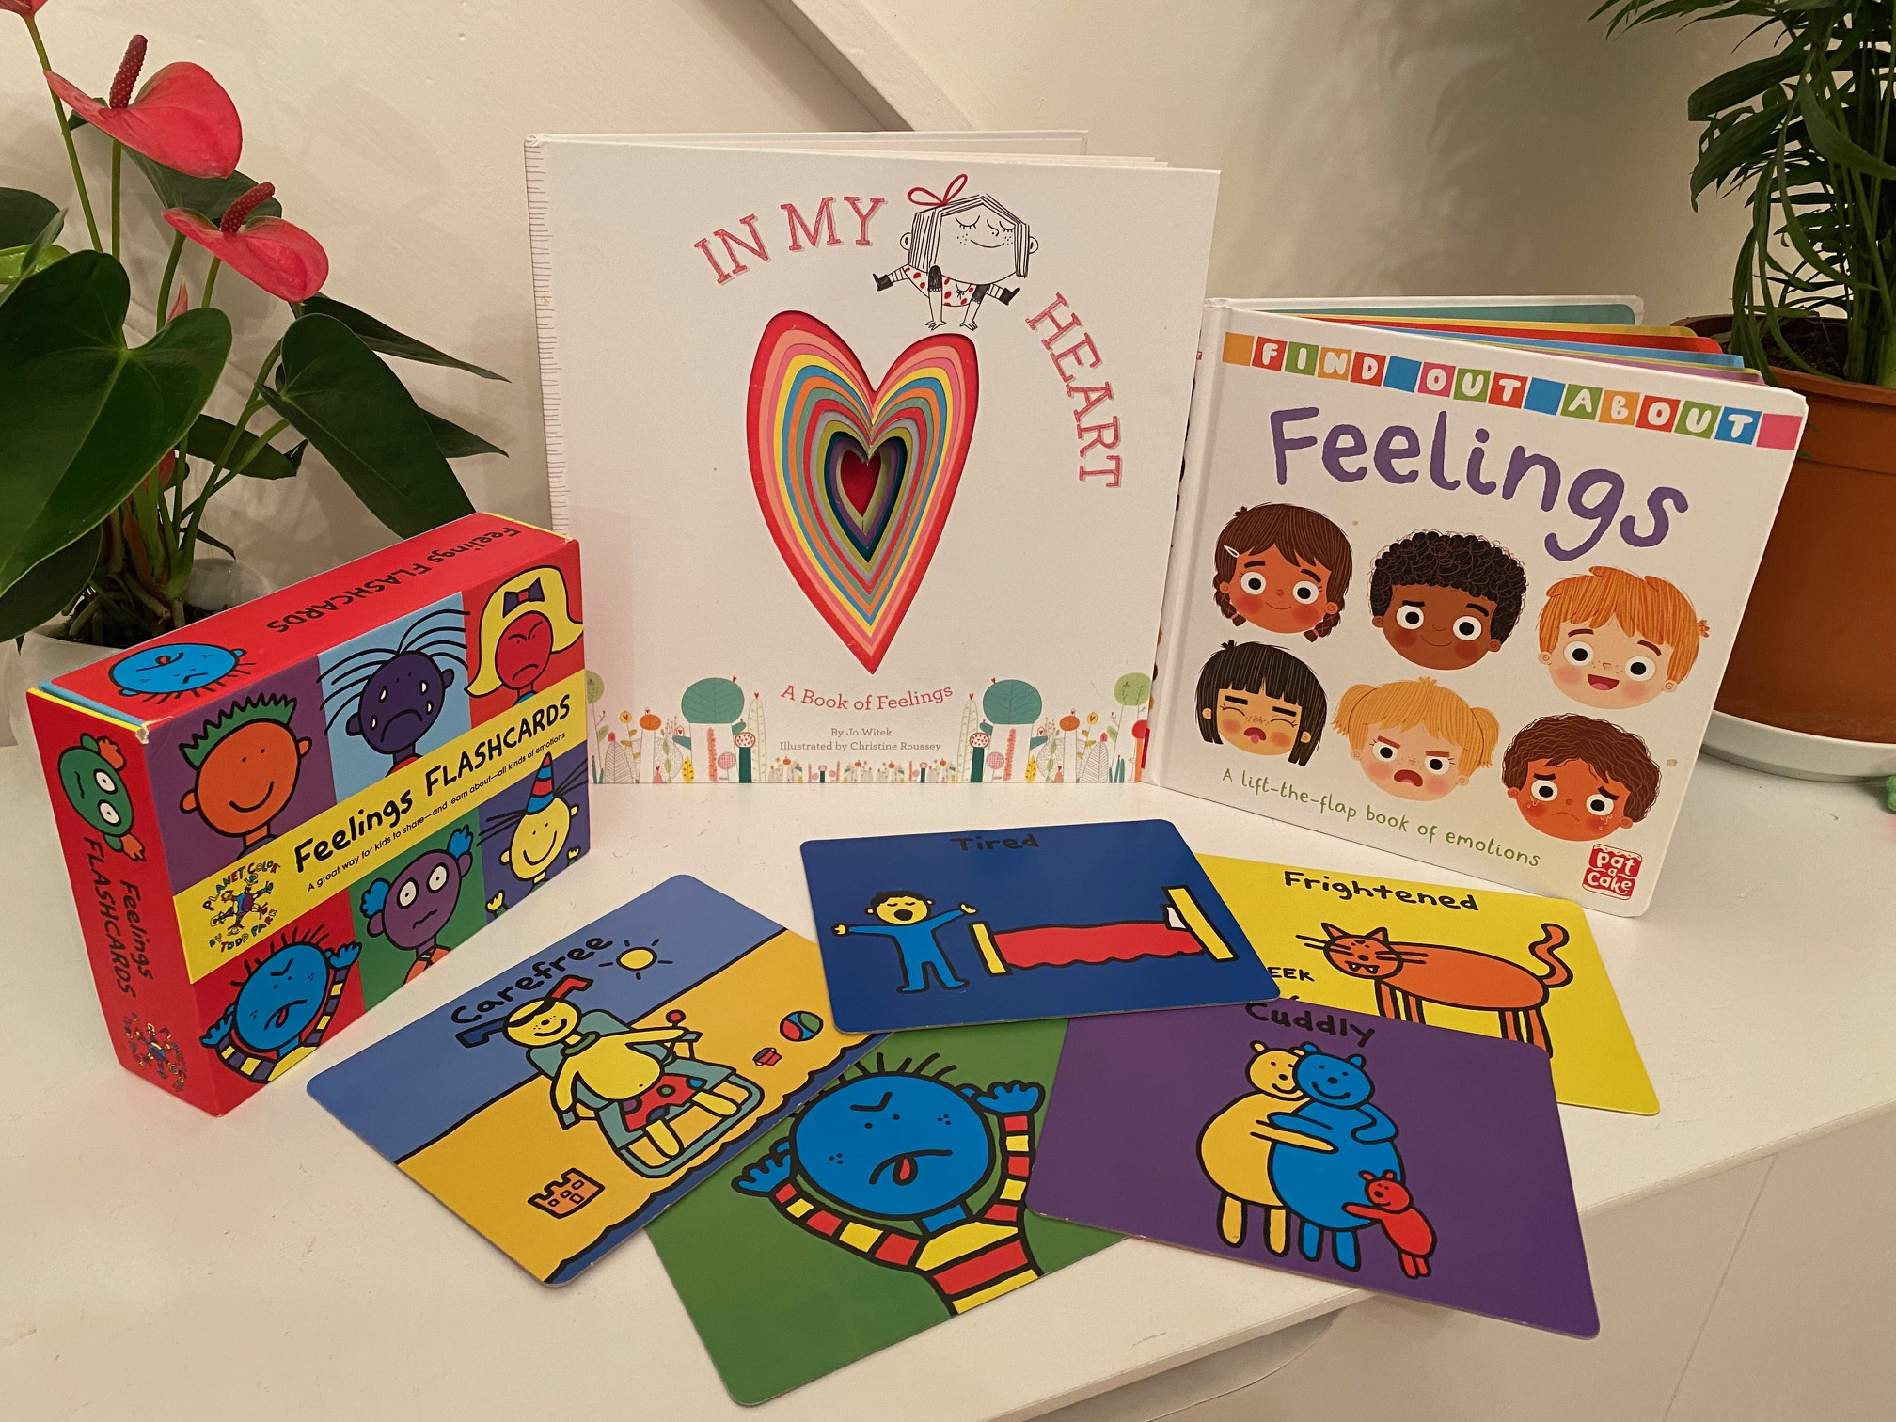
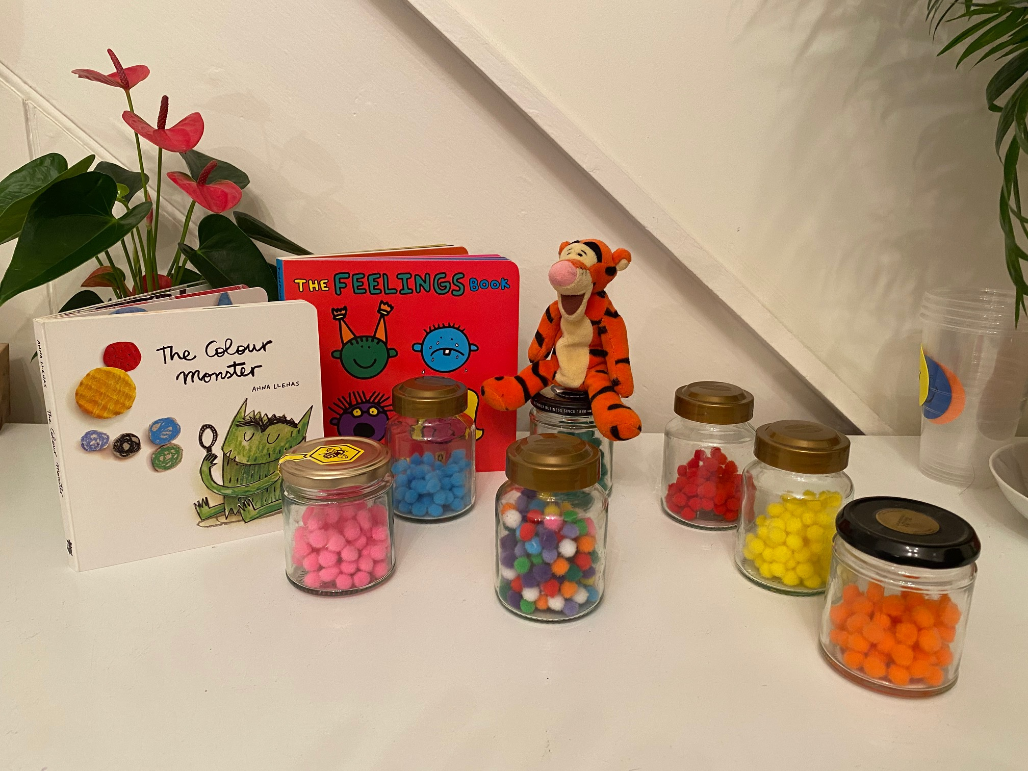
Feelings
There are a whole host of ways to help children identify and understand their feelings

Slide 29
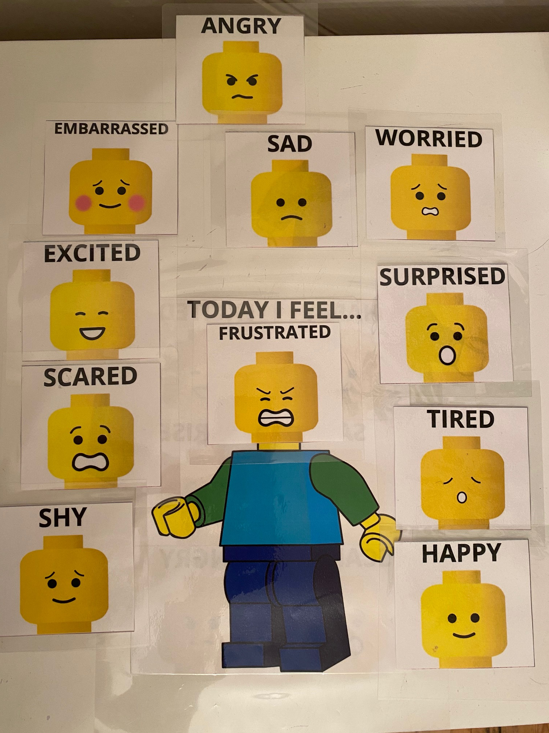
Feelings using charts give opportunity to show what they may be feeling when they cant find the words

Slide 30
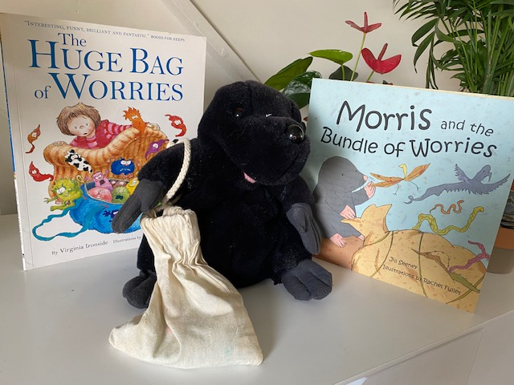
Worries
Records of all the work undertaken with the child should be kept safely to share.
This could give them a really good understanding of how the child has managed the transition process.
It should help to highlight their hopes and fears about the future.
Notes:
Read the colour monster

Slide 31
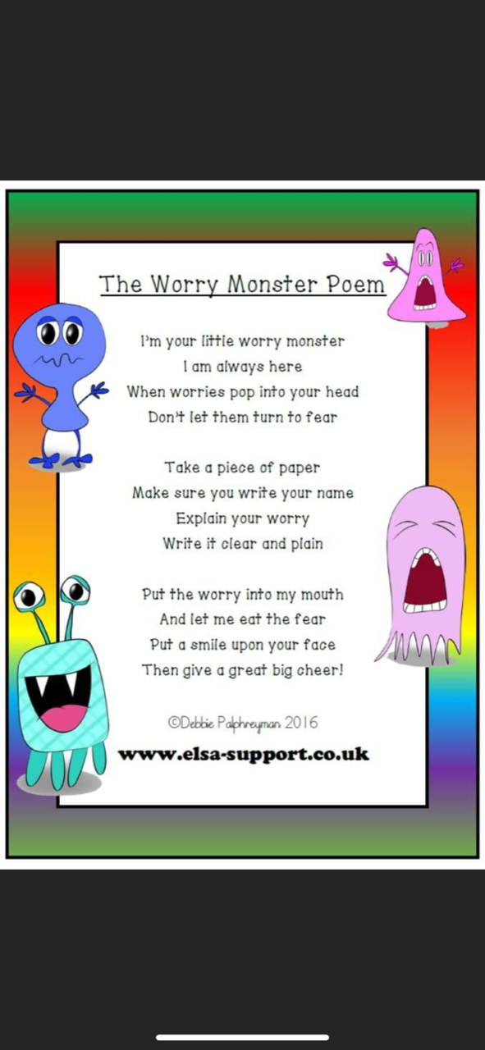
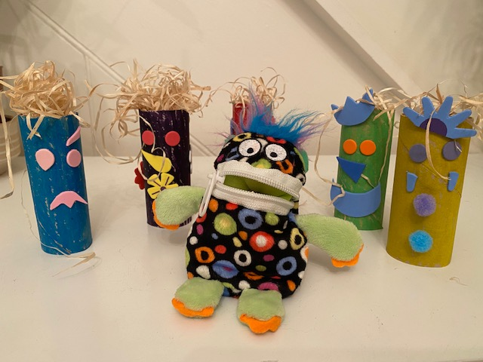
WORRY MONSTERS

Slide 32
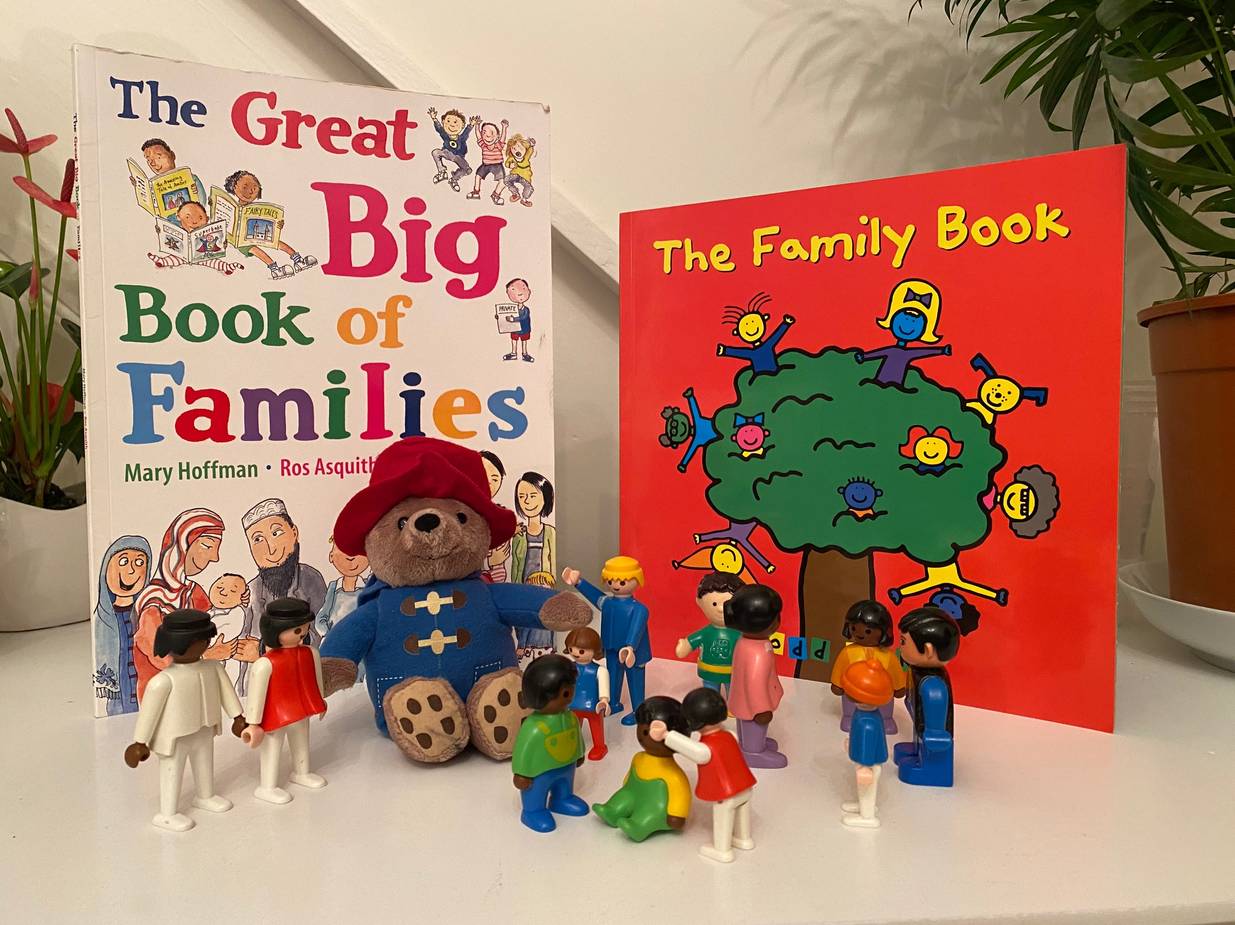
Families
These books will help the children to see there are many different kinds of families

Slide 33
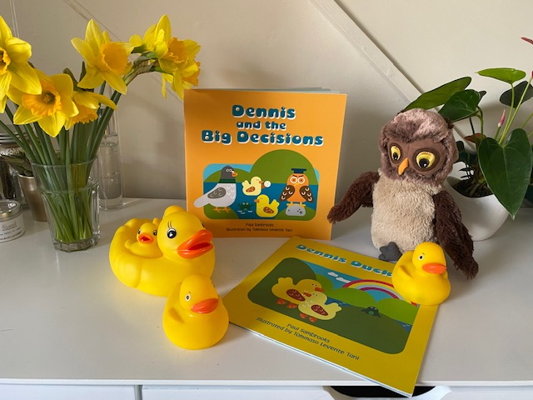
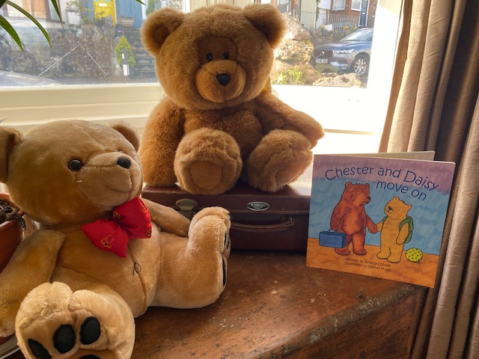
Factual Stories with themes of moving
Bring the stories alive by playing them out with the child

Slide 34
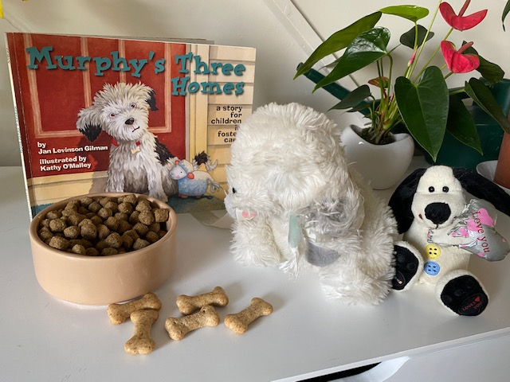
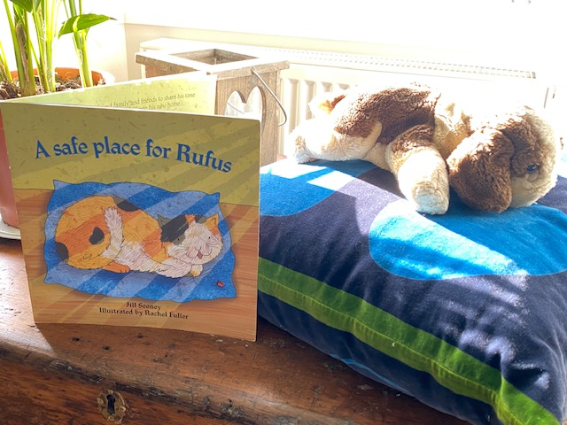
Fictional stories about moving on
Their play can give good clues of what they may be thinking and feeling

Slide 35
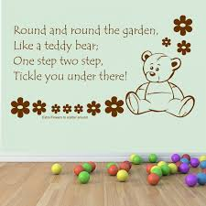
Relationship Based Play Activities
These activities are based on Theraplay principles and serve to encourage consistency and connection between child and carers / adopters. There are many activities in RBP, all of them very simple. Some of them seem a bit strange at first, some of them are probably things many parents or carers already do with their children.
The activities encourage deeper connections through play that involves physical and emotional presence, touch rhythm reciprocity and co-regulation.
Touch, physical and emotional connection are critical factors in the development of attachments especially when transferring from one pair of safe hands to another. It will help the child to view / experience the adopters as safe people. The child needs to be able to see and feel that the foster carer has a trusting relationship with the adopters

Slide 36
Example of Relationship Base Play plan for Foster Carers:
Example of Relationship Base Play plan for adopters:
Games for virtual introductions:
Hello song
Check in (you do must of the talking)
Mirror
Hand claps
Fish and chip
Snack and drink
Good bye song
Games for virtual introductions:
Hello song
Check in (you do must of the talking)
Mirror
Hand claps
Fish and chip
Snack and drink
Read ‘the invisible string’
Good bye song

Slide 37
Come up with a nice way of greeting him/her… a way which you will use every time you see him/her… e.g, ‘there you are or there s/he is… and say something like we’ve been thinking of you…
Hello Song
Hello “ childs name”
Hello “ childs name”
Hello“ childs name”
We’re glad you’ve come to play
Check in (you do most of the talking)
Now let’s see what you have brought with you today? Oh gosh look I’m glad you brought your big (colour of eyes, we’re going to use those today to have fun…
Oh and let’s see your hands, fantastic, how many fingers have you brought with you today? Let’s count them together. Wow can you wiggle your fingers…
What about those arms they look really strong. Can you show me your strong arms? Then you show her yours (so she knows that you can keep her safe and sometimes she does not need to be strong because you can be strong for her).
I wonder how many toes you’ve brought with you today? Foster carer to take Ellie’s shoes and socks off and you all count her toes, can you wiggle your toes?
For the first couple of times after she shows you her eyes etc you show her yours and talk about the colour etc and also hair colour etc
Count your fingers and toes and say something like; oh gosh look at that we’re the same (creating similarities between yourself will support the connection)

Slide 38
Mirror
Get her to see if s/he can copy a funny face you make, do about three funny faces and see if she can copy them
Then see if s/he can copy your movements eg; touching you nose, flap your arms like wings, stretching your arms out wide and then give yourself a big hug (loving way to regulate ones self)
*at any time if she wants you to copy him/ her, you need to say ‘oh you want us to copy you ok, first you copy me two/three/one more time/s and then we’ll copy you… this will support her knowing that she can’t take control of the play and in a subtle way that you are in control…
Hand claps
I wonder if you could copy this, simple tune using hand clap
Repeat about 4 or 5 different tunes

Slide 39
Fish and chips
You say Fish (in a different voice, or whisper, or load etc) and they say Chips back using the same voice or volume.
You don’t need to use Fish and Chips you could use things like ice cream and jelly or beans and toast etc
It’s likely a child will say the same word as you and that’s fine just go with what s/he brings…
Snack and drink
Have you got your snack and drink ready?
She has this while you read ‘the invisible string’
While s/he’s snuggled up with her carer sing the good bye song:
Bye bye “ childs name”
Bye bye “ childs name”
Bye bye “ childs name”
I’m glad you came to play

