Slide 1
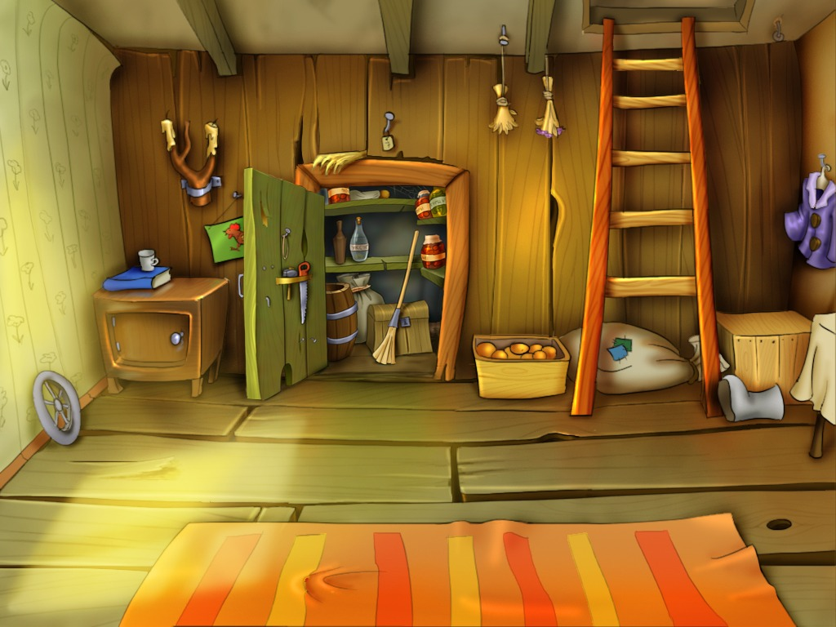

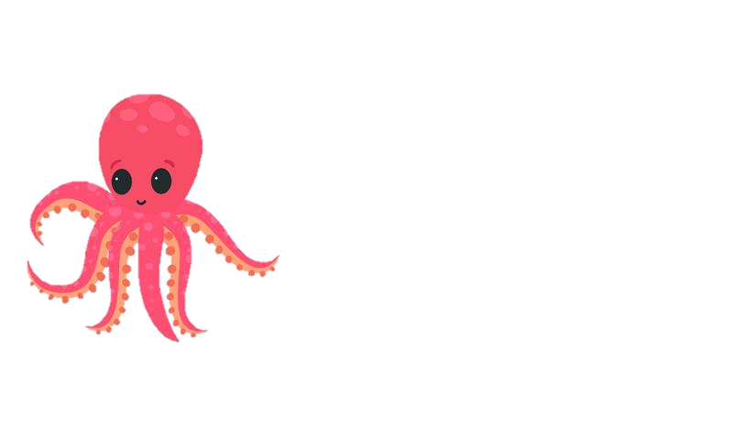
Olive needs a home!
Howie needs
a new home.

Slide 2
This is Olive.
She is 2 years old.
Olive is a lovely, kind little Octopus, who tries very hard to make everyone around her happy!
Howie needs
a new home.

Slide 3
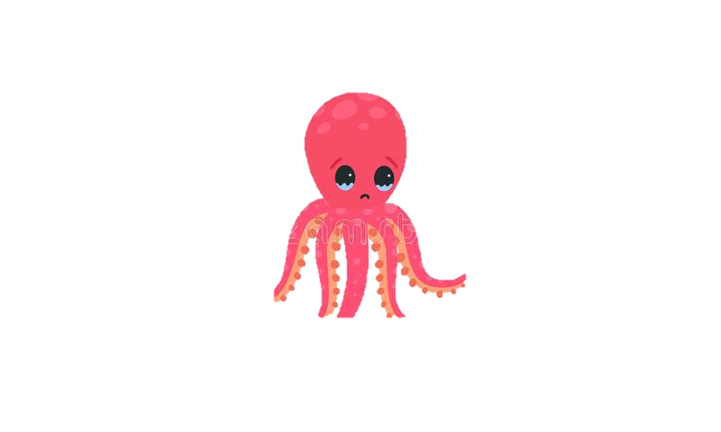
Unfortunately Olive’s family could not keep her safe.
Olive thought it was her fault!
But it was not her fault at all!
Howie needs
a new home.

Slide 4
They could not give Olive all the things she needed to grow into a big strong Octopus.
Howie needs
a new home.

Slide 5

What do you think children need to be safe and grow big and strong?

Slide 6

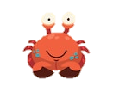
This is Cody, He is 5 years old.
He is very a Sweet, kind Crab who loves living in the sea and playing on the beach.

Slide 7


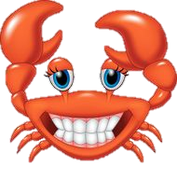
Cody is very lucky, his family knew how to give him everything he needed to be safe and grow to be a big strong Crab!

Slide 8

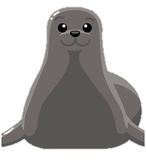
This is Sally!
She is a special person called a Social Worker.
A Social Worker is someone who works with children and families to keep children safe.
Some children don’t have mummy’s and daddy’s who can look after them, so they need other families to live with who are able to look after them. These families can help them to feel safe, happy and loved. If this happens it is Sally’s job to find the perfect family for them.

Slide 9

Back at Olives house, Sally the Social Worker had come to visit and was getting very worried about Olive not being safe at home.
Howie needs
a new home.

Slide 10
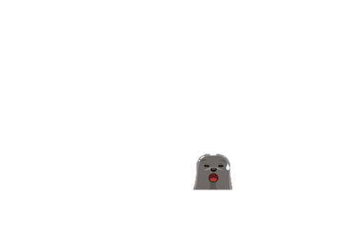
Sally was so worried, she thought Olive wasn’t save with her mum and dad anymore and Sally needed to take her to somewhere safe!
Howie needs
a new home.

Slide 11
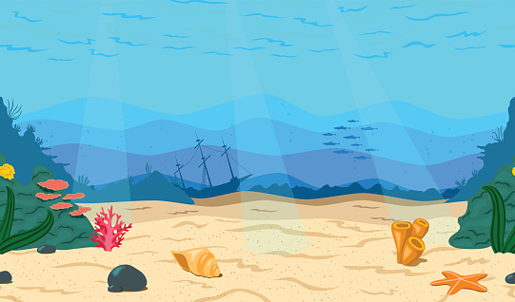
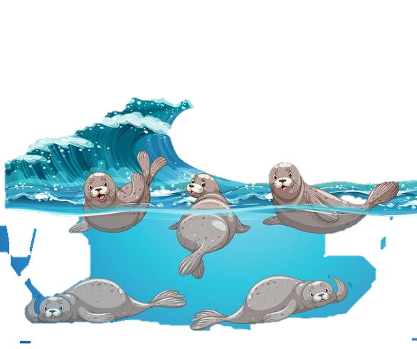
Sally and the other social worker Seals got together and made a difficult decision. They agreed Sally needed to find Olive a new home with a special family who could keep her safe and help her grow into a happy Octopus!
Howie needs
a new home.

Slide 12


Meanwhile at Cody’s house…
Cody was watching T.V with his mummy….
Howie needs
a new home.

Slide 13


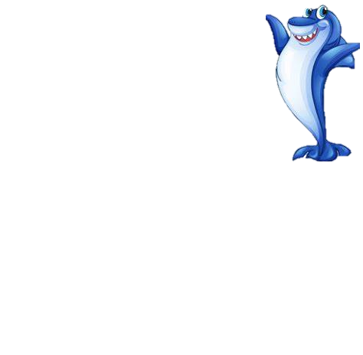

On T.V there was a Mummy shark who had a baby growing in her tummy.

Slide 14
Cody’s mummy explained that Cody had grown in her tummy too.
Howie needs
a new home.

Slide 15



Cody thought about this for a little while and realised he had love in his heart to share too.

Slide 16
Mummy told Cody that both Daddy and Mummy had a lot of love in their hearts and maybe they could share that love with another child who needed them, One that did not come from her tummy.

Slide 17
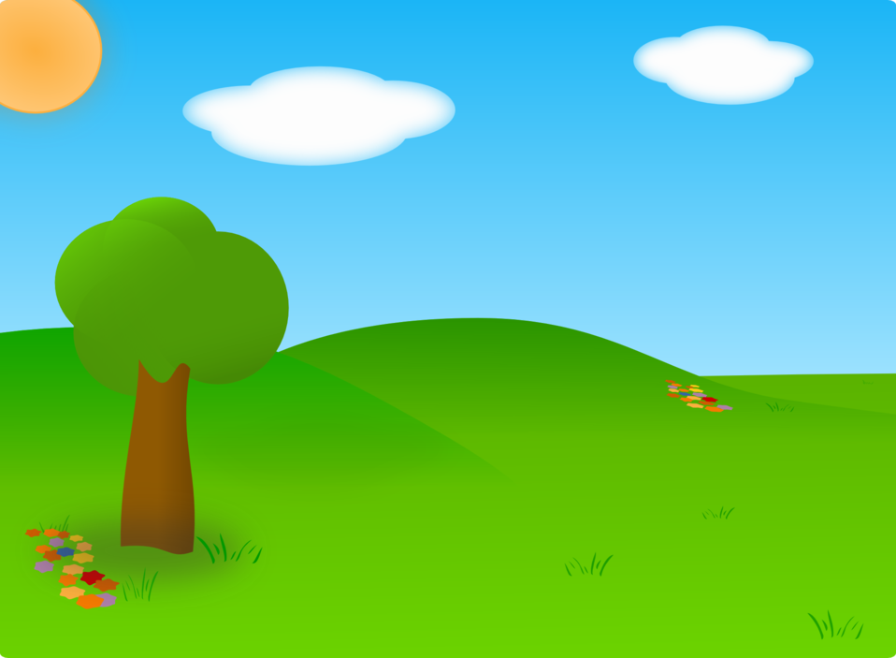



He thought about how exciting it would be to have another brother or sister to play with and share their lovely home with!

Slide 18
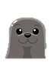
Mummy knew just what to do!
She rang Sally and asked if she knew of a child who needed all the love they had to give?

Slide 19

Sally knew the perfect little sea creature!

Slide 20
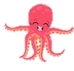


A little while later..
Sally brought Olive to meet Cody, his mum and his dad.
They had so much fun together.

Slide 21
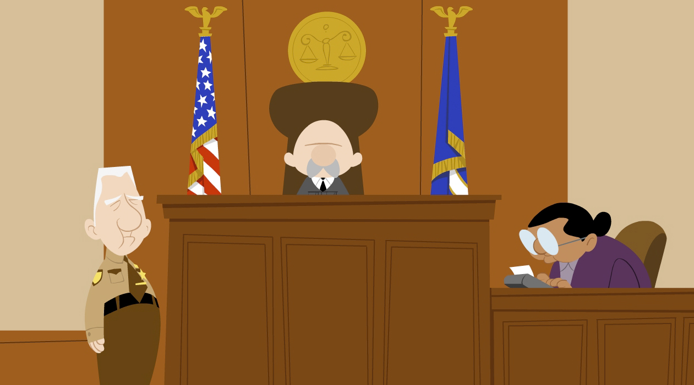
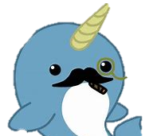
Sally went to see a wise judge about Olive.
The wise Judge told Sally that he also thought that Olive should go to live with Cody and his family.

Slide 22
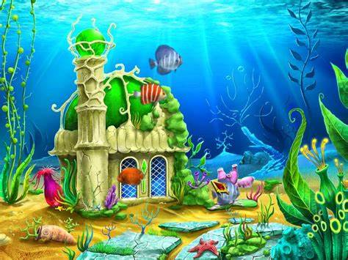


Olive is now at home with her new family.
And Cody has a new sister to play with.

Slide 23


A story created especially for
Osian!
Created by Janine Griffiths.

