Slide 1
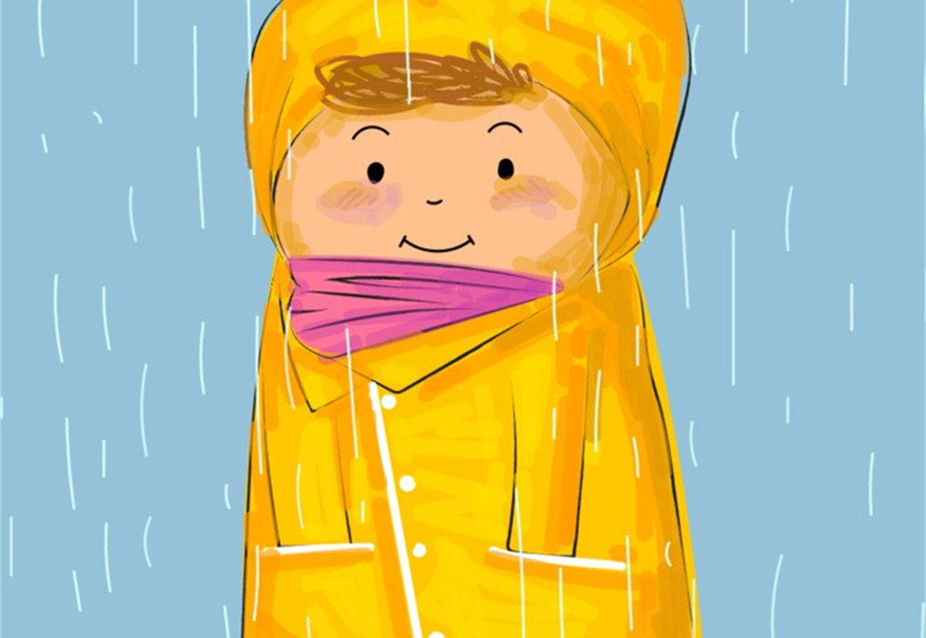
Jasper’s Coat

Slide 2
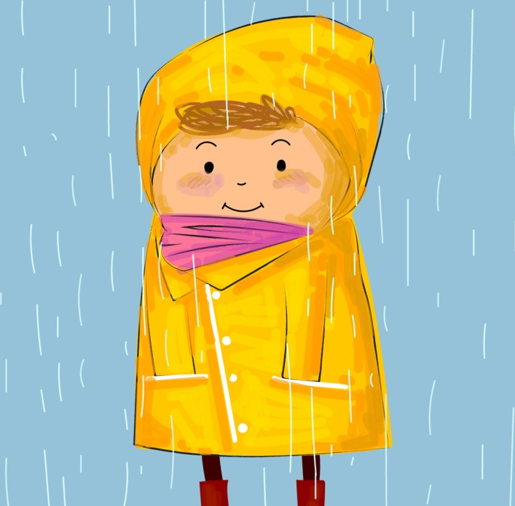
Jasper had a coat.
As soon as he had been born it had been wrapped around him. He wore it every day, it was his coat.
Everyone in Jasper’s village had a coat that had been wrapped around them as soon as they had been born.
They all needed their coats to keep them warm, cosy and safe and sheltered from the rain.
Each coat had big, deep pockets that were kept full of special memories and the treasures that the villagers had found.

Slide 3
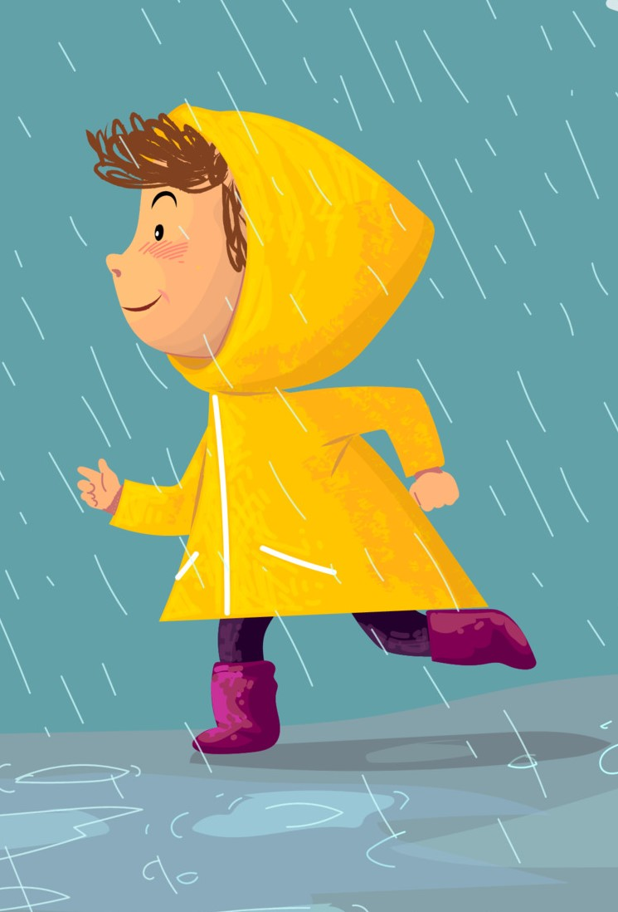
But over time, the villagers noticed that Jasper’s coat wasn’t quite right.
Holes were beginning to appear in its fabric and the stitching was frayed and loose.
The coat didn’t keep Jasper warm and cosy, and the holes weren’t keeping him
safe and dry from the rain.
The holes in the pockets of Jasper’s coat meant that the treasures and memories that Jasper tried to keep safe fell out and got damaged or lost.

Slide 4
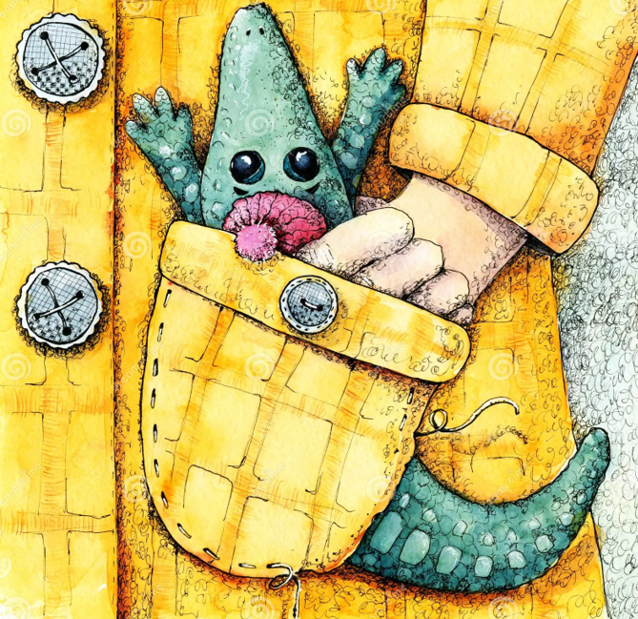
The sleeves of the coat began to shrink, and it was hard for Jasper to keep wearing it.
They pinched and rubbed at his arms and made them sore.
Even though pinching sleeves hurt, and Jasper was cold and damp from the rain that the holes let in, he couldn’t take his coat off.
It was his.
Jasper tried hard to hide the holes, but they kept getting bigger
Soon the villagers saw how sad and tatty Jasper’s coat was. They saw the holes that let in the rain and the pockets that couldn’t hold Jasper’s treasures.
They decided to try and help Jasper.

Slide 5
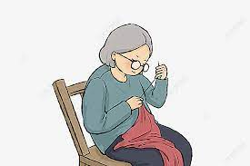
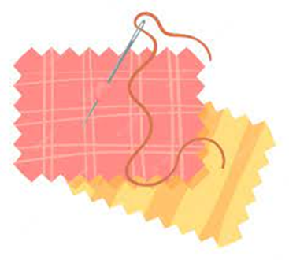

‘Jasper needs a new coat’ they said,
and they decided to see the Tailor.
At first, lots of the villagers tried to help patch up the coat with scraps of fabric to cover the holes and new stiches to keep the seams together.
But as soon as one hole had been patched, another one would begin to appear, and as soon as a seam had been stitched back together, another one began to fray, and come loose.
The villagers held a meeting. They had tried everything they could to fix Jasper’s coat, but it just couldn’t keep him warm and cosy anymore.

Slide 6
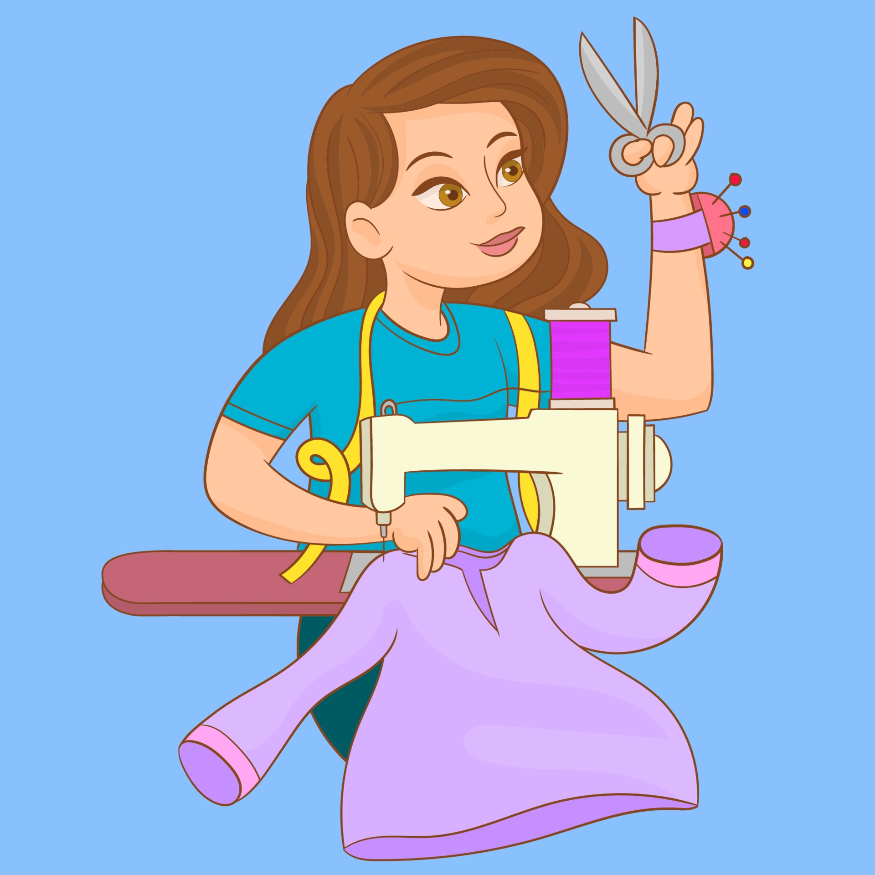
The villagers told the Tailor about Jasper’s coat, about the holes in the fabric and the frayed seams and the sleeves that pinched and hurt his arms.
The Tailor listened carefully to each of the villagers who told her about the patches that had been added to the coat and how they had tried to sew the seams back in place.
When the villagers had finished telling the Tailor she thought for a long time.
Then she said,’ Jasper needs a very special new coat’.

Slide 7
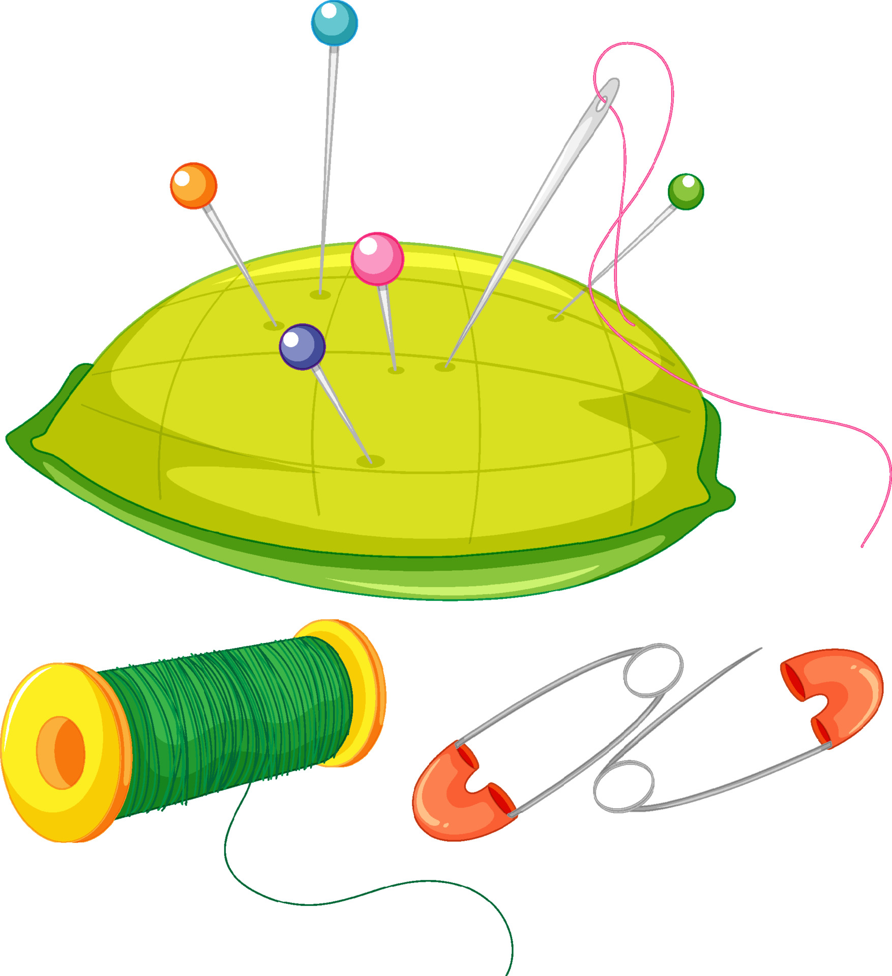
The Tailor set to work straight away.
She wanted to make Jasper a coat with exactly the right fabric to keep him warm, cosy, and safe and sheltered from the rain.
She would make sure that the new coat would have big, deep pockets that Jasper could keep all his memories and treasures in.

Slide 8
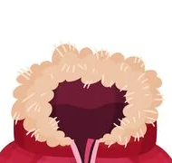
She knew it needed a big hood, with a fluffy trim that could kiss and tickle Jasper’s cheeks and make him smile.
It would take a little time to make just the right coat for Jasper, but it would be a much better fit.

Slide 9
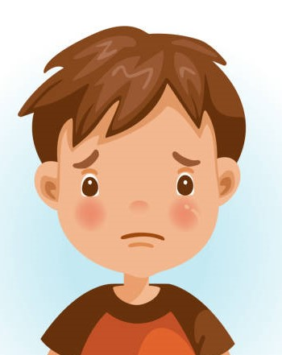
When the villagers told Jasper about his new coat,
he felt very nervous. He wasn’t sure he wanted to
say goodbye to his old coat.
Even though it had holes and frayed edges,
and the sleeves pinched his arms he still loved it,
it was his coat.
The villagers understood. They all loved their coats and knew that it was sad to have to say goodbye.
They explained to Jasper that he needed a new coat, to be safe and warm in, but that didn’t mean he had to forget about his old coat.

Slide 10
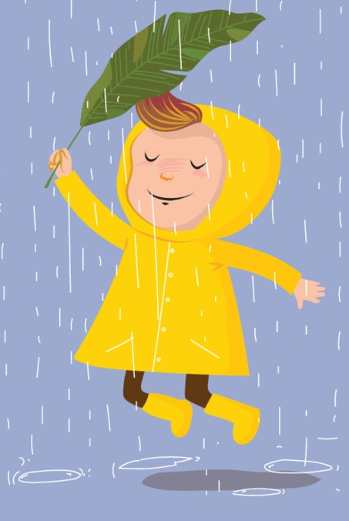
When Jasper tried on his new coat it was VERY warm and VERY cosy.
The sleeves had plenty of room in them for Jasper’s arms and didn’t pinch or rub.
And the big, fluffy hood tickled and kissed his cheeks and made him smile.

Slide 11
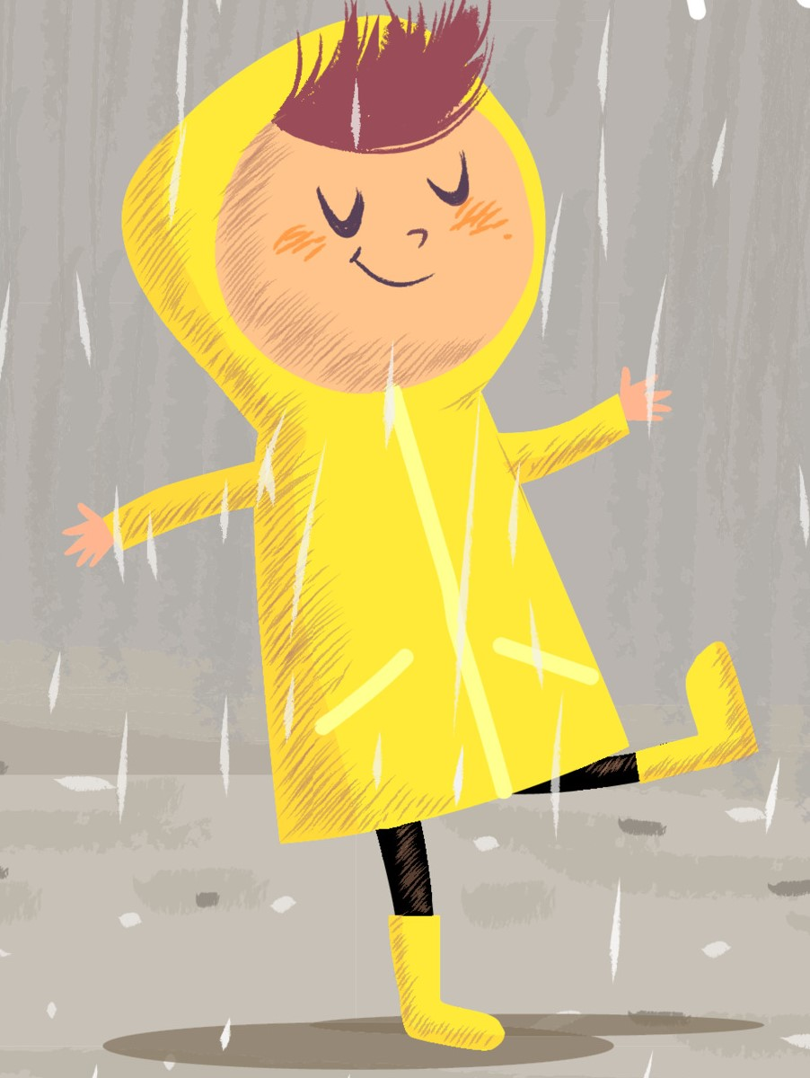
It took a while for Jasper to get used to wearing his new coat, but that was okay.
After all, when you’ve worn one thing for a long time, it can take just as long to get used to wearing something new.
But Jasper soon grew to love his new coat and although he doesn’t wear his old coat anymore, he keeps a patch of its fabric safe in the pockets of the new one.
He holds it in his hand from time to time and takes it out to look at it whenever he wants to.

Slide 12
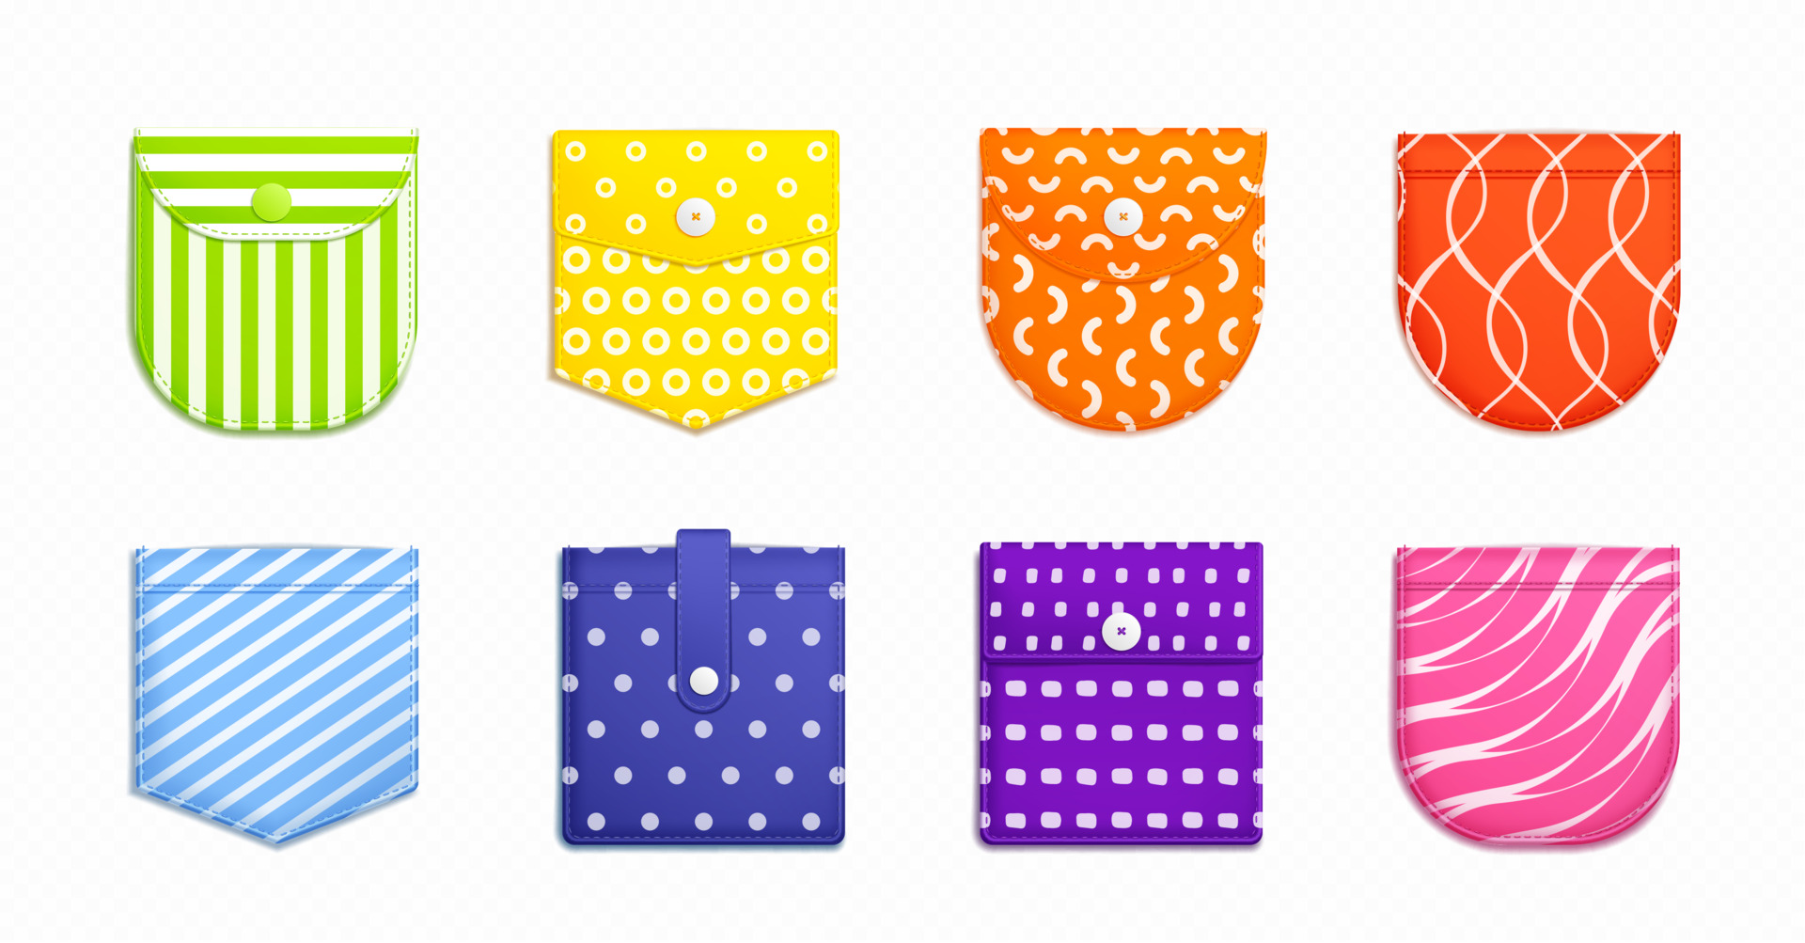
Over time the big deep pockets of Jasper’s new coat have many treasures and memories in them.
These pockets are so strongly stitched to his coat that they will never come apart, and they are so deep that they will never get full.

Slide 13
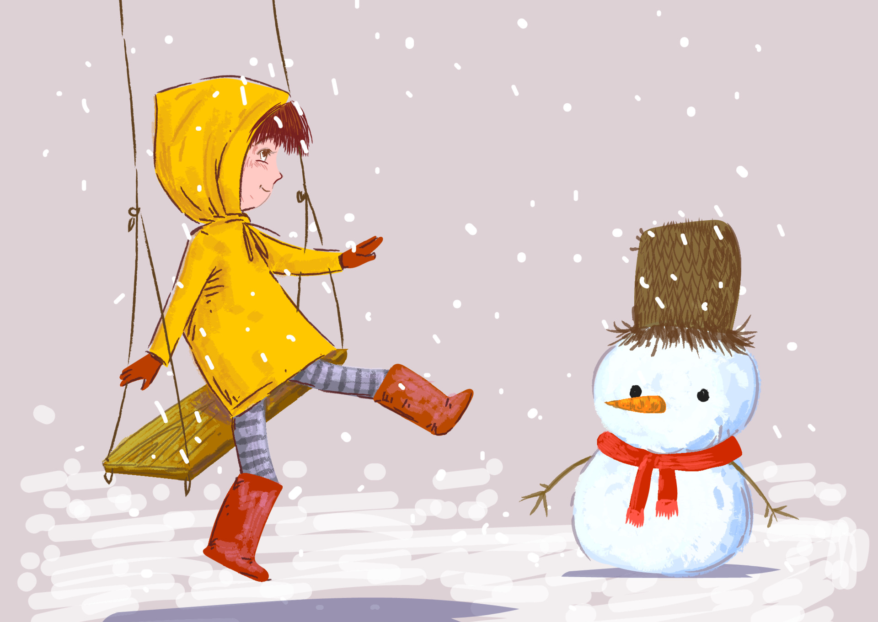
Jasper will go on collecting treasures and memories until he is a grown up.
And the patch of fabric from Jasper’s old coat will always be safe in his pocket.

