Slide 1
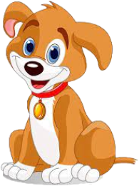

How Budgie became a sister.

Slide 2
Say ‘Hello’ to Budgie!
Hello my name is Budgie. And I go ‘Woof Woof’. Can you make a Woof noise too?

Slide 3

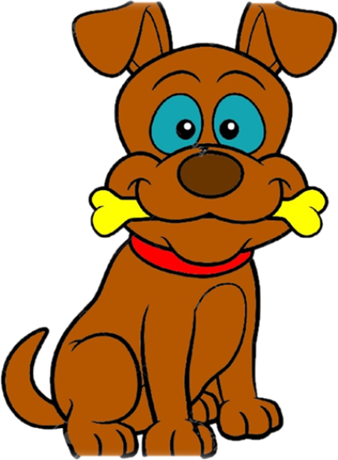

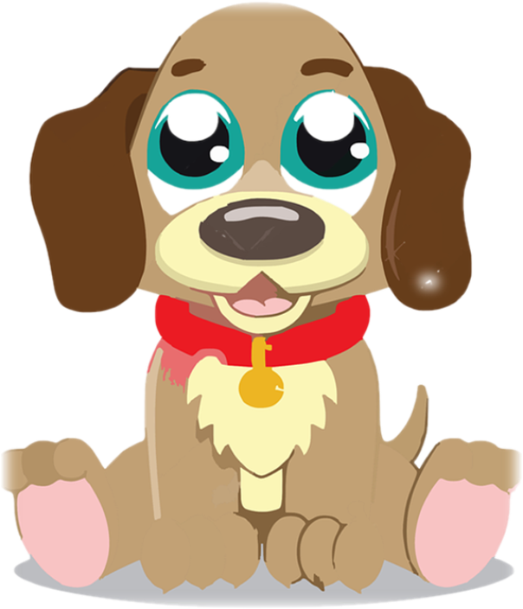
Budgie lives with her Mummy, Daddy and sister Birdy in their home. They are the Wagtail family. Here are the Wagtails outside their home.
Budgie loves living with her Mummy, Daddy and sister. Budgie loves to draw and colour in. Budgie loves to make things and is very crafty. Budgie likes to go on her scooter. Budgie is really good at wagging her tail. But best of all Budgie loves to spend time with her sister Birdy playing. Budgie and Birdy’s favourite game is playing puppies. What do you like doing with your Mummy, Daddy and sister? What are you really good at doing? Can you spot Budgie?
This is Budgie’s story about how she became a sister to Birdy.

Slide 4

One day Mummy and Daddy spoke to Budgie and explained that they wanted to adopt a little puppy. So their family of 3 would be a family of 4. Mummy explained to Budgie what the word Adoption meant.
‘Adoption is when a child is grown in a Tummy Mummy’s Tummy and the Tummy Mummy or Tummy Daddy couldn’t look after them. This can be for lots of different reasons.’
This is Budgie’s story about how she became a sister.

Slide 5
Budgie has some muddles in her head!
Budgie was feeling excited about having a brother or sister but over the next few days and weeks she also had a few muddles in her head about adoption.
And she had a lot of questions! What questions would you think of?
???
???
???

Slide 6
One beautiful sunny day Mummy and Budgie were playing hide and seek in the garden when Budgie asked Mummy a big question.
‘When you adopt a puppy will you still love me?
Mummy!
I have a question?

Slide 7
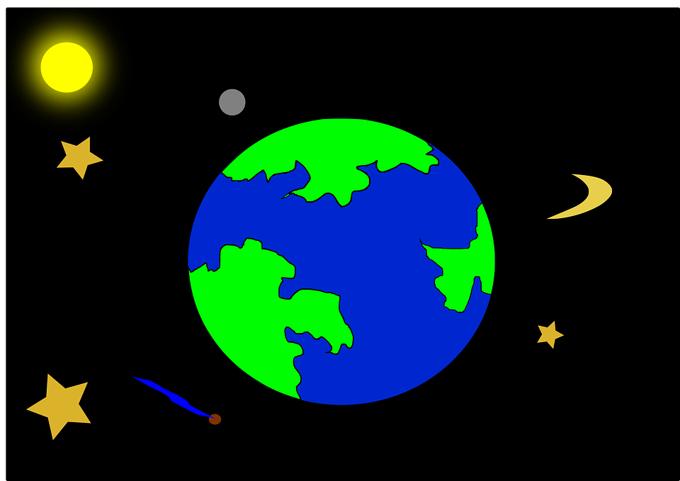
Oh Budgie! Darling! Mummy and Daddy will still love you. Love doesn’t have a fixed number or size. It’s infinite! Just like the size of the Universe.
‘Oh Budgie! Darling! Mummy and Daddy will still love you. Love doesn’t have a fixed number or size. It’s infinite! Just like the size of the Universe!

Slide 8

Our love for you is like a magic elastic band it grows and grows. And becomes bigger and bigger.’
Mummy told Budgie she was so proud of her for asking such an important question.

Slide 9

Hello Budgie! My name is Mrs Mouse. I go ‘Squeak Squeak’. Can you make a Squeak noise like me?
Meet Mrs Mouse.
Mrs Mouse’s job is to make sure that puppies are looked after by their Mummies and Daddies. And Mrs Mouse had an extra special job which was to find the right parents for puppies.
Mrs Mouse was going to match Mummy and Daddy to the right puppy for their family. So she came to the house and met Mummy and Daddy.
Budgie met Mrs Mouse too.

Slide 10
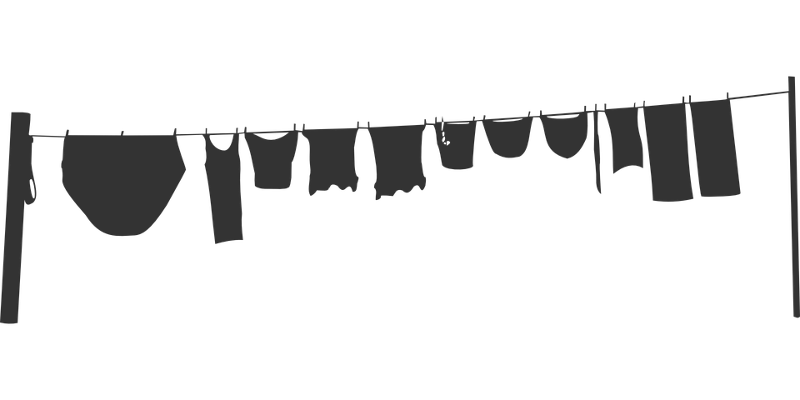
One day Daddy and Budgie were in the garden. And Daddy was putting the washing on the line when Budgie asked Daddy a big question.
‘Why are puppies adopted?’
Daddy!
I have a question?

Slide 11
Daddy gave Budgie a big hug and said.
‘Bringing up puppies is a bit like building a wall. To make big, strong walls you need a very good foundation at the bottom of the wall and then by using the right type of brick and just the right amount of cement, you carefully put the bricks on top of each other.
The foundation is like the love that holds everything else together and makes the wall strong. You can see from the wall that puppies need love, but they also need lots of different kinds of caring to help them grow properly. Puppies may be loved by their birth Mummy or birth Daddy but they may not be able to give a puppy all those other things to help them grow up happy, healthy and strong.’
We know that we can give a puppy all those things.’

Slide 12
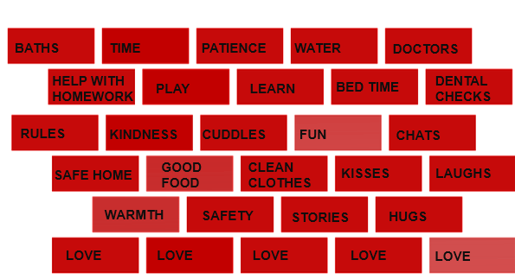
Daddy explained to Budgie all the things that little puppies need from their parents to grow up healthy, happy and strong.

Slide 13


Meet Wise Owl.
Twit Tawoo! Can you make a Twit Tawoo like me?
The Wise Owl’s job is to take time and to think really hard about where puppies go to live if they are going to be adopted. The Wise Owl listens to everyone such as the birth family, the puppy, the social worker Mrs Mouse and many other people who have been part of the birth family or puppies’s life.
After they have read everything and talked to everyone they make the final decision about where the puppy is going to live and their adoption.

Slide 14


Wise Owl makes an important decision.
Mrs Mouse thought that Mr and Mrs Wagtail and Budgie would be the perfect family for a puppy called Birdy. So she went to talk to the Wise Owl. Mrs Mouse told the Wise Owl that the Wagtail family want to adopt Birdy. This would mean that Birdy will live with them and they would be her Mummy and Daddy. And Budgie would be her sister.
Wise Owl thought very hard about this as it was a very important decision to make and she needed time to think about what the answer would be. After some thinking time. Wise Owl agreed with Mrs Mouse and thought that Mr and Mrs Wagtail would be the perfect Mummy and Daddy for Birdy. And Budgie would be a great sister for Birdy.

Slide 15
Mrs Mouse went to visit Mr and Mr Wagtail to tell them what the Wise Owl had said and that she had agreed that they could adopt Birdy. Mr and Mrs Wagtail were so happy as they loved Birdy so much.
So this is how Birdy became Birdy Wagtail. And how Mr and Mrs Wagtail became Birdy’s Mummy and Daddy. And how Budgie became Birdy’s sister.
Mummy and Daddy love Budgie and Birdy very much. Just like that magic elastic band their love expands and gets bigger and bigger! And it is as big as the Universe! The love is big and strong enough for everyone in the Wagtail family.
THE END.

Slide 16


