Slide 1
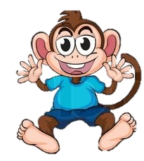
George gets a new sister!

Slide 2
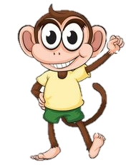
This is George,
He is super excited because today is the day George gets to meet his new little sister Lyla.

Slide 3
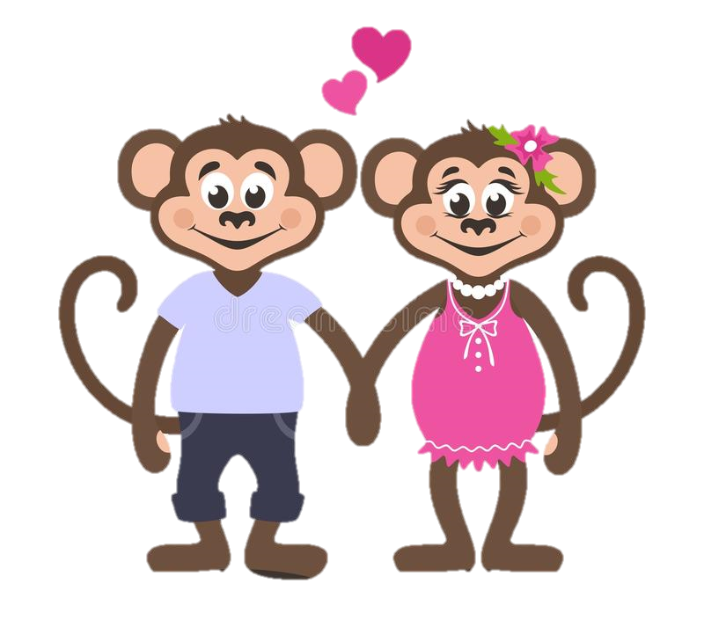
George’s Mum and Dad have already met Lyla and have said she is a lovely, cute little girl.
But Lyla isn’t like George, she isn’t a happy little monkey like George!
Lyla is a little Sloth!

Slide 4
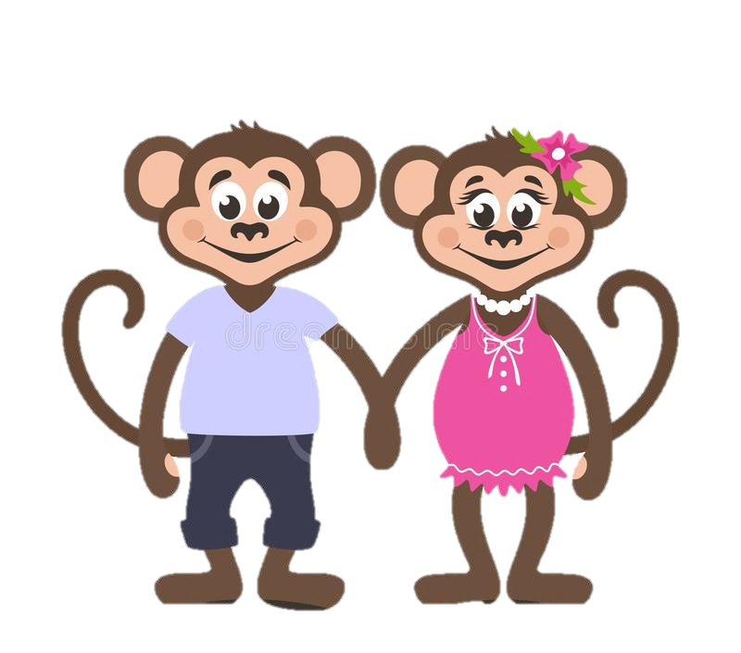
Mum and dad reminded George that Lyla may be very nervous today and that George must be grown up and be calm around her so she doesn’t get scared.

Slide 5
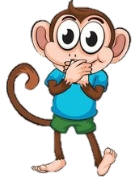
George was soooo excited but promised he would stay calm around Lyla.
He really did not want to scare Lyla.

Slide 6
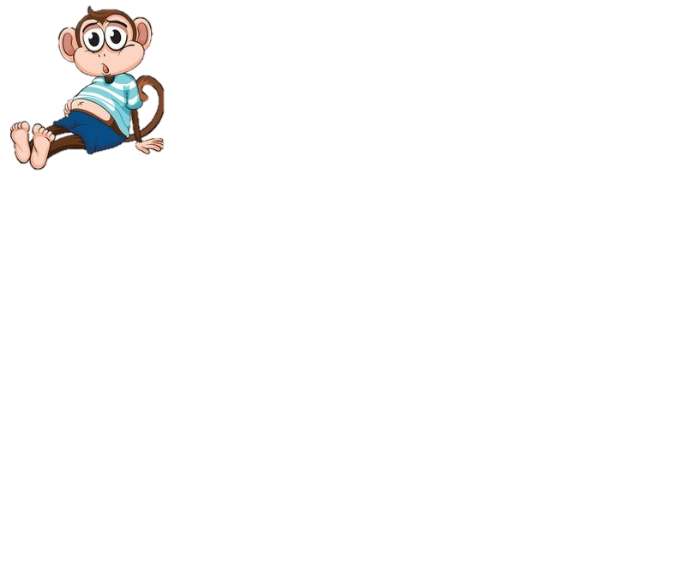
Suddenly…..
George could hear some elephant footprints walking towards the tree house!
It was Nelly and
she had Lyla with her!
George’s tummy began to feel bubbly
again, he really hoped that Lyla
would like him.

Slide 7
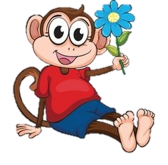
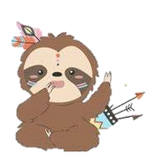
Hello Lyla,
My name is George and I hope we can be good friends.
George took a big breath and walked over to meet Lyla.
Mum and dad were right.. Lyla was super cute!
Lyla looked at George and George could tell Lyla was just as nervous as him!
Hi George,
I am a little nervous but I hope so too!

Slide 8
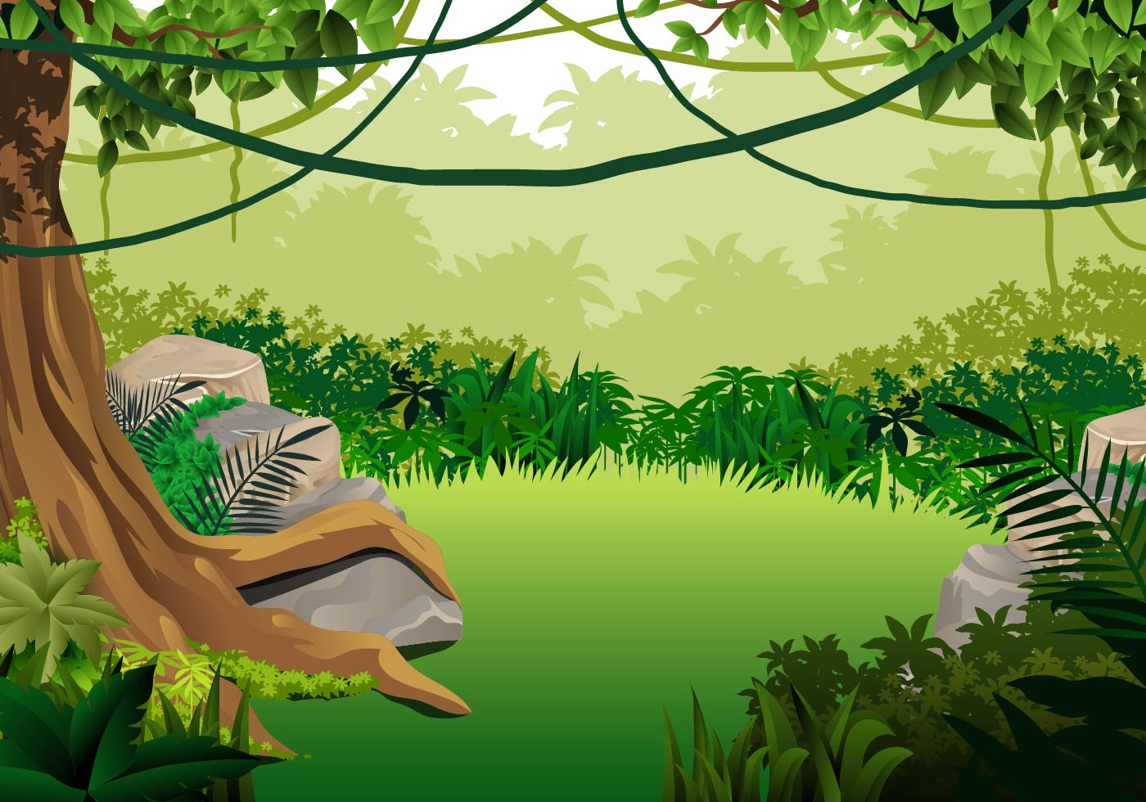
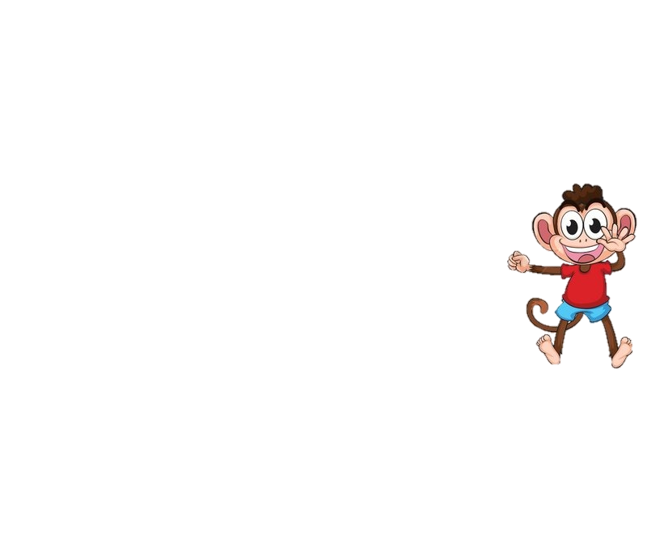
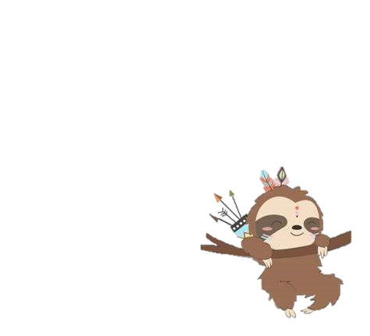
George, Lyla, mum and dad had a great day together playing Tag up in the trees.
Lyla was a little slower than George, but that was ok.
George made sure to go slow enough for Lyla to catch him.

Slide 9
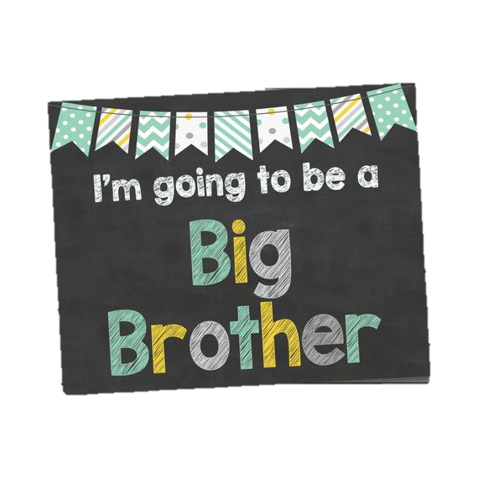
Lyla came to visit a few more times until mum and dad told George it was time for Lyla to come and live with them hopefully forever.
George was so pleased! He would finally get to be Lyla’s big brother.

Slide 10
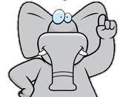
The following week Nelly brought Lyla and her box of memories to George’s house.
Lyla was finally moving in and George was so excited but…..

Slide 11
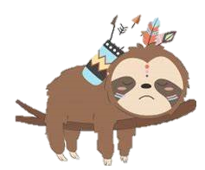

Lyla did not look happy at all!
Lyla looked …Sad?
George didn’t understand why Lyla was so upset?
Wasn’t she excited about coming to live with George and his family?

Slide 12
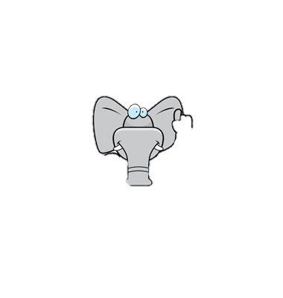

Nelly explained to George that Lyla had been living with a lovely family called a Foster family and she was sad to leave them.
She explained that it did not mean Lyla didn’t want to live with George it was just a difficult time for Lyla to say goodbye to them.

Slide 13
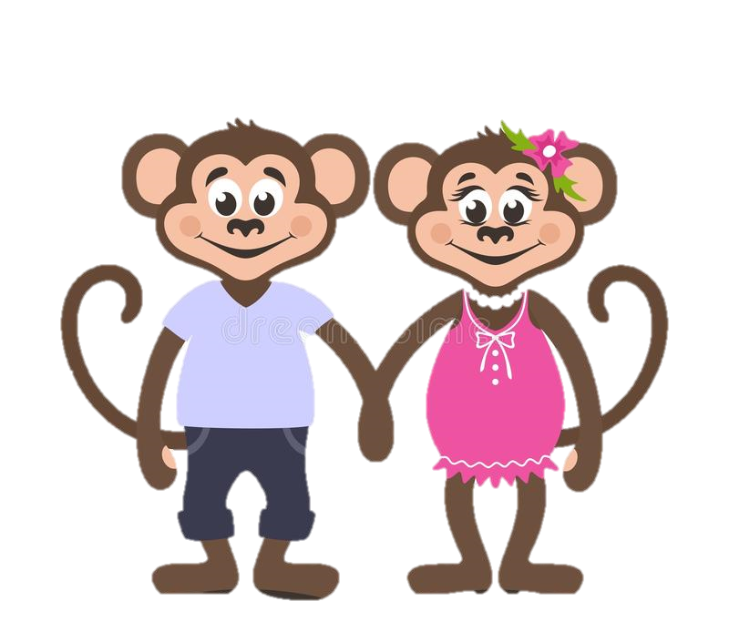
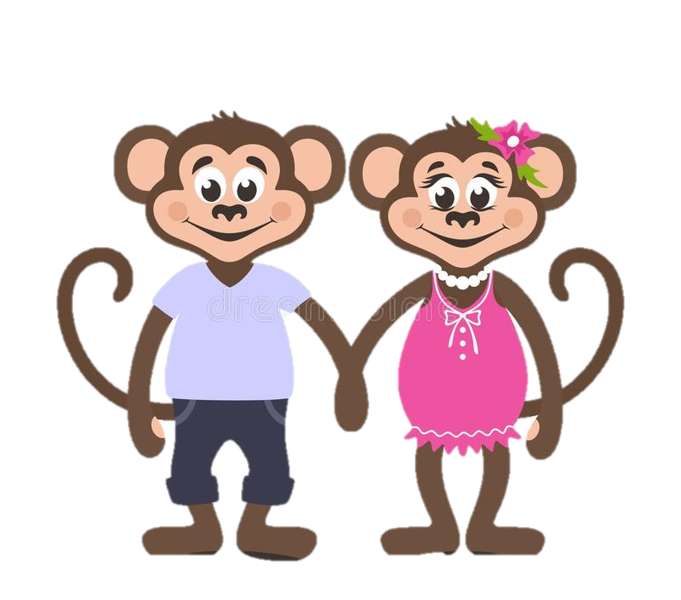
George could understand how hard it must have been for Lyla to leave her Foster family.
Mum and Dad reminded George that they had to be patient and understanding to Lyla and help her feel safe and loved in their family.

Slide 14

For the next few days things were not how George had imagined.
Lyla was sometimes happy, sometimes sad and sometimes really angry!
Lyla seemed to cry a lot and George wasn’t sure why!

Slide 15
Mum and dad reminded George of what Nelly had told them.
Lyla had a lot of bubbly feelings in her tummy and needed George, her mum and her dad to help her understand these bubbly feelings.
George had to imagine he was Lyla and how he would feel if he had to move to a strange new house with different people and say goodbye to everyone he has ever known.
George realised that poor Lyla couldn’t help being sad or angry. She was trying to make sense of all those bubbly feelings inside her tummy!

Slide 16

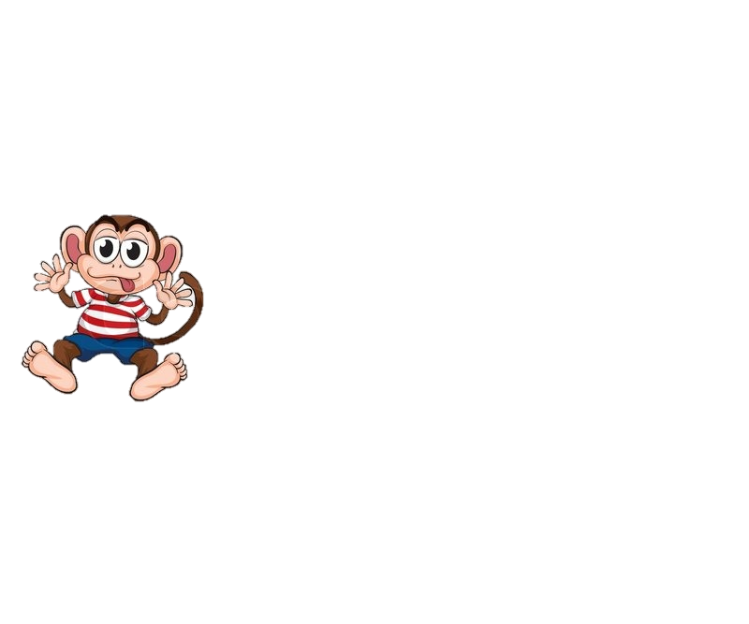
Over the next few weeks George, mum and dad worked hard to help Lyla feel safe and loved in her new home.
They helped Lyla to understand her bubbly feelings and how to stop the bubbles coming.
Mum and dad were so proud of George!

Slide 17
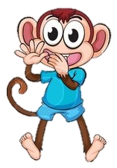

George knew Lyla never meant to be sad or angry and just needed George’s help and Patience.
.

Slide 18
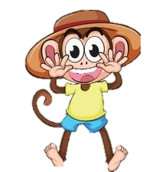
George and Lyla soon became the best of friends.
Lyla still gets upset and angry sometimes but George is there to help her.
They all love each other to the top of the beanstalk and back.

