Slide 1
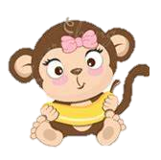
Gwen gets a new brother!

Slide 2
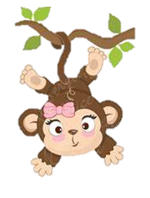
This is Gwen,
She is super excited because today is the day Gwen gets to meet her new little brother Sammy.

Slide 3
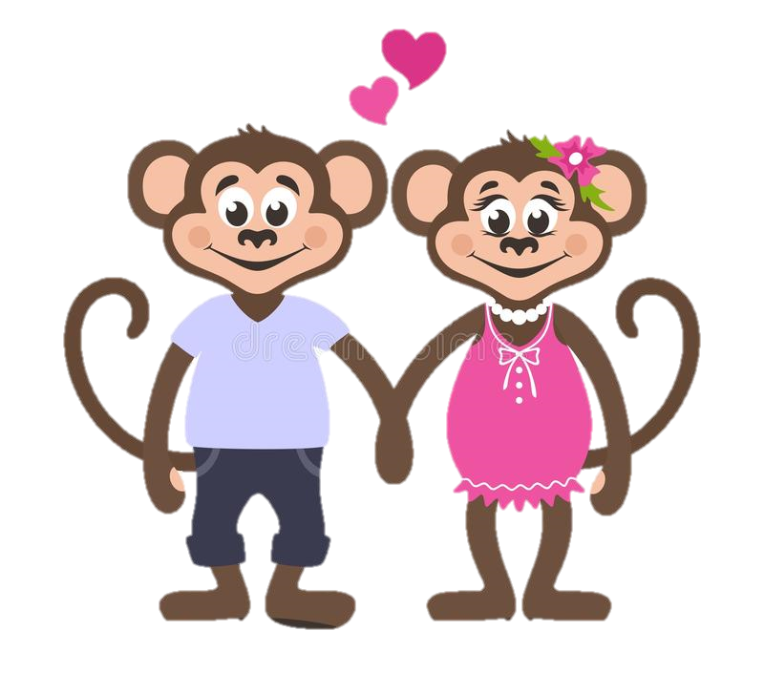
Gwen’s Mum and Dad have already met Sammy and have said he is a lovely, cute little boy.
But Sammy isn’t like Gwen, he isn’t a happy little monkey like Gwen!
Sammy is a little Sloth!

Slide 4
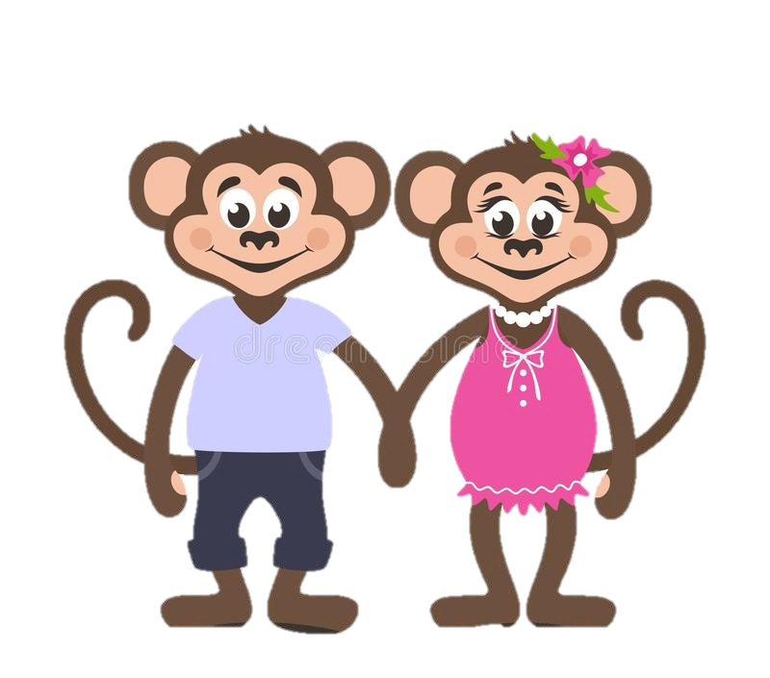
Mum and dad reminded Gwen that Sammy may be very nervous today and that Gwen must be grown up and be calm around him so he doesn’t get scared.

Slide 5
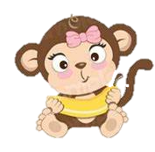
Gwen was soooo excited but promised she would stay calm around Sammy.
She really did not want to scare Sammy.

Slide 6
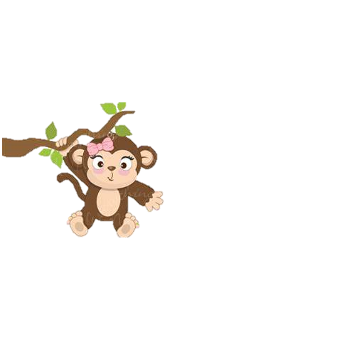

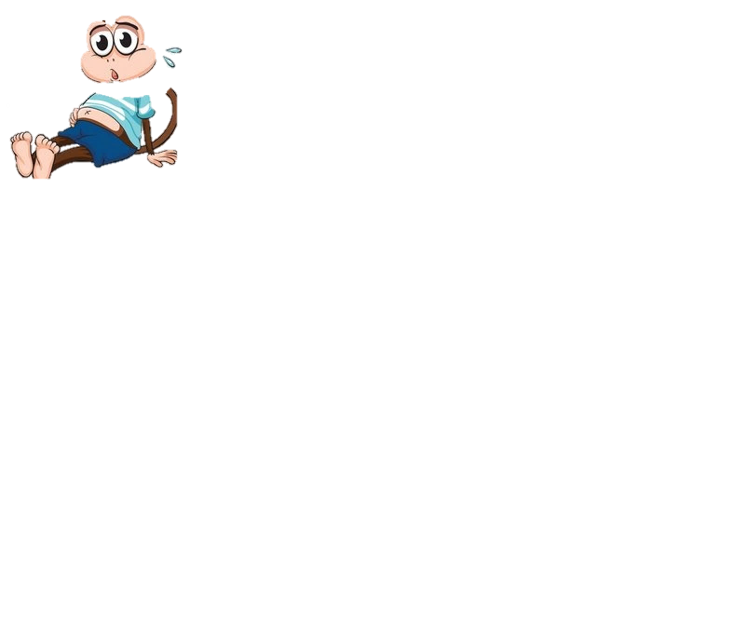
Suddenly…..
Gwen could hear some elephant footprints walking towards the tree house!
It was Nelly and
she had Sammy with her!
Gwen’s tummy began to feel bubbly
again, he really hoped that Sammy
would like her.

Slide 7
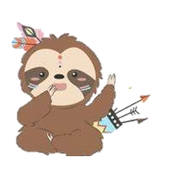
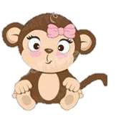
Gwen took a big breath and walked over to meet Sammy.
Mum and dad were right.. Sammy was super cute!
Sammy looked at Gwen and Gwen could tell Sammy was just as nervous as her!
Hello Sammy,
My name is Gwen and I hope we can be good friends.
Hi Gwen,
I am a little nervous but I hope so too!

Slide 8
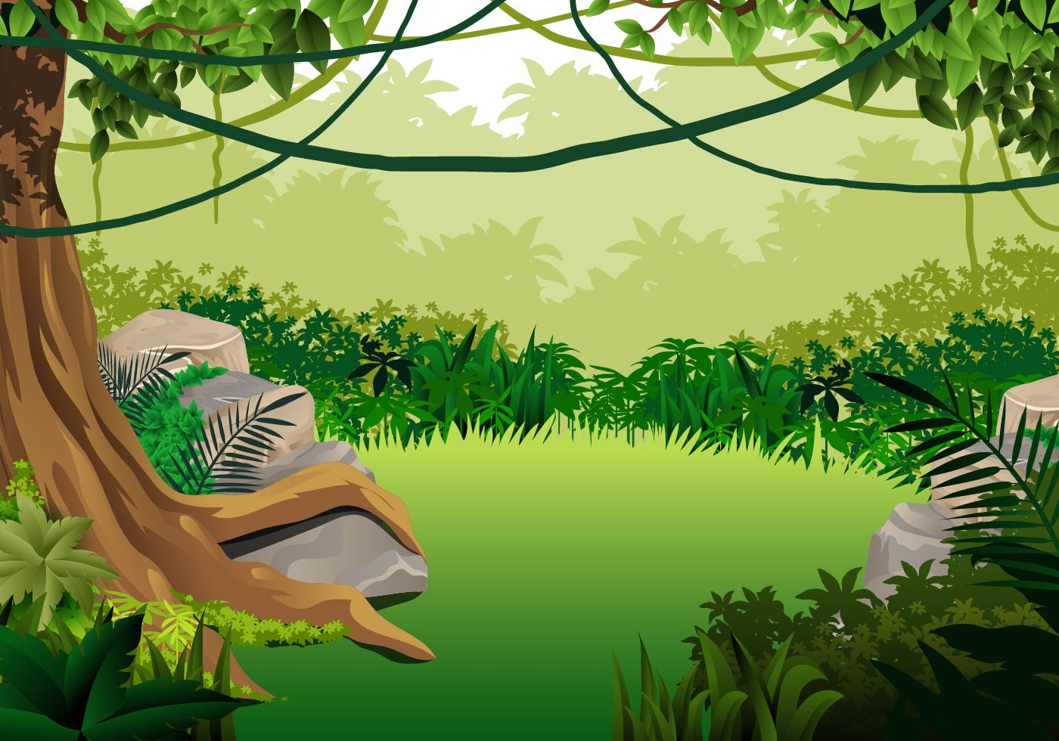
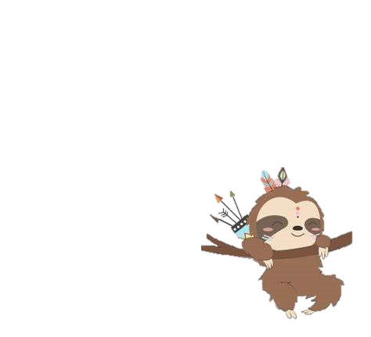
Gwen, Sammy, mum and dad had a great day together playing Tag up in the trees.
Sammy was a little slower than Gwen, but that was ok.
Gwen made sure to go slow enough for Sammy to catch him.

Slide 9
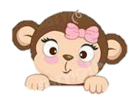
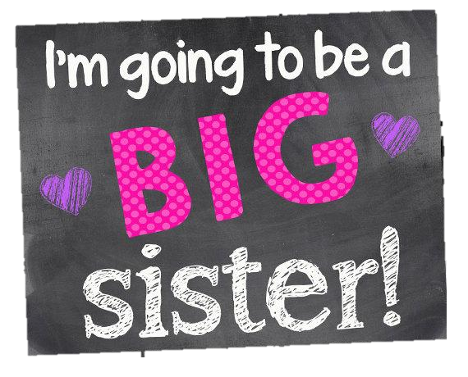
Sammy came to visit a few more times until mum and dad told Gwen it was time for Sammy to come and live with them hopefully forever.
Gwen was so pleased! She would finally get to be Sammy’s big sister.

Slide 10
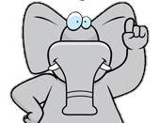

The following week Nelly brought Sammy and his box of memories to Gwen’s house.
Sammy was finally moving in and Gwen was so excited but…..

Slide 11
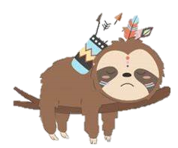
Sammy did not look happy at all!
Sammy looked …Sad?
Gwen didn’t understand why Sammy was so upset?
Wasn’t he excited about coming to live with Gwen and her family?

Slide 12
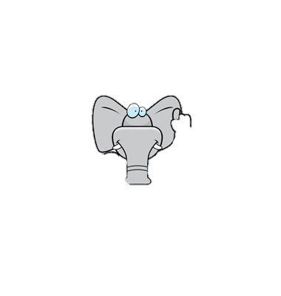
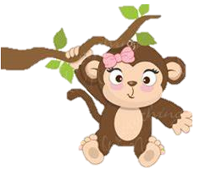
Nelly explained to Gwen that Sammy had been living with a lovely family called a Foster family and he was sad to leave them.
She explained that it did not mean Sammy didn’t want to live with Gwen it was just a difficult time for Sammy to say goodbye to them.

Slide 13
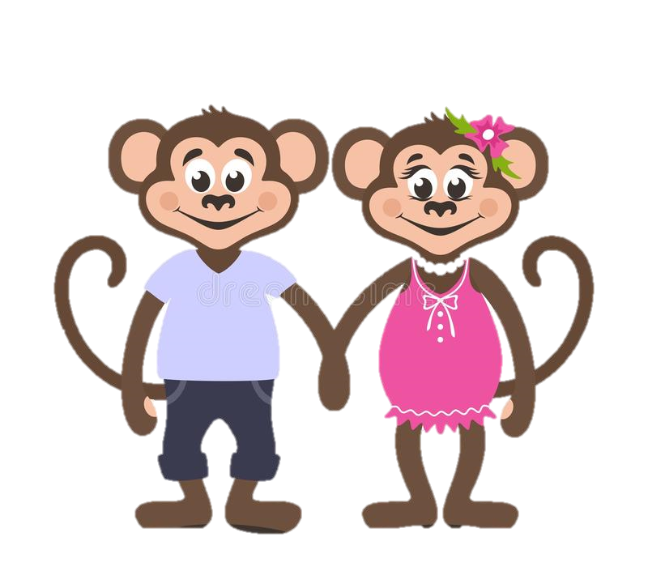
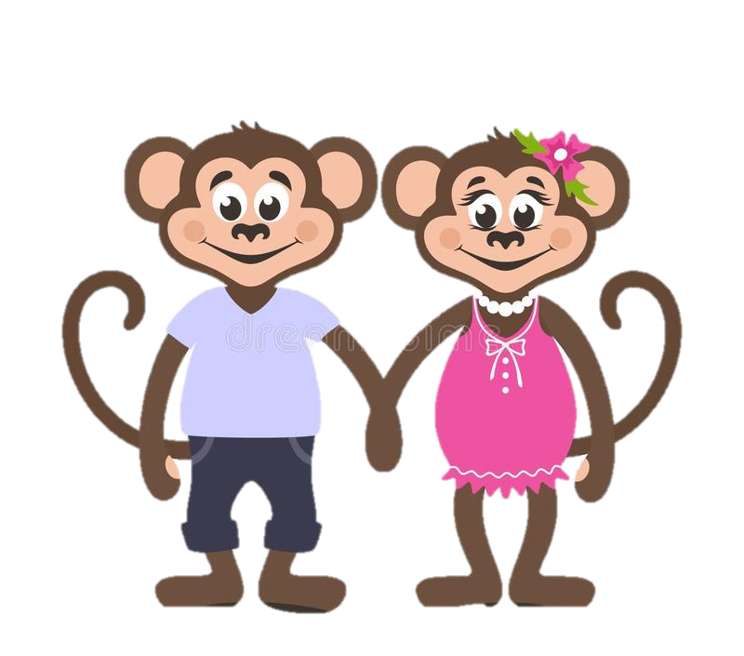
Gwen could understand how hard it must have been for Sammy to leave his Foster family.
Mum and dad reminded Gwen that they had to be patient and understanding with Sammy and help him feel safe and loved in their family.

Slide 14

For the next few days things were not how Gwen had imagined.
Sammy was sometimes happy, sometimes sad and sometimes really angry!
Sammy seemed to cry a lot and Gwen wasn’t sure why!

Slide 15
Mum and dad reminded Gwen of what Nelly had told them.
Sammy had a lot of bubbly feelings in his tummy and needed Gwen, her mum and her dad to help him understand these bubbly feelings.
Gwen had to imagine she was Sammy and how she would feel if she had to move to a strange new house with different people and say goodbye to everyone she had ever known.
Gwen realised that poor Sammy couldn’t help being sad or angry. He was trying to make sense of all those bubbly feelings inside his tummy!

Slide 16

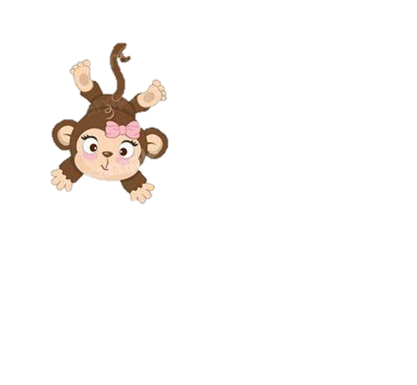
Over the next few weeks Gwen, mum and dad worked hard to help Sammy feel safe and loved in his new home.
They helped Sammy to understand his bubbly feelings and how to stop the bubbles coming.
Mum and dad were so proud of Gwen!

Slide 17
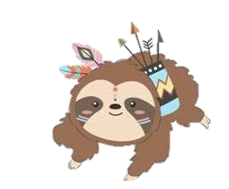
Gwen knew Sammy never meant to be sad or angry and just needed Gwen’s help and Patience.
.

Slide 18
Gwen and Sammy soon became the best of friends.
Sammy still gets upset and angry sometimes but Gwen is there to help him.
They all love each other to the Moon and back.

