Slide 1
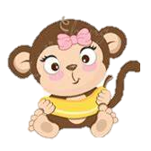
A New Brother for Gwen!

Slide 2
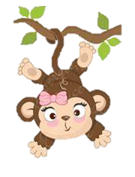
This is Gwen,
She is a lovely little monkey who loves swinging from trees and eating bananas.

Slide 3
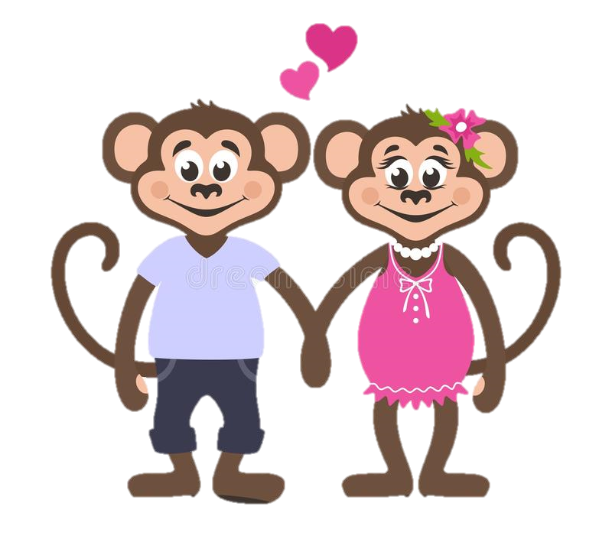
This is Gwen’s Mum and Dad.
They also love swinging from trees but mostly they love Gwen.

Slide 4

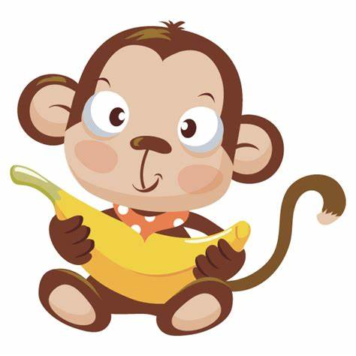
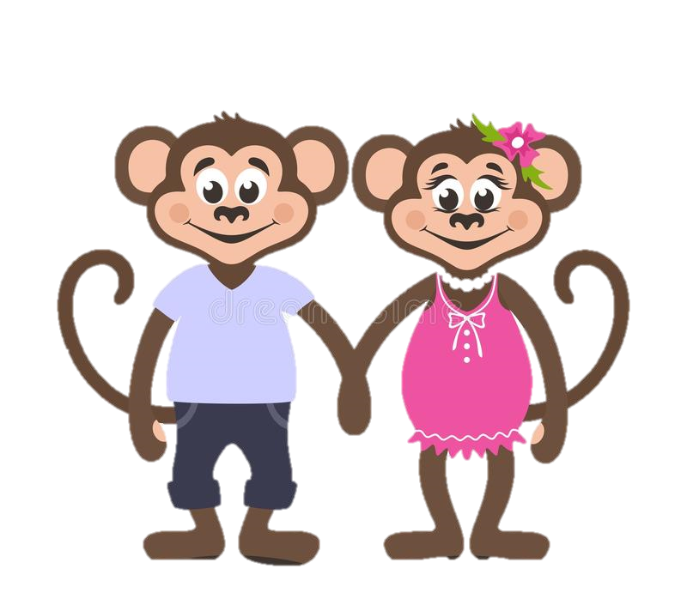
Gwen’s Mum and Dad loved her so much and thought it would be nice for Gwen to have a little brother or sister.

Slide 5
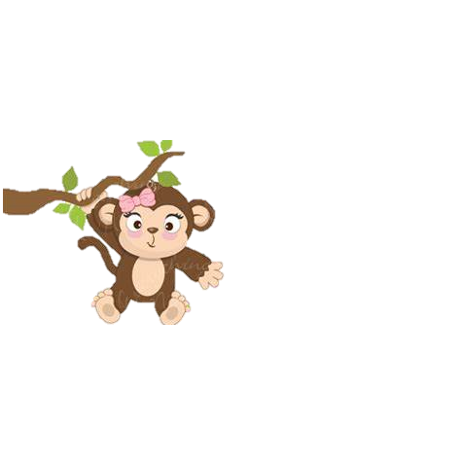

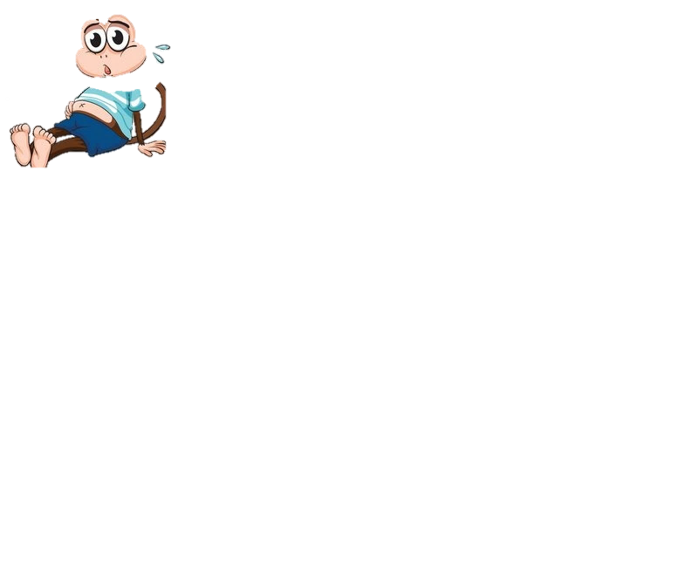
Gwen wasn’t so sure about having a little brother or sister.

Slide 6

Gwen worried that her mum and dad wouldn’t be able to spend as much time with her anymore.
She didn’t want to share them.

Slide 7

Mum explained to Gwen that love is magic,
She explained that love can grow and is big enough to share.
Mum and dad will always love Gwen to the Moon and back and nothing will ever change that.

Slide 8
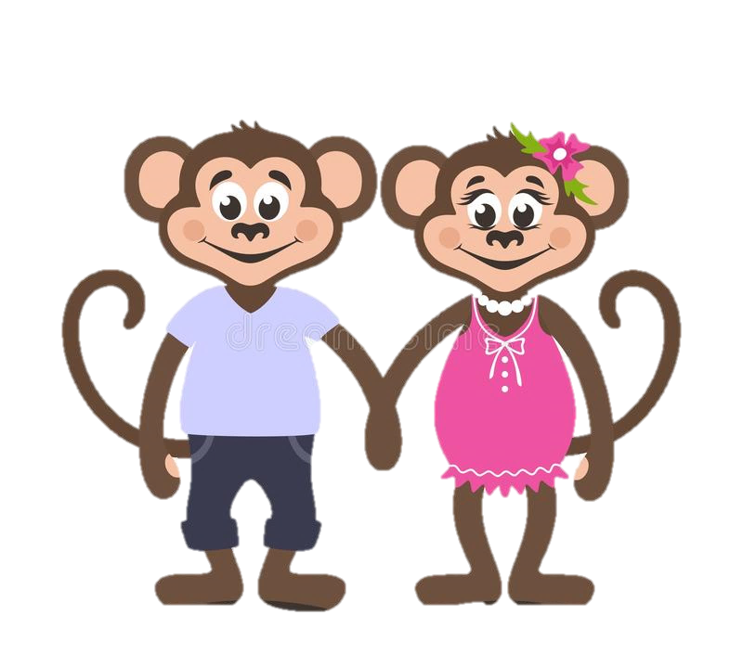
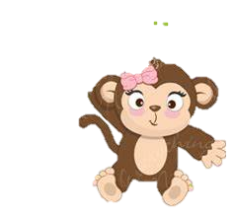
Dad told Gwen that having a little brother or sister could be so much fun!
They could play tag in the trees and even watch Peppa Pig together!
Gwen thought this did sound like fun and was starting to look forward to a new brother or sister!

Slide 9
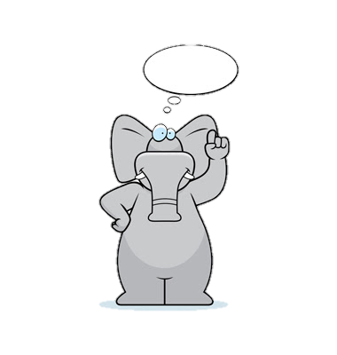
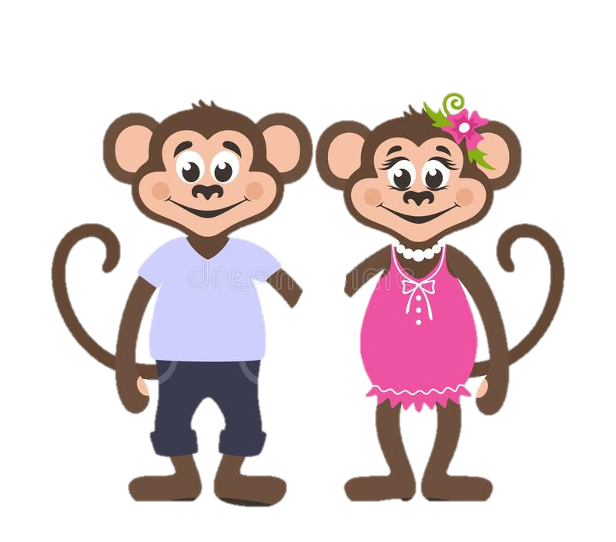
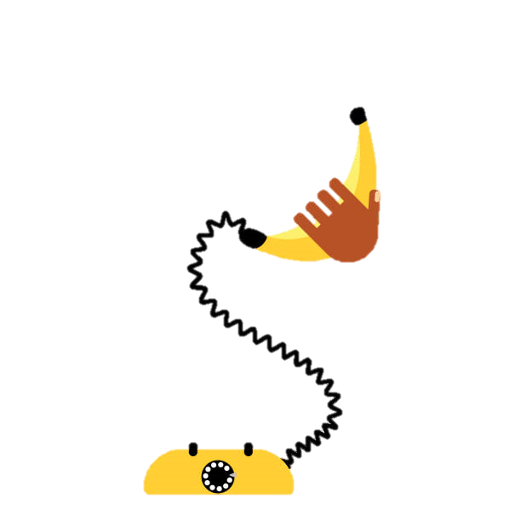
Mum and Dad told Gwen that there were lots of animals in the Jungle that needed a home and a family like theirs.
Mum and Dad rang the jungle Social Worker Nelly to help them find just the right brother or sister for Gwen.

Slide 10
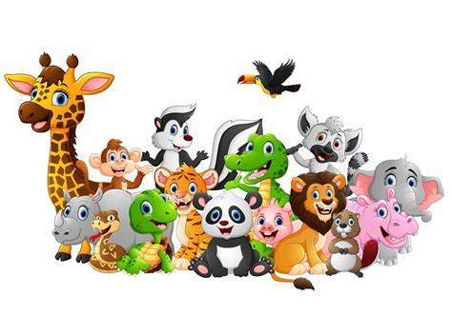
It was Nelly’s job to look after little animals and make sure they are looked after just the right way.
Sometimes Nelly had to find new families for the animals and it was a tough job finding the perfect family.

Slide 11
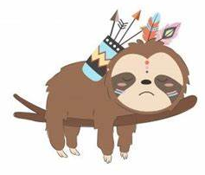
Nelly had been looking for the perfect family for a little boy named Sammy who really needed a good home.
She thought that Gwen’s family would be perfect for little Sammy.

Slide 12
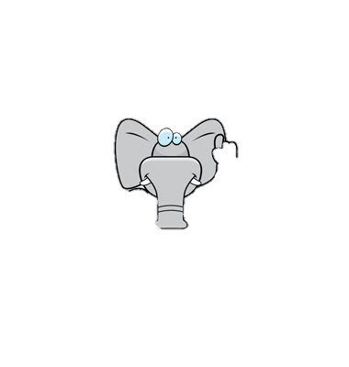
Nelly told mum and dad all about little Sammy and mum and dad agreed that he sounded like the perfect little boy for them and would make a great little brother for Gwen!

Slide 13
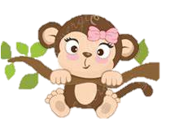
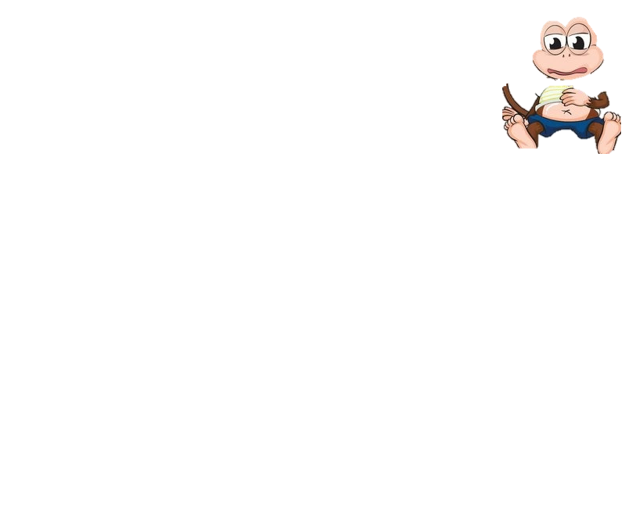
Gwen felt very strange!
She was excited about having a little brother but was also nervous in case Sammy did not like her?
What if Sammy didn’t like playing tag in the trees or eating watermelons?
What if Sammy wanted someone else as their big sister?
Gwen’s tummy began to feel very bubbly.

Slide 14
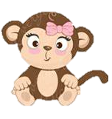
Mum and dad told Gwen they were nervous too and it was ok to be worried about having a new brother.
They told her that Sammy may find it difficult to settle in with their family and home at first.
As Sammy is coming to a brand new strange family he was probably just as scared as Gwen was, maybe even a little more scared and worried than her.
Gwen realised that she was going to be the big sister and help Sammy to settle into his new family.

Slide 15
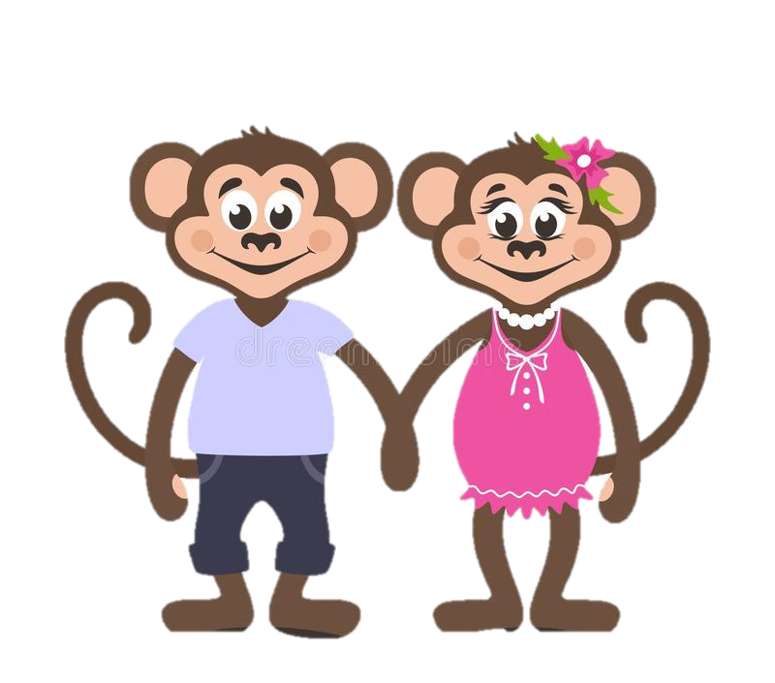
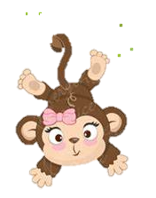
Gwen, mum and dad started to get the tree house ready for Sammy.
Mum and dad got to meet Sammy too and they said that he was very lovely and sweet.
They told Gwen that very soon Sammy would be able to come home to live with them.

Slide 16
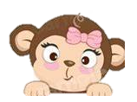
Join us in the next chapter to see what happens when Sammy comes to live with Gwen and her family.

