Slide 1
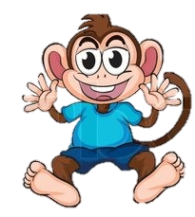
George gets a new brother!

Slide 2
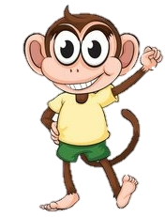
This is George,
He is super excited because today is the day George gets to meet his new little brother Link.

Slide 3
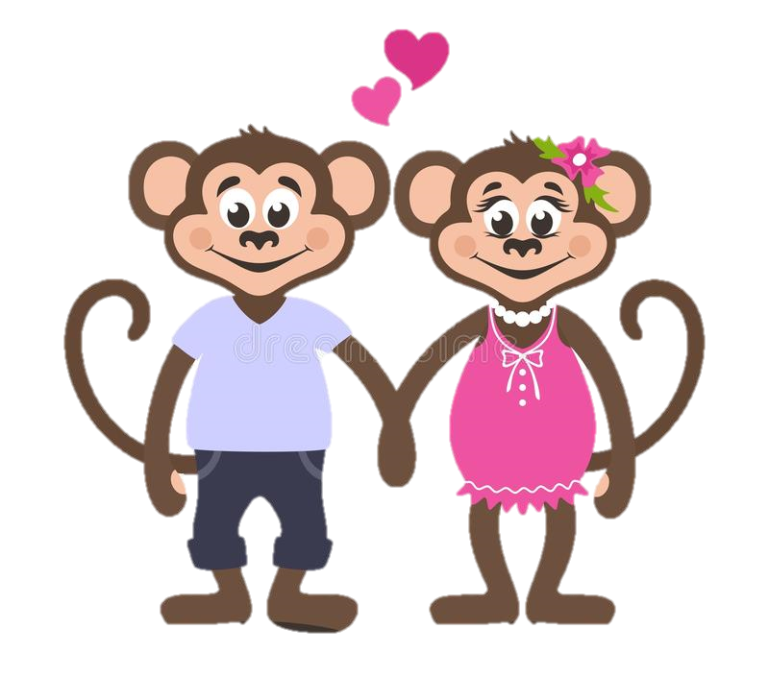
George’s Mum and Dad have already met Link and have said he is a lovely, cute little boy.
But Link isn’t like George, he isn’t a happy little monkey like George!
Link is a little Sloth!

Slide 4
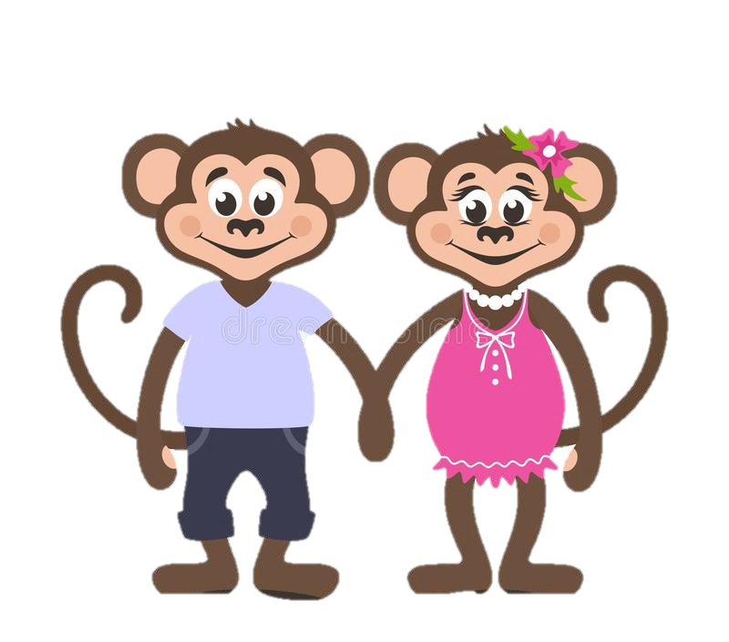
Mum and dad reminded George that Link may be very nervous today and that George must be grown up and be calm around him so he doesn’t get scared.

Slide 5
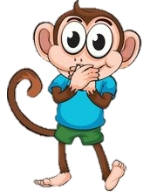
George was soooo excited but promised he would stay calm around Link.
He really did not want to scare Link.

Slide 6
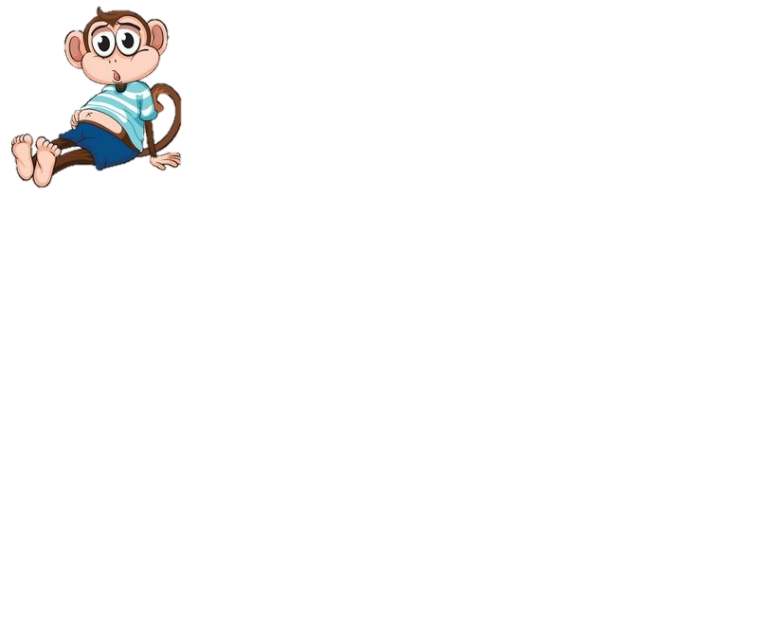
Suddenly…..
George could hear some elephant footprints walking towards the tree house!
It was Nelly and
she had Link with her!
George’s tummy began to feel bubbly
again, he really hoped that Link
would like him.

Slide 7
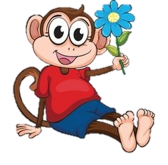
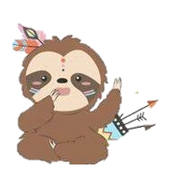
Hello Link,
My name is George and I hope we can be good friends.
George took a big breath and walked over to meet Link.
Mum and dad were right.. Link was super cute!
Link looked at George and George could tell Link was just as nervous as him!
Hi George,
I am a little nervous but I hope so too!

Slide 8
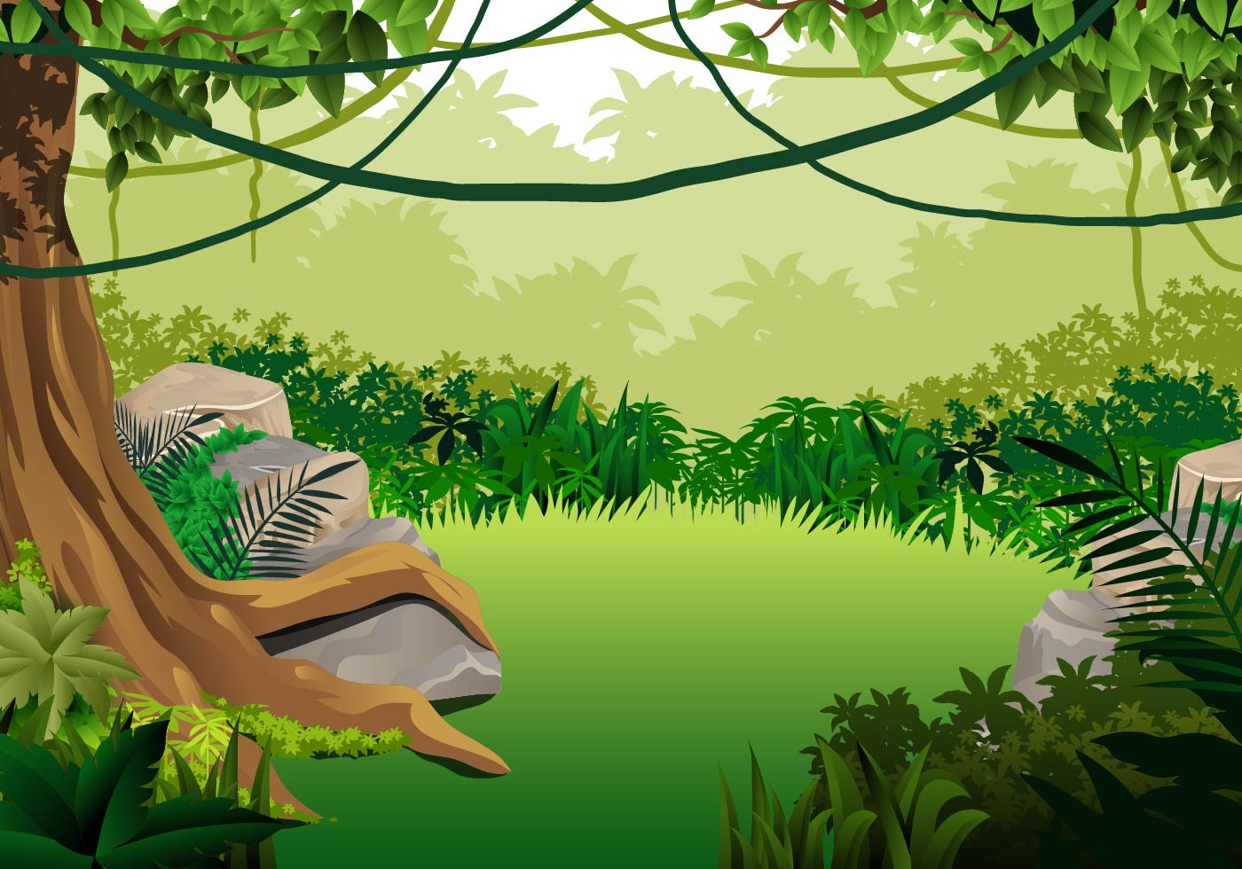
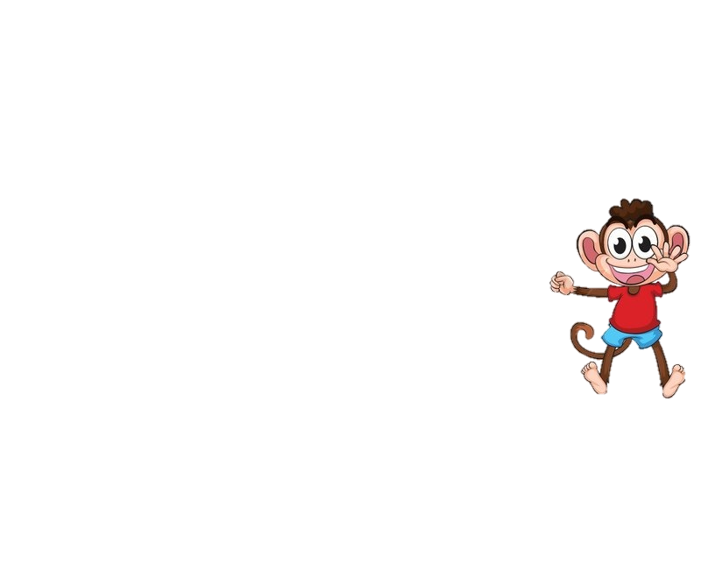
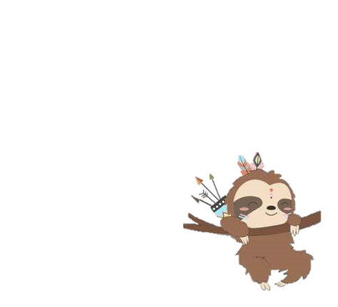
George, Link, mum and dad had a great day together playing Tag up in the trees.
Link was a little slower than George, but that was ok.
George made sure to go slow enough for Link to catch him.

Slide 9

Link came to visit a few more times until mum and dad told George it was time for Link to come and live with them hopefully forever.
George was so pleased! He would finally get to be Links big brother.

Slide 10
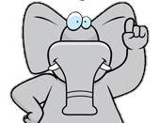
The following week Nelly brought Link and his box of memories to George’s house.
Link was finally moving in and George was so excited but…..

Slide 11
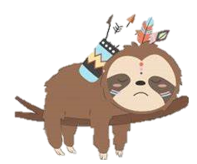

Link did not look happy at all!
Link looked …Sad?
George didn’t understand why Link was so upset?
Wasn’t he excited about coming to live with George and his family?

Slide 12
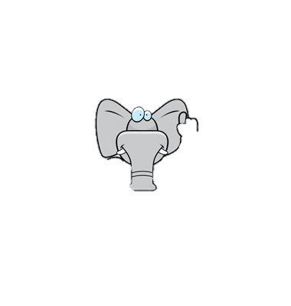

Nelly explained to George that Link had been living with a lovely family called a Foster family and he was sad to leave them.
She explained that it did not mean Link didn’t want to live with George it was just a difficult time for Link to say goodbye to them.

Slide 13
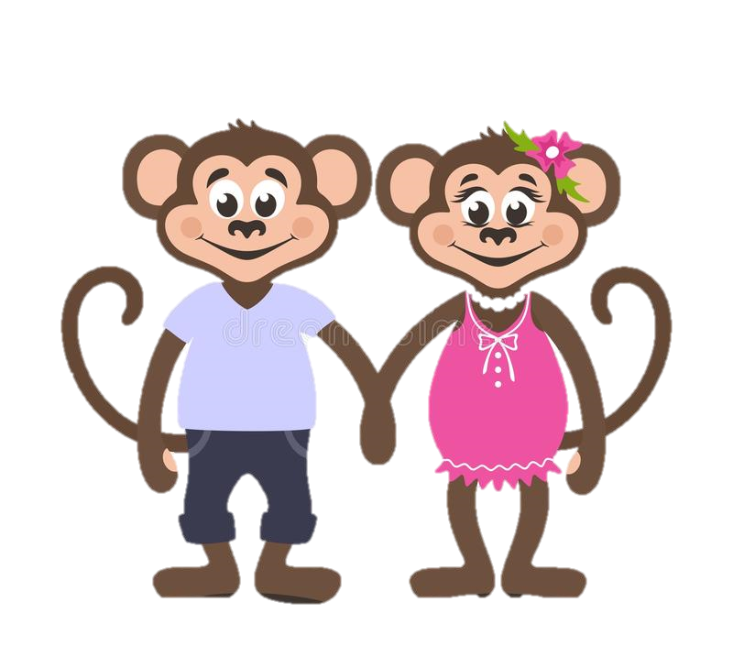
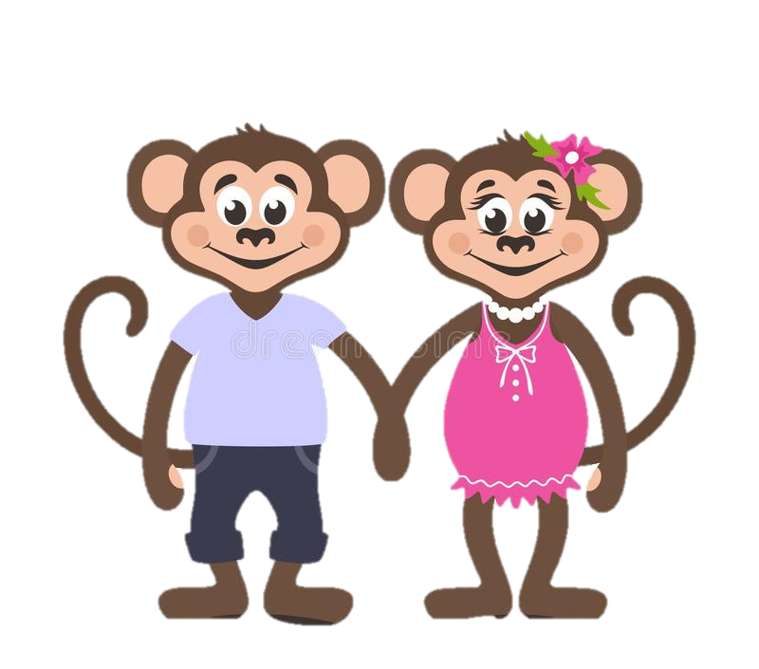
George could understand how hard it must have been for Link to leave his Foster family.
Mum and dad reminded George that they had to be patient and understanding to Link and help him feel safe and loved in their family.

Slide 14

For the next few days things were not how George had imagined.
Link was sometimes happy, sometimes sad and sometimes really angry!
Link seemed to cry a lot and George wasn’t sure why!

Slide 15
Mum and dad reminded George of what Nelly had told them.
Link had a lot of bubbly feelings in his tummy and needed George, his mum and his dad to help him understand these bubbly feelings.
George had to imagine he was Link and how he would feel if he had to move to a strange new house with different people and say goodbye to everyone he has ever known.
George realised that poor Link couldn’t help being sad or angry. He was trying to make sense of all those bubbly feelings inside his tummy!

Slide 16

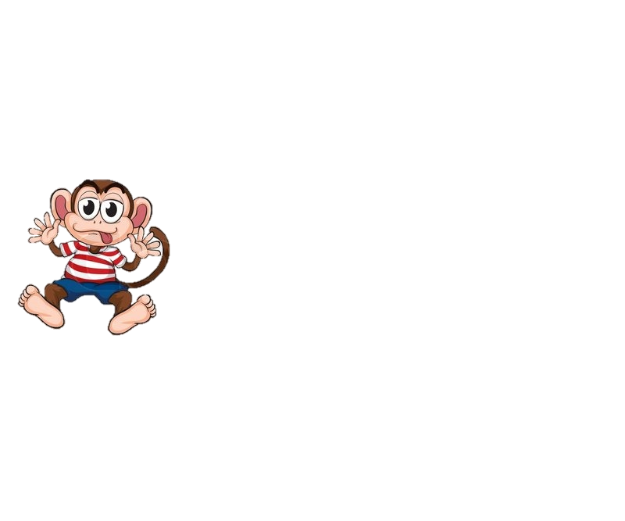
Over the next few weeks George, mum and dad worked hard to help Link feel safe and loved in his new home.
They helped Link to understand his bubbly feelings and how to stop the bubbles coming.
Mum and dad were so proud of George!

Slide 17
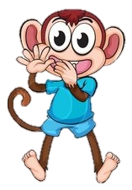
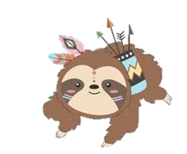
George knew Link never meant to be sad or angry and just needed George’s help and Patience.
.

Slide 18
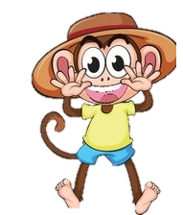
George and Link soon became the best of brothers.
Link still gets upset and angry sometimes but George is there to help him.
They all love each other to the top of the beanstalk and back.

