Slide 1
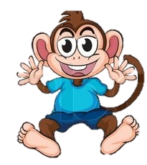
A New Brother for George!

Slide 2
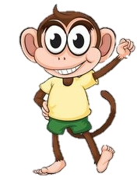
This is George,
He is a lovely little monkey who loves swinging from trees and eating watermelons, blueberries and raspberries.

Slide 3
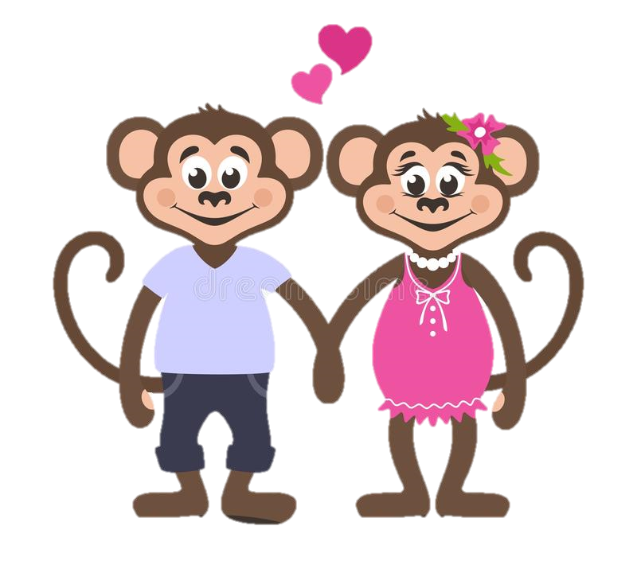
This is George’s Mum and Dad.
They also love swinging from trees but mostly they love George.

Slide 4
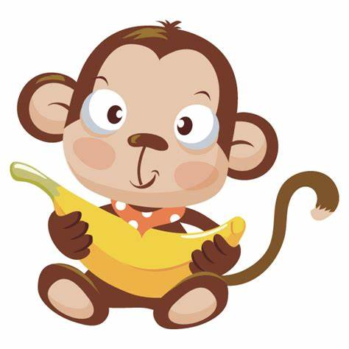
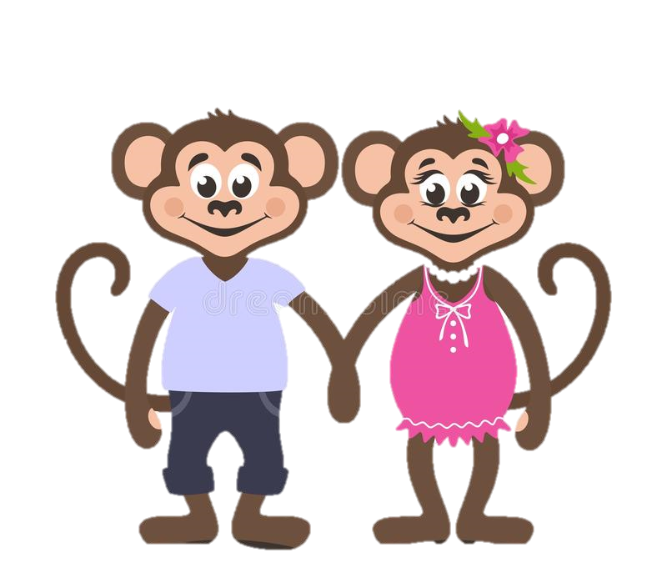
George’s Mum and Dad loved him so much and thought it would be nice for George to have a little brother or sister.

Slide 5
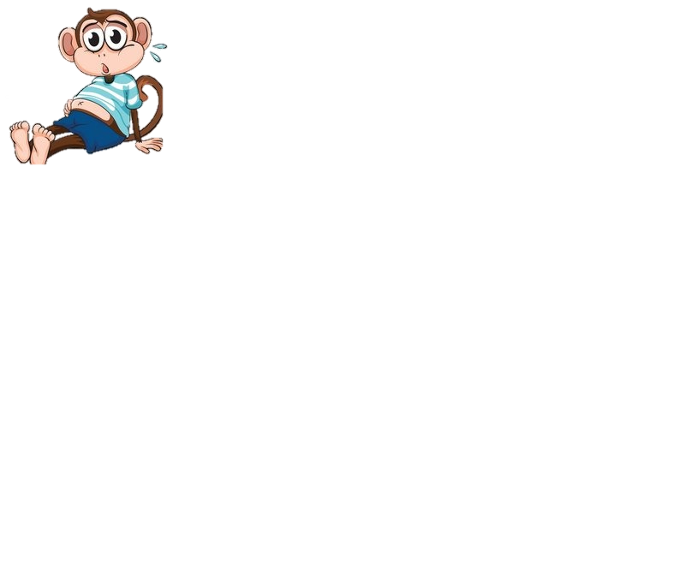
George wasn’t so sure about having a little brother or sister.

Slide 6

George worried that his mum and dad wouldn’t be able to spend as much time with him anymore.
He didn’t want to share them.

Slide 7

Mum explained to George that love is magic,
She explained that love can grow and is big enough to share.
Mum and dad will always love George to the top of the beanstalk and back and nothing will ever change that.

Slide 8
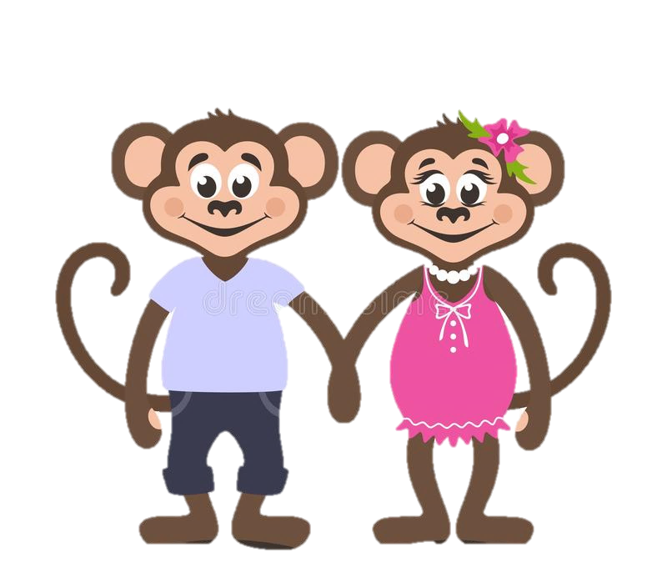

Dad told George that having a little brother or sister could be so much fun!
They could play tag in the trees and even watch Paw Patrol together!
George thought this did sound like fun and was starting to look forward to a new brother or sister!

Slide 9
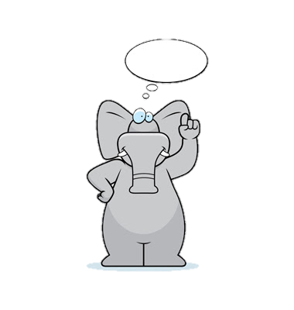
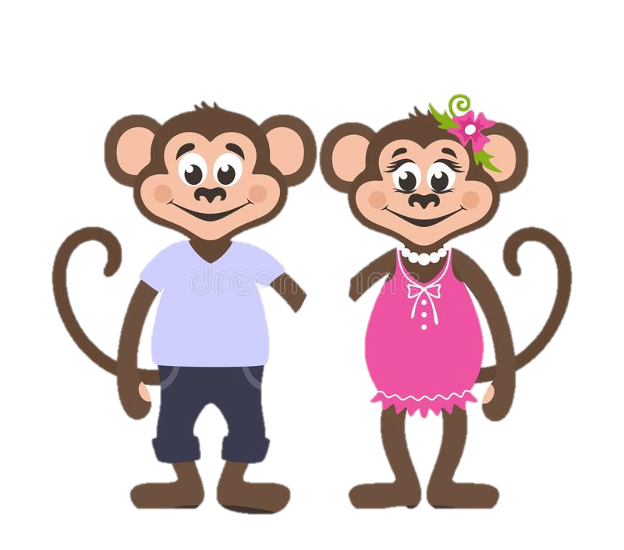
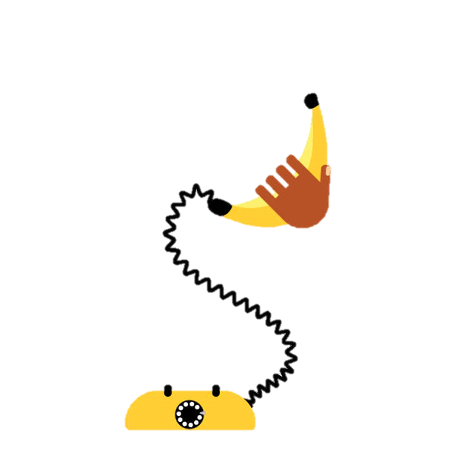
Mum and Dad told George that there were lots of animals in the Jungle that needed a home and a family like theirs.
Mum and Dad rang the jungle Social Worker Nelly to help them find just the right brother or sister for George.

Slide 10
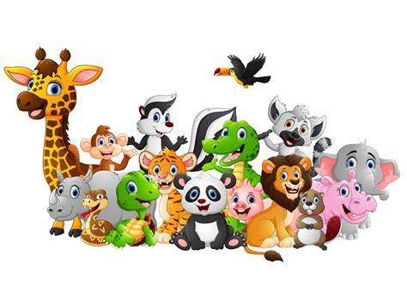
It was Nelly’s job to look after little animals and make sure they are looked after just the right way.
Sometimes Nelly had to find new families for the animals and it was a tough job finding the perfect family.

Slide 11
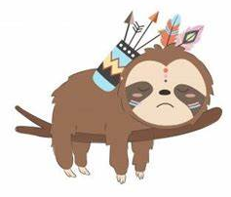
Nelly had been looking for the perfect family for a little boy named Link who really needed a good home.
She thought that George’s family would be perfect for little Link.

Slide 12
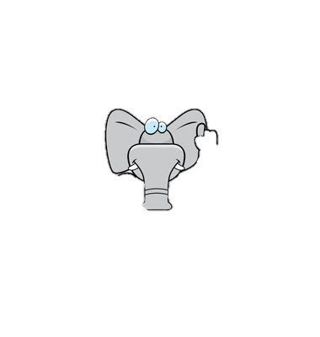
Nelly told mum and dad all about little Link and mum and dad agreed that he sounded like the perfect little boy for them and would make a great little brother for George!

Slide 13
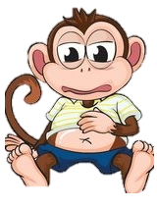
George felt very strange!
He was excited about having a little brother but was also nervous in case Link did not like him?
What if Link didn’t like playing tag in the trees or eating watermelons?
What if Link wanted someone else as their big brother?
Georges tummy began to feel very bubbly.

Slide 14
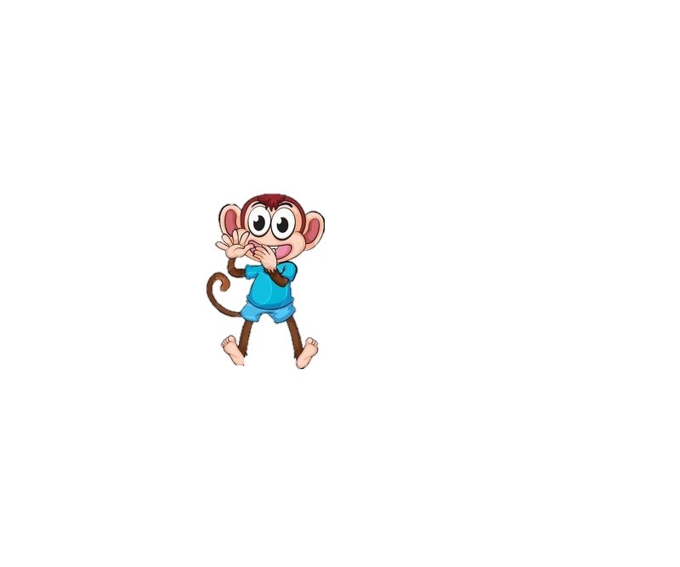
Mum and dad told George they were nervous too and it was ok to be worried about having a new brother.
They told him that Link may find it difficult to settle in with their family and home.
As Link is coming to a brand new strange family he was probably just as scared as George was, maybe even a little more scared and worried than him.
George realised that he was going to be the big brother and help Link to settle into his new family.

Slide 15
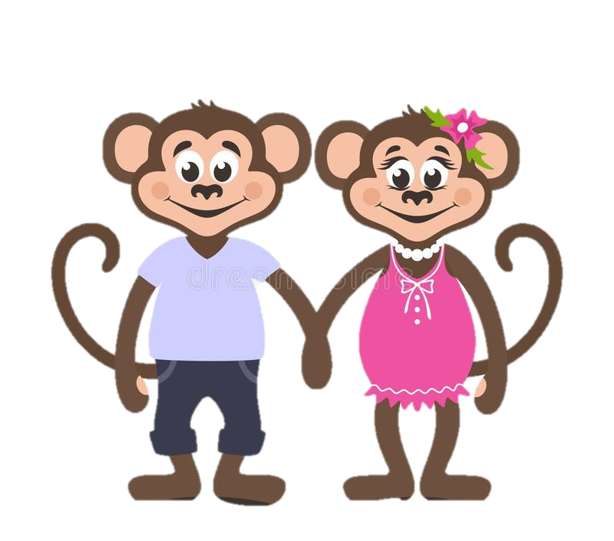
George, mum and dad started to get the tree house ready for Link.
Mum and dad got to meet Link too and they said that he was very lovely and sweet.
They told George that very soon Link would be able to come home to live with them.

Slide 16
Join us in the next chapter to see what happens when Link comes to live with George and his family.

