Slide 1
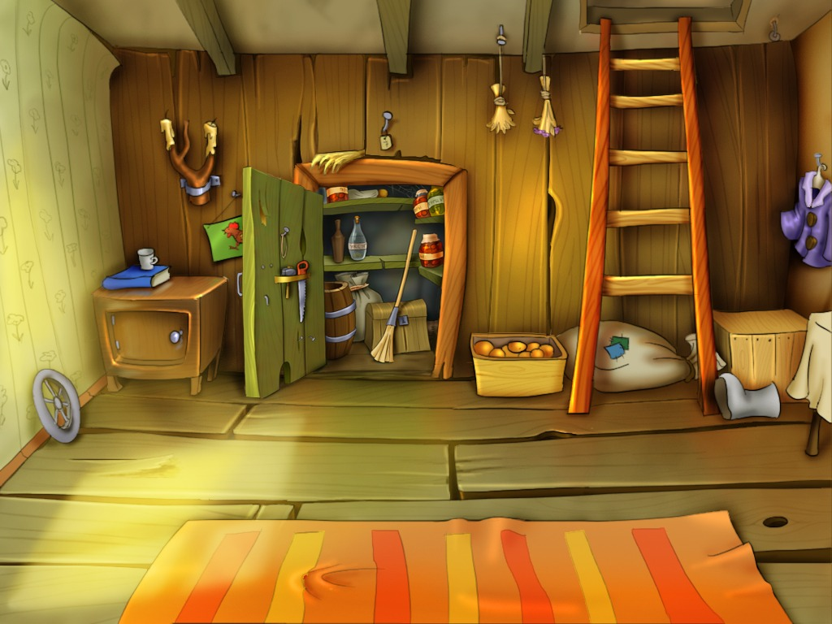
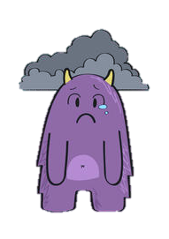
Norm needs a home!
Howie needs
a new home.

Slide 2
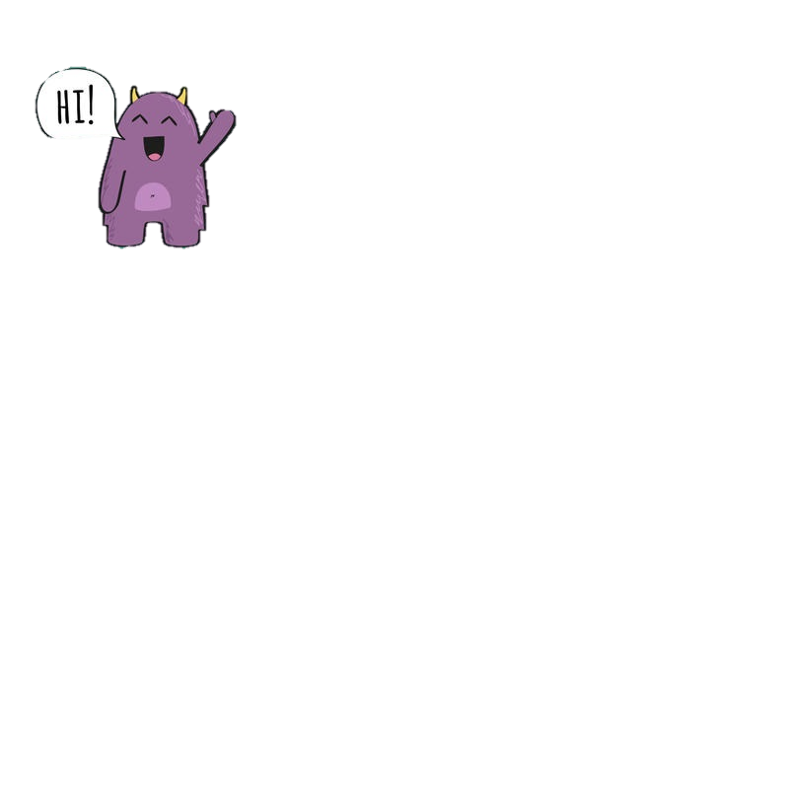
This is Norm!
He is 3 years old.
Norm is a lovely, Kind little monster who tries very hard to make everyone around him happy!
Howie needs
a new home.

Slide 3
Unfortunately Norm’s family could not look after him.
Norm thought it was his fault!
But it was not his fault at all!
Howie needs
a new home.

Slide 4
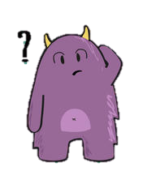
They could not give Norm all the things he needed to grow into a big strong monster.
Howie needs
a new home.

Slide 5

What do you think children need to grow big and strong?

Slide 6
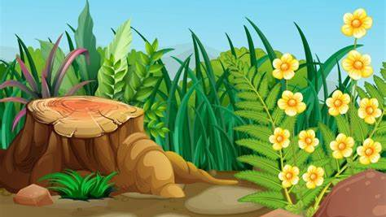
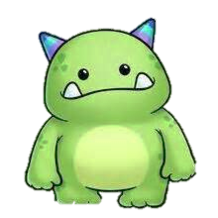

This is Bean, He is 5 years old.
This is Beans sister Dot, she is 3 years old.

Slide 7
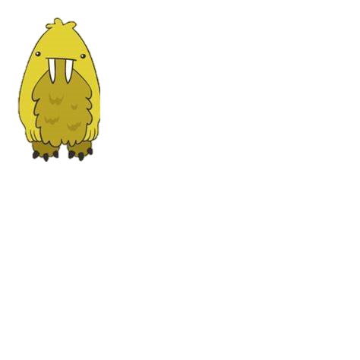
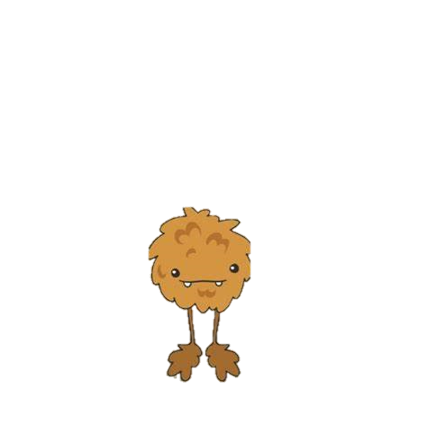

They are very lucky, their family know how to give them everything they need to grow into big strong monsters!

Slide 8
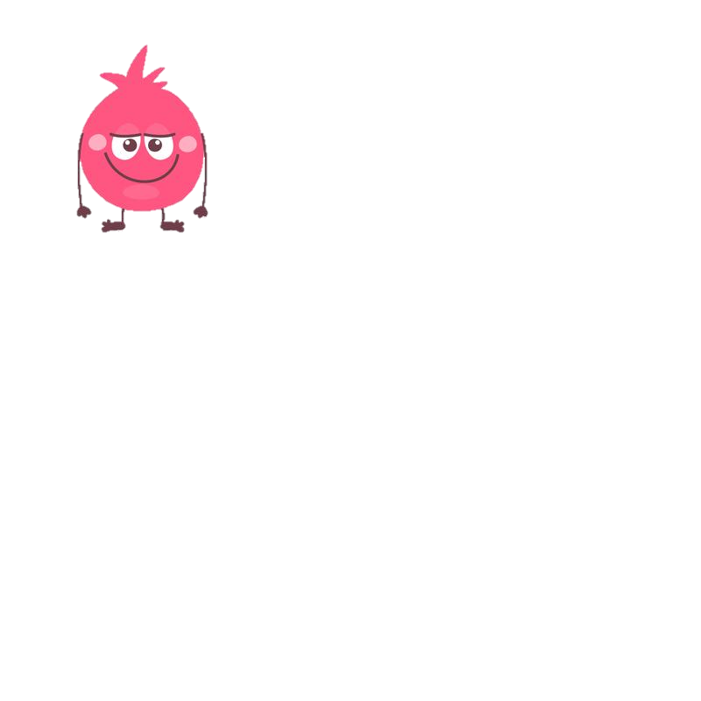

This is Mari!
She is a special person called a Social Worker.
A Social Worker is someone who works with children and families to keep children safe.
Some children don’t have mummy’s and daddy’s who can look after them, so they need other families to live with who are able to look after them. These families can help them to feel safe, happy and loved. If this happens it is Mari’s job to find the perfect family for them.

Slide 9

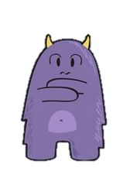
Mari was Norms Social Worker and she was worried about Norm.
Mari thought Norm needed to live with a special family who could help him grow into a happy Strong Monster!
Howie needs
a new home.

Slide 10



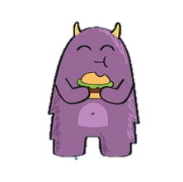
Mari needed to find the perfect family for Norm.
Howie needs
a new home.

Slide 11

Meanwhile at Bean’s house…
Bean and Dot were watching T.V with their mummy….
Howie needs
a new home.

Slide 12



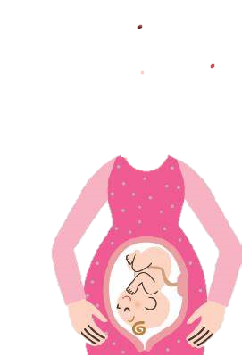
On T.V there was a Mummy who had a baby growing in her tummy.

Slide 13
Beans mummy explained that Bean and his sister Dot had grown in her tummy too.
Howie needs
a new home.

Slide 14


Mummy told Bean and Dot that daddy and mummy had a lot of love in their heart and maybe they could share that love with another child who needed them, One that did not come from her tummy.

Slide 15
Bean and Dot thought about this for a little while and realised they had love in their heart to share too!

Slide 16
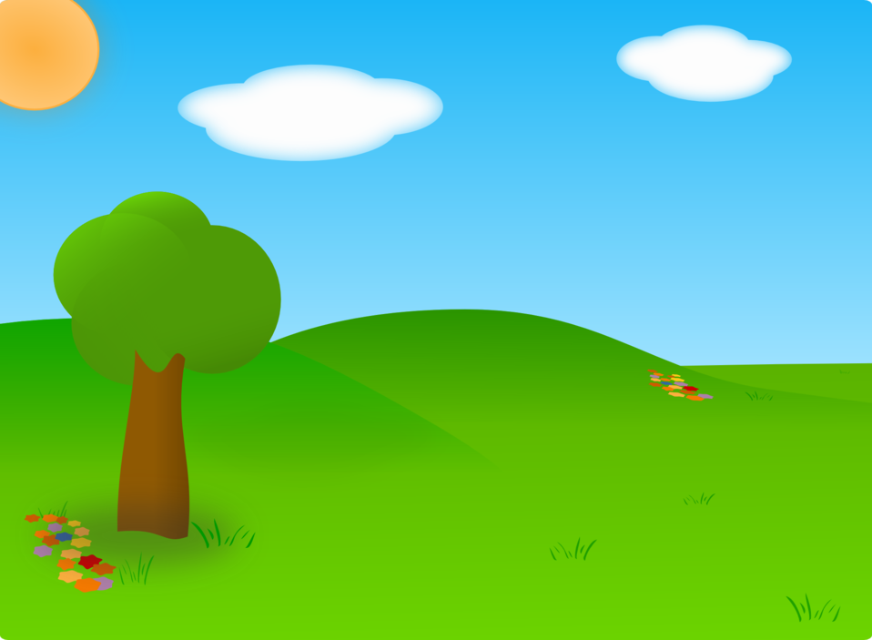



They thought about how exciting it would be to have another brother or sister to play with and share their lovely home with!

Slide 17

Mummy knew just what to do!
She rang Mari and asked if she knew of a child who needed all the love they had to give?

Slide 18

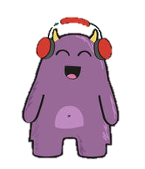

Mari knew the perfect little monster who needed a home and could join their family!

Slide 19
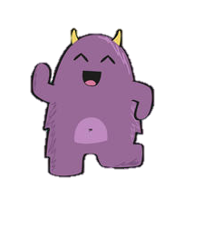
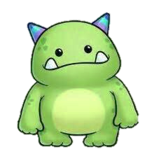

Mari brought Norm to meet Bean, his mum, his dad and Dot.
They had so much fun together.
A little while later..
Howie needs
a new home.

Slide 20
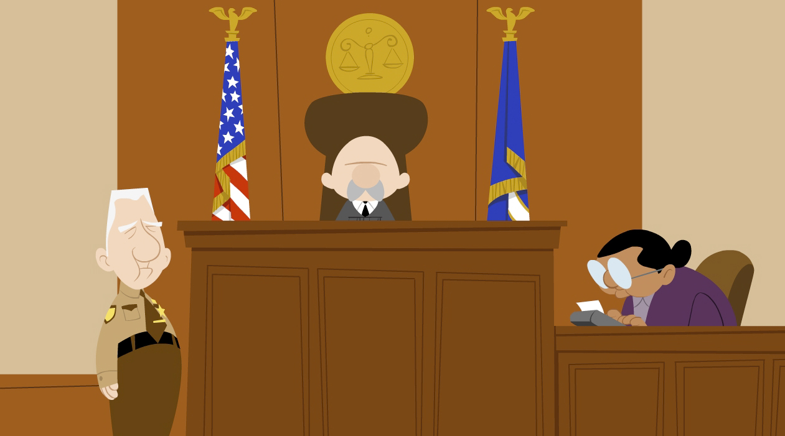

Mari went to see a wise judge about Norm.
The wise Judge told Mari that he thinks that Norm should go to live with Bean, Dot and his family.

Slide 21


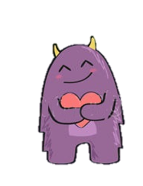
Norm is now a happy little monster with his new family.
And best of all Bean and Dot get a new brother to play with.

Slide 22

A story created especially for
Created by Janine Griffiths.

