Slide 1
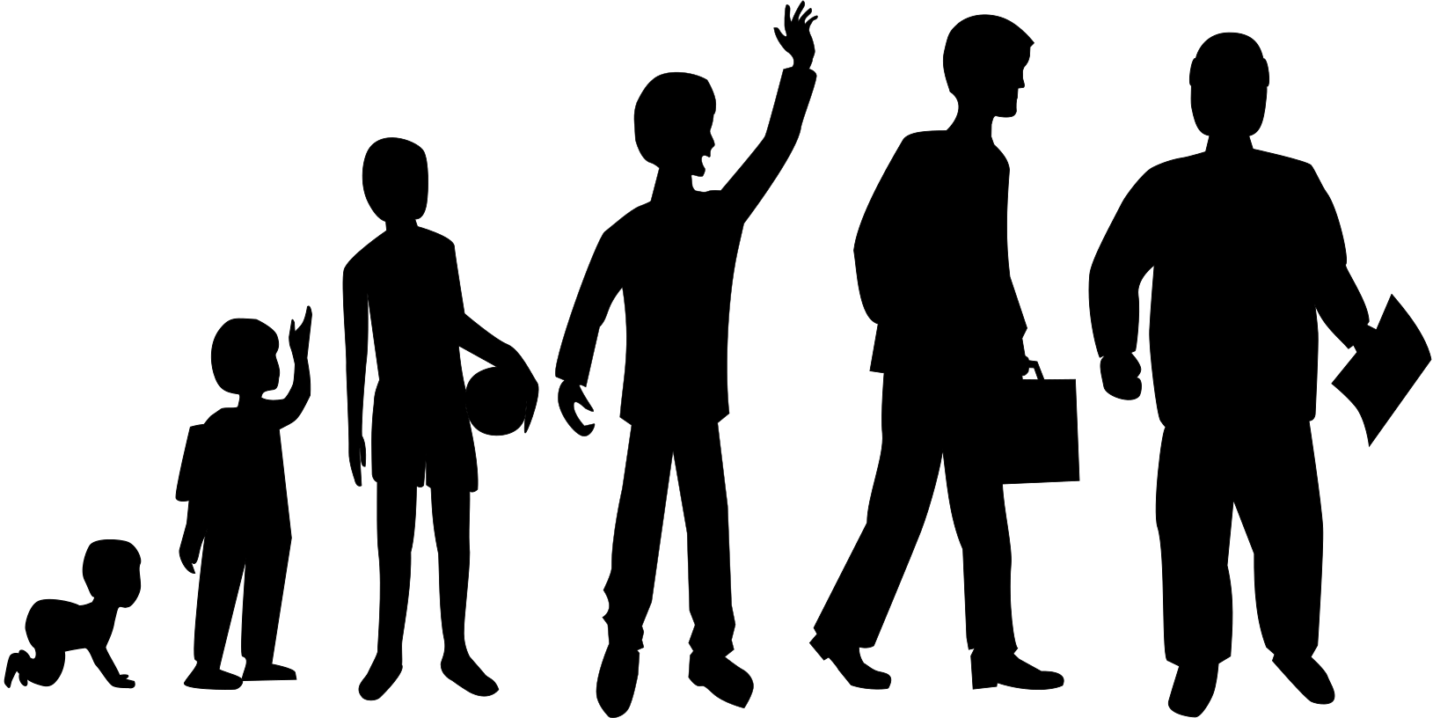
A child’s understanding of their story. Using the research of David M. Brodzinsky

Slide 2


The Jigsaw metaphor.
The information given needs to be developmentally appropriate.
Secondary school age
and beyond
Primary school years
O – 5 years

Slide 3

Preschool Age 0 - 4
A child has no understanding of adoption, fostering
or kinship care.
Family is the people who you live with.
A child will not understand the word and concept of adoption until they understand that they were born the same as other children and grown in another person’s tummy.
Language and Values. The language of adoption can begin to promote an environment of open communication.
The child is in the ego centric stage of development.

Slide 4
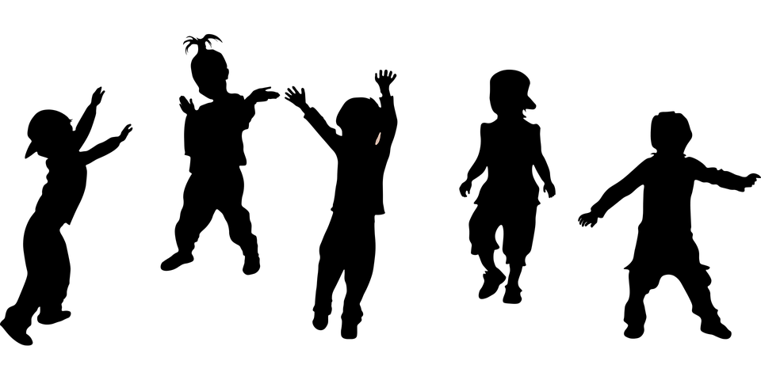
School age 4 - 6
Family is people who live together.
They can repeat words such as adoption.
They may be curious about where babies are from.
As a child approaches preschool age, he or she develops magical thinking, the world of fantasy is used to explain that which he or she cannot comprehend.
The concept of time and space. At 4 to 5 years a child begins to grasp the context of the past. And that people and places exist outside of their environment.
The child is in the ego centric stage of development.

Slide 5
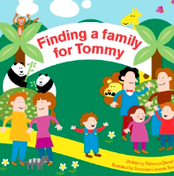
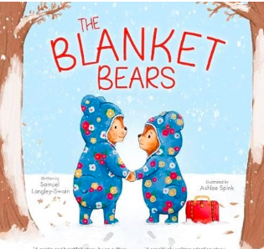

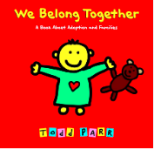
Story books have been used to support children to understand. .
A story with a beginning, middle and end. The act of telling a story releases oxytocin and cortisol in a child.

Slide 6



Parallel or Metaphorical stories.

Slide 7
Early middle childhood - Ages 6 to 8.
At 6 to 8 years old the child begins to understand
biological connections.
A child begin to wonder why their birth family
did not keep them?
Children need a good simple and truthful explanation. The child will accept this explanation.
Children will accept that their adoptive family is permanent.
Children don’t understand the legal process.
A household where there is open communication and a child needs to know that they can ask questions and not upset their carers.

Slide 8

Middle childhood ages 8 - 10
At 8 to 10 years old the child begins to understand
the difference between birth families and adoption.
They recognise the loss of the birth family and
understand that adoption is different.
A child’s understanding of problem solving becomes
more sophisticated which means that the child may wonder if the birth parent could have made a different decision.
A child may wonder if the birth parent’s circumstances have changed.
There is still no legal understanding.

Slide 9




Story books.

Slide 10
Adaptive Grieving.
Grief is what you think and feeling and is a
reaction to a significant loss.
There may be some changes of behaviour at home or school. A parent/carer or teacher may see that a child is more withdrawn, anger, sadness, difficult to concentrate, making up stories, feeling different to other children, poor impulse control and feeling overwhelmed by choice.
The child may be labelled as having behaviour difficulties. Or given a diagnosis.

Slide 11
Adaptive Grieving.
"One can think about some of the feelings of the adopted child as reflecting a grief and bereavement process – an adaptive one. "What’s going on is that the child’s intellectual ability to understand his adoption experience is temporarily outpacing his emotional ability to handle it."
Brodzinsky 2015

Slide 12

Pre-teenage – Ages 10 - 12
The child begins to understand the legal authorities
Involved in their care so judges, social workers and solicitors.
The child begins to understand the reason why they are adopted. And permanence is accepted.
The child begins to understand the more complex reasons they are adopted or looked after.
When a carer/adoptive parent speaks about the birth family in an empathetic, truthful but neutral manner.
Continue to have open conversations.

Slide 13

Teenage – Ages 13 +
The development of abstract thinking and the meaning of adoption deepens.
The young person begins to truly understand the legal permanence associated with adoption.
The capacity for understanding other people’s thoughts and feeling also matures during adolescence. The young person can understand the life situation of the birth family.

Slide 14
Teenage – Ages 13 +
The young person begins to understand adoption from a society point of view.
Again the process of adaptive grieving continues. The young person may need to have photos and further information to understand the reason for their adoption. They may assume their birth identity. They may reject itand judge their birth parents. They may reject adoptive parents. They have to try and work towards making sense of the people who gave them life and the people who raised them.

